Slide 1
Cross species AAV
SCGE Consortium
Asokan Lab

Slide 2
Evolution scheme of cross-species compatible AAVs (ccAAVs)
Notes:
Figure 1. Evolution scheme of cross-species compatible AAVs (ccAAVs).
ccAAV libraries were generated through saturation mutagenesis of variable loop regions IV & VIII on the AAV9 capsid surface. Intravenous dosing of viral libraries was first performed in mice (round 1) followed by dosing in pigs (round 2) and non-human primates (round 3). Viral DNA was amplified from target tissue and used to make subsequent libraries. Following 3 rounds of evolution, capsid libraries were submitted for high-throughput sequencing and enriched ccAAV mutants were identified.

Slide 3
Representation of enriched ccAAV variants in vivo
VR4
VR8
Notes:
Figure 2. Enrichment of distinct capsid sequences following cross-species evolution
Parental and evolved libraries were subjected to high-throughput sequencing using the Illumina NovaSeq platform. A custom Perl script was used for analysis and enriched amino acid sequences were plotted in R for both the parental and evolved libraries for variable loop regions IV and VIII. The y-axis represents the percent of reads for the variants in each library and the x-axis corresponds to a random number assigned to each capsid variant in the library. Each bubble represents a distinct capsid amino acid sequence with the area proportional to the enrichment score for that sequence comparing the percent of reads in the parental to the evolved libraries.

Slide 4
Experimental Parameters
C57/BL6 mice were injected intravenously at a dose of 5e13 vg/kg (N=3) mouse with a self-complementary AAV9 or ccAAV vector.
Animals were sacrificed 4 weeks post injection and multiple organs harvested and transduction evaluated by native fluorescence or IHC.

Slide 5
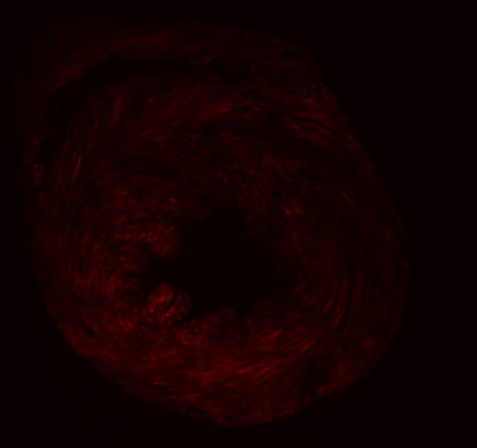
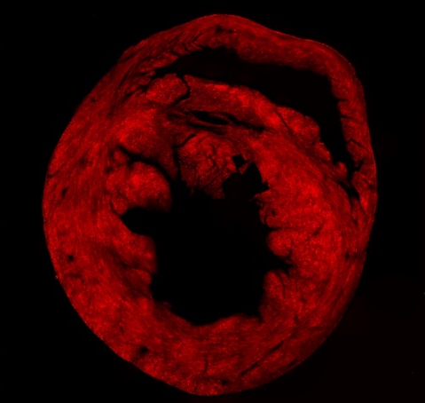
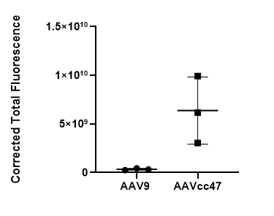
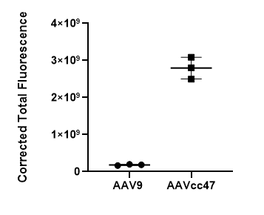
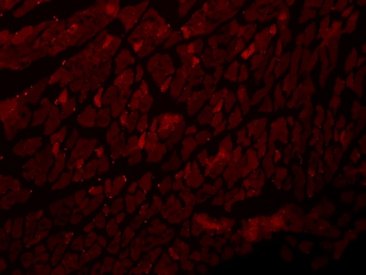
Expression of VR4 ccAAVs in cardiac and skeletal muscle
A.
Mock
AAV9
AAVcc.47
*
B.
****
Greater transduction observed in the heart and skeletal muscle with cc47 compared to AAV9.
Notes:
Figure 3. Expression of VR4 ccAAVs in cardiac and skeletal muscle
Adult C57/B6 mice were injected intravenously at 5e13 vg/kg (N=3). A self-complementary Mcherry cassette was packaged into lead ccAAV mutants driven by a chicken-beta actin human hybrid (CBh) promoter. Mice were sacrificed 4-weeks post injection and heart and skeletal muscle was post-fixed in 4% PFA for 24 hrs. Fixed tissue was embedded in agarose and cut into 50μm thick sections using a vibratome. Native fluorescence was quantified using Image J. For each animal, 6 images were taken from 2 sections and used to calculate corrected total cell fluorescence using the formula: Integrated Density – (Area of selected image X Mean fluorescence of background readings). Significance was determined by one-way ANOVA with Welch’s correction. Where indicated, *p < 0.05; ****p < 0.0001. Error bars represent 1 SD.

Slide 6
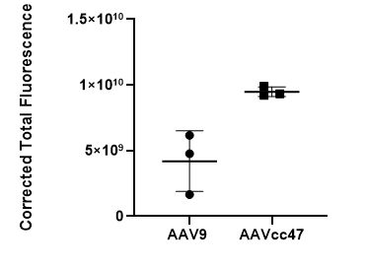
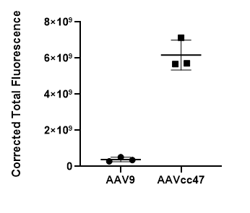
Expression of VR4 ccAAVs in liver and kidney
A.
Mock
AAV9
AAVcc.47
**
B.
****
Greater transduction observed in the liver and kidney with cc47 compared to AAV9.
Notes:
Figure 4. Expression of VR4 ccAAVs in liver and kidney
Adult C57/B6 mice were injected intravenously at 5e13 vg/kg (N=3). A self-complementary Mcherry cassette was packaged into lead ccAAV mutants driven by a chicken-beta actin human hybrid (CBh) promoter. Mice were sacrificed 4-weeks post injection and liver and kidney was post-fixed in 4% PFA for 24 hrs. Fixed tissue was embedded in agarose and cut into 50μm thick sections using a vibratome. Native fluorescence was quantified using Image J. For each animal, 6 images were taken from 2 sections and used to calculate corrected total cell fluorescence using the formula: Integrated Density – (Area of selected image X Mean fluorescence of background readings). Significance was determined by one-way ANOVA with Welch’s correction. Where indicated, **p < 0.01; ****p < 0.0001.Error bars represent 1 SD.

Slide 7
Expression of VR4 ccAAVs in the brain following IV injection
Mock
AAV9
AAVcc.47
CTX
HC
CB
CTX
HC
CB
CTX
HC
CB
TH
STR
MB
TH
STR
MB
TH
STR
MB
More Mcherry positive cells are observed with cc47 compared to AAV9. This was determined through IHC.
Notes:
Figure 5. Expression of VR4 ccAAVs in the brain
Adult C57/B6 mice were injected intravenously at 5e13 vg/kg (N=3). A self-complementary Mcherry cassette was packaged into lead ccAAV mutants driven by a chicken-beta actin human hybrid (CBh) promoter. Mice were sacrificed 4-weeks post injection brain was post-fixed in 4% PFA for 24 hrs. Tissue was cut into 50μm sagittal sections using a vibratome. Immunohistochemical staining of brain sections revealed neuronal and astrocytic expression (representative images are shown).

Slide 8
Quantitative comparison on neuronal and glial cell transduction for ccAAVs
Neurons
CB
CTX
HC
STR
TH
MB
***
**
*
**
***
Astrocytes
CB
CTX
HC
STR
TH
MB
*
**
Enhanced neuronal transduction was observed with cc47 compared to AAV9.
Notes:
Figure 6. Quantitative comparison on neuronal and glial cell transduction for VR4 ccAAVs
Adult C57/B6 mice were injected intravenously at 5e13 vg/kg (N=3). Mice were sacrificed 4 weeks after administration of vectors packaging a self-complementary CBh Mcherry cassette. Relative neuronal and astrocytic transduction levels were quantified by counting the number of transduced neurons and glia, identified based on morphology, for each brain region per 50μm sagittal section. Transduction of parental serotype, AAV9, is shown alongside the ccAAV variant cc47, across various regions of the brain, including the (CB) cerebellum, (CTX) cortex, (HC) hippocampus, (MB) midbrain, (TH) thalamus, and (STR) striatum. Errors bars represent 1 SD. Significance was determined by one-way ANOVA with Welch’s correction. *p<0.05, **p<0.01, ***p<0.001.

Slide 9
Expression of VR8 ccAAVs in cardiac and skeletal muscle
A.
Mock AAV9 AAVcc.81 AAVcc.84
B.
Greater transduction in the heart with cc81 and cc84 compared to AAV9. Similarly, cc81 outperformed AAV9 in transducing skeletal muscle.
Notes:
Figure 7. Expression of VR8 ccAAVs in cardiac and skeletal muscle
Adult C57/B6 mice were injected intravenously at 5e13 vg/kg (N=3). A self-complementary GFP cassette was packaged into lead ccAAV mutants driven by a chicken-beta actin human hybrid (CBh) promoter. Mice were sacrificed 4-weeks post injection and heart and skeletal muscle was post-fixed in 4% PFA for 24 hrs. Fixed tissue was embedded in agarose and cut into 50μm thick sections using a vibratome. Native fluorescence was quantified using Image J. For each animal, 6 images were taken from 2 sections and used to calculate corrected total cell fluorescence using the formula: Integrated Density – (Area of selected image X Mean fluorescence of background readings). Significance was determined by one-way ANOVA with Welch’s correction. Where indicated, *p < 0.05; **p < 0.01; ***p < 0.001. Error bars represent 1 SD.

Slide 10
Expression of VR8 ccAAVs in liver and kidney
A.
Mock
AAV9
AAVcc.81
AAVcc.84
B.
Similar transduction profiles were observed in the liver and kidney between VR8 ccAAVs and AAV9.
Notes:
Figure 8. Expression of VR8 ccAAVs in liver and kidney
Adult C57/B6 mice were injected intravenously at 5e13 vg/kg (N=3). A self-complementary GFP cassette was packaged into lead ccAAV mutants driven by a chicken-beta actin human hybrid (CBh) promoter. Mice were sacrificed 4-weeks post injection and liver and kidney was post-fixed in 4% PFA for 24 hrs. Fixed tissue was embedded in agarose and cut into 50μm thick sections using a vibratome. Native fluorescence was quantified using Image J. For each animal, 6 images were taken from 2 sections and used to calculate corrected total cell fluorescence using the formula: Integrated Density – (Area of selected image X Mean fluorescence of background readings). Significance was determined by one-way ANOVA with Welch’s correction. Error bars represent 1 SD.

Slide 11
Expression of VR8 ccAAVs in the brain following IV injection
Mock
AAV9
AAVcc.81
AAVcc.84
CTX
HC
CB
CTX
HC
CB
CTX
HC
CB
CTX
HC
CB
TH
STR
MB
TH
STR
MB
TH
STR
MB
TH
STR
MB
VR8 ccAAVs have more neuronal tropism than AAV9 in the brain.
Notes:
Figure 9. Expression of VR8 ccAAVs in the brain
Adult C57/B6 mice were injected intravenously at 5e13 vg/kg (N=3). A self-complementary GFP cassette was packaged into lead ccAAV mutants driven by a chicken-beta actin human hybrid (CBh) promoter. Mice were sacrificed 4-weeks post injection brain was post-fixed in 4% PFA for 24 hrs. Tissue was cut into 50μm sagittal sections using a vibratome. Immunohistochemical staining of brain sections revealed neuronal and astrocytic expression (representative images are shown).

Slide 12
Quantitative comparison on neuronal and glial cell transduction for ccAAVs (VR8)
Neurons
**
*
*
***
*
*
*
Astrocytes
**
**
***
***
**
**
In addition to increased neuronal tropism, VR8 ccAAVs also have less astrocyte tropism than AAV9.
Notes:
Figure 10. Quantitative comparison on neuronal and glial cell transduction for VR8 ccAAVs
Adult C57/B6 mice were injected intravenously at 5e13 vg/kg (N=3). Mice were sacrificed 4 weeks after administration of vectors packaging a self-complementary CBh Mcherry cassette. Relative neuronal and astrocytic transduction levels were quantified by counting the number of transduced neurons and glia, identified based on morphology, for each brain region per 50μm sagittal section. Transduction of parental serotype, AAV9, is shown alongside the ccAAV variants cc81 and cc84, across various regions of the brain, including the (CB) cerebellum, (CTX) cortex, (HC) hippocampus, (MB) midbrain, (TH) thalamus, and (STR) striatum. Errors bars represent 1 SD. Significance was determined by one-way ANOVA with Welch’s correction. *p<0.05, **p<0.01, ***p<0.001.

