Slide 1
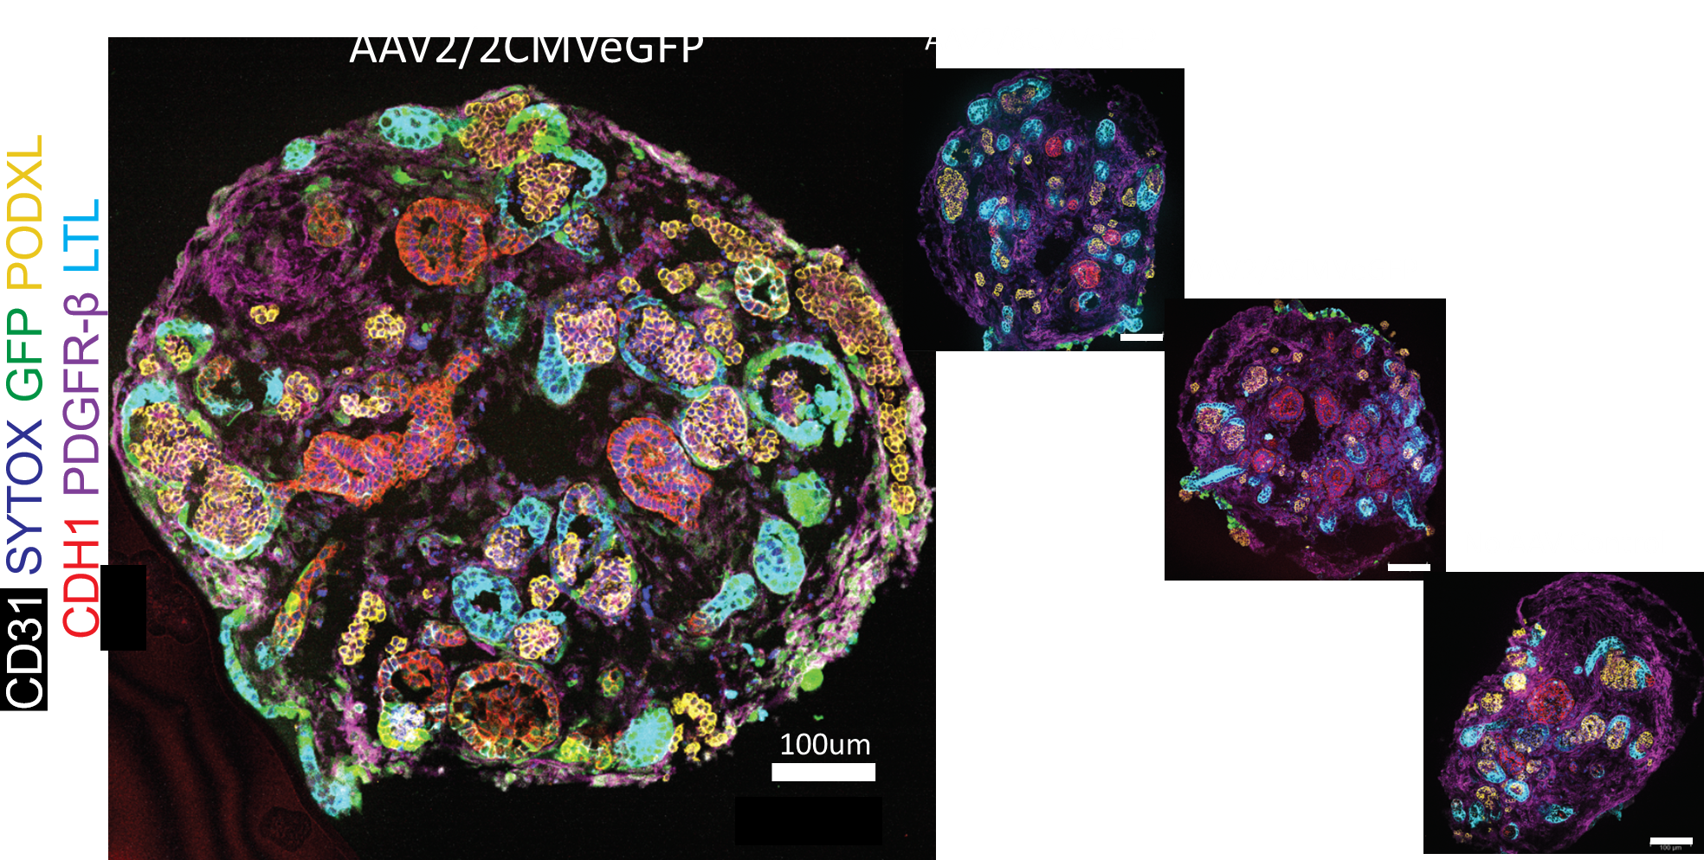
Figure 1
A
B
Fig. 1 AAV tropism in kidney organoids derived from human pluripotent stem cells.
(A) Immunostaining images of kidney organoids exposed to AAV2/2, 2/8, or 2/9 at MOI 10^5 for 1 week. 5 cell types in kidney organoids are visualized by staining for LTL (proximal tubules), PODXL (podocytes), CDH1 (loops of Henle~distal nephrons), PDGFRb (interstitial stromal cells), and CD31 (endothelia). (B) Graphs showing percentages of AAV transduced cells in each cell type in kidney organoids.

Slide 2
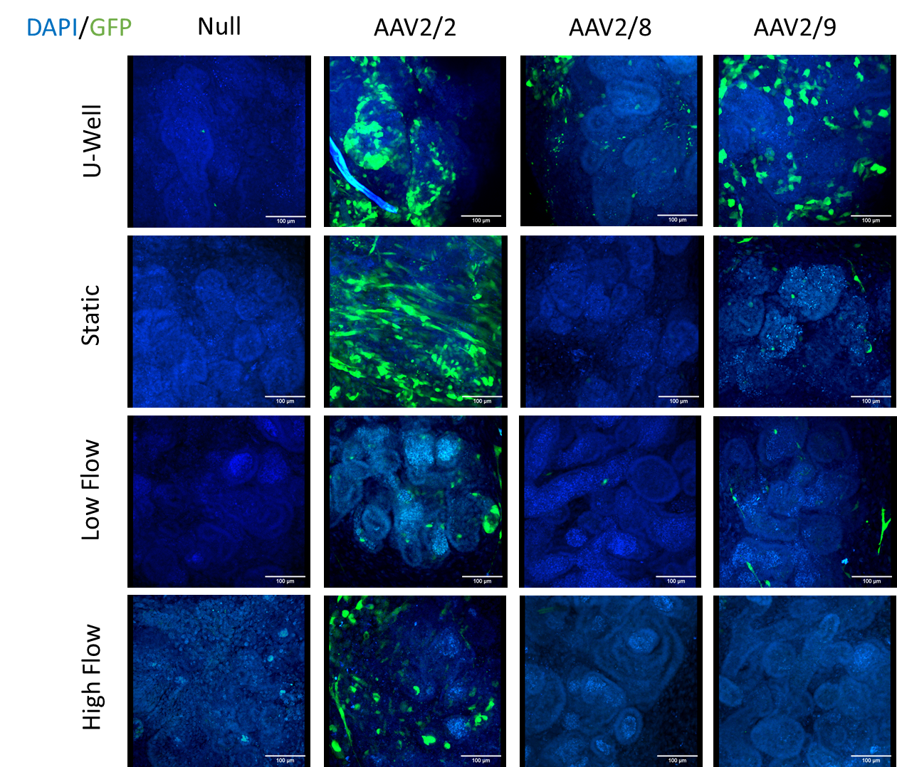
Figure 2
A
B
C
D
E
Fig. 2 AAV tropism in kidney organoids cultured under flow (A) Immunostaining images of kidney organoids exposed to AAV2/2, 2/8, or 2/9 at MOI 10^5 for 1 week in four culture conditions. (B) Graphs showing percentages of transduced cells by AAV2/2, 2/8, or 2/9. (C) Immunocytochemistry for LTL and GFP in organoids treated with AAV2/2. (D, E) GFP+ cells in podocytes or proximal tubules in organoids treated with AAV2/2.

Slide 3
Figure 3
A
B
Fig. 3 AAV2/2 transduction efficiencies in kidney organoids cultured under flow (A) Flow cytometry of kidney organoids exposed to AAV2/2 at MOI 10^5 for 1 day in four culture conditions. (B) Graphs showing percentages of transduced cells by AAV2/2 in LTL+ proximal tubules.

Slide 4
Figure 4
Fig. 4 Biomarker assays to evaluate toxicity and inflammation induced by AAVs in kidney organoids.
(A) H9 samples showing MCP-1 and KIM-1 levels using Luminex (Bio-plex 200). The infection rate was kept at 10^5 vg/cell. (B) BJFF samples showing KIM-1 levels using Luminex (Bio-plex 200). Groups were divided based on infection from Day 21 - 24 and Day 25 – 28.

Slide 5
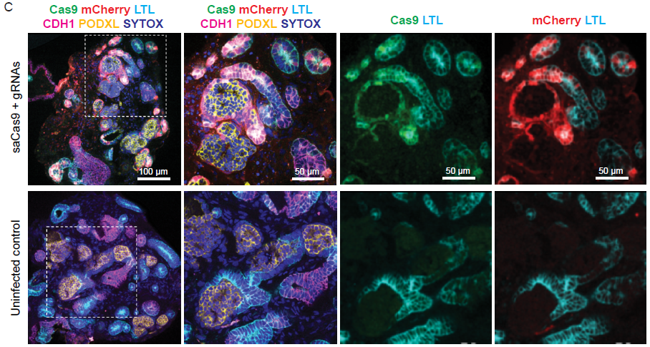
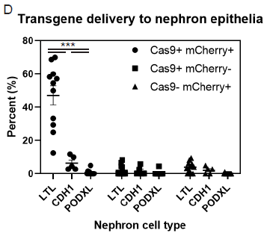
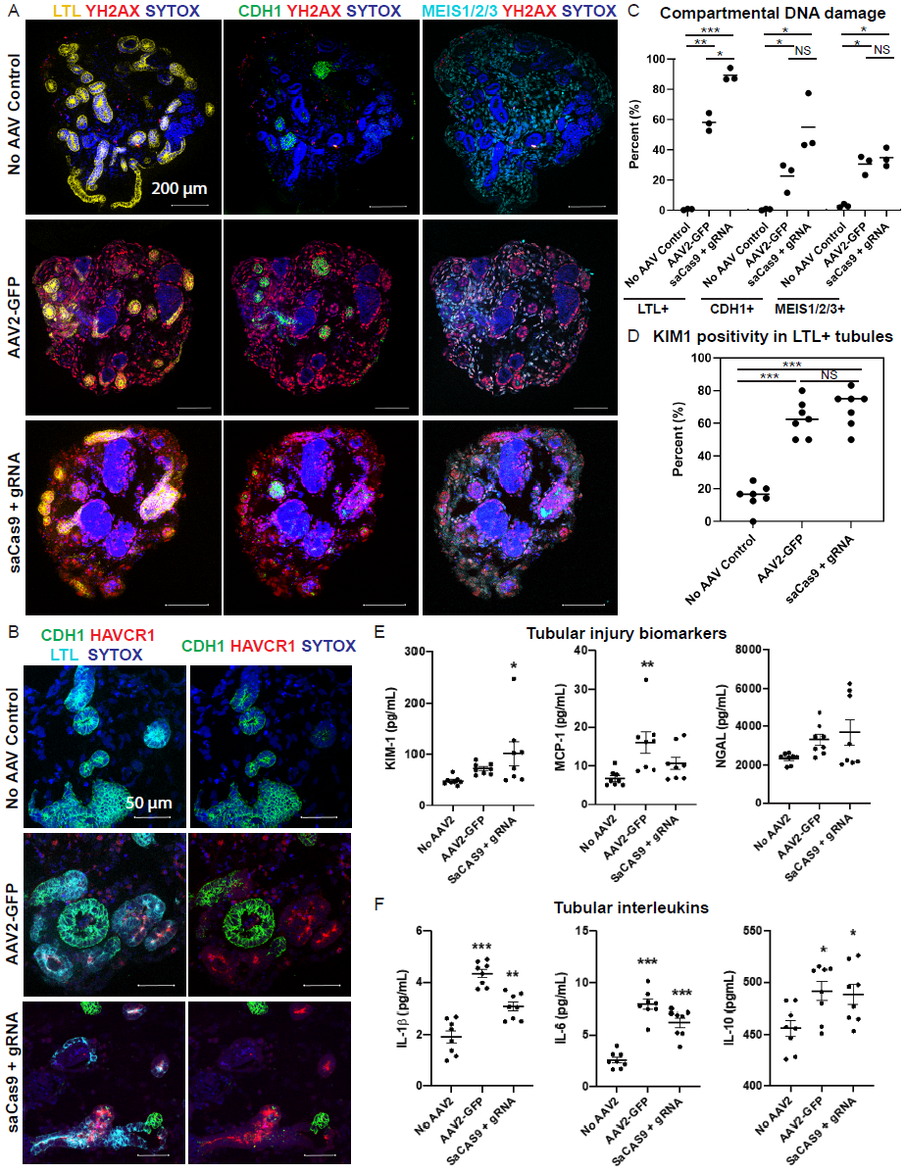
Figure 5
A
B
C
D
Fig. 5 Toxicity and inflammatory responses to AAV2 and saCas9 genome editing.
(A,B) Evaluation on delivery of saCas9 and gRNAs by AAV2 in kidney organoids. (C-F) Toxicity evaluation by immunohistochemistry. (G,H) Biomarker assays for toxicity and inflammation.
F
E
G
H

