Slide 1
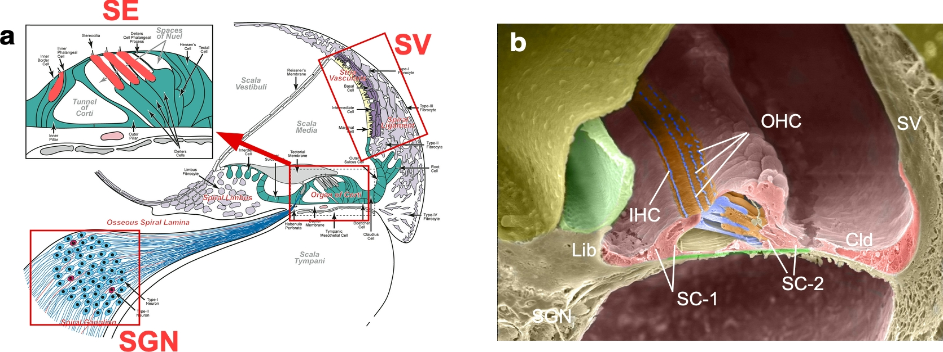
Notes:
Fig1. Structure of adult mouse cochlea. a. 2D illustration. b. 3D illustration. SE: sensory epithelia; SGN: spiral ganglion neurons; SV: stria vascularis; IHC: inner hair cells; OHC: outer hair cells; Cld: Claudius cells; SC: supporting cells.

Slide 2
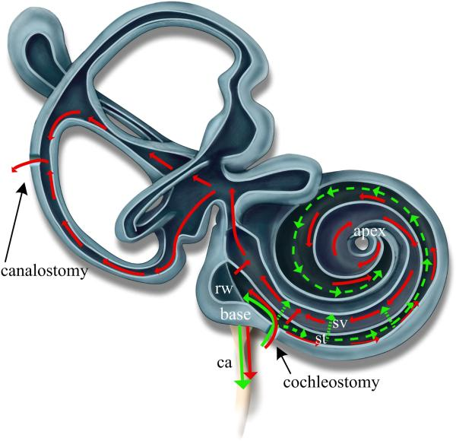
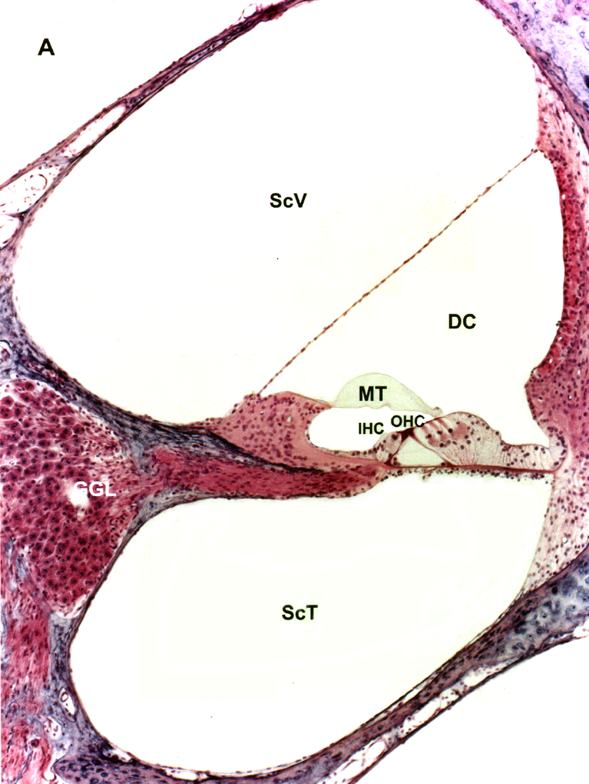
a
b
canalostomy
RM
cochleostomy
ScM
ScM
c
OHC
BM
canalostomy
IHC
Notes:
Fig2. In vivo delivery methods for adult inner ear. a and b. Illustration (a) and cross section (b) of adult cochlea showing delivery routes of canalostomy and cochleostomy. c. Wholemount immunofluorescence of MYO7A antibody (green) showing hair cells in adult cochlea. rw: round window; ca: cochlear aqueduct; ScV and sv: scala vestibuli; ScM: scala media; ScT and st: scala tympani; IHC: inner hair cells; OHC: outer hair cells; BM: basilar membrane; MT: tectorial membrane; RM: Reissner’s membrane.

Slide 3
a
b
Notes:
Fig3. Synthesis of (a) R-O12B and (b) R-S10 cationic lipids.

Slide 4
a
306-O12B
113-O12B
306-S10
b
Cas9 mRNA + sgRNA /LNP | 113-O12B | 306-O12B | 306-S10
Size determined by DLS | 131 nm | 139 nm | 132 nm
Notes:
Fig4. LNPs selected for in vivo injection. a, structures of LNPs. b, sizes of LNPs were determined by DLS.

Slide 5
a
306-O12B
200 um
b
306-S10
100 um
Notes:
Fig5. In vitro screening of LNPs. Primary fibroblast cells were derived from skins of P5 Ai14 mice and plated in 48-well plates at 10,000-20,000 cells per well. LNP was mixed with Cas9 mRNA and sgRNA in 15:1:1 ratio and added to the well. The final concentration of LNP is 7.6 ug/ml. Cells were collected 48 hr later to check tdT signal. a, 306-O12B; b, 306-S10.

Slide 6
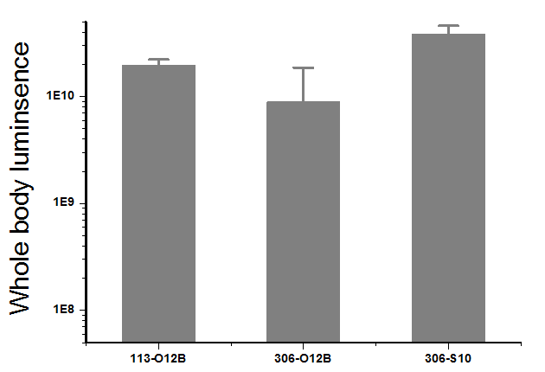
Fluc mRNA delivery
I.V. injection
10 ug mRNA/mouse
6h post imaging
Notes:
Fig6. In vivo luciferase assay for mRNA delivery. Selected LNPs were mixed with Fluc mRNA and injected into adult wild type mice via i.v. injection at 10 μg mRNA per mouse. The luciferase expression was evaluated 6 h later by live animal bioluminescence imaging.

Slide 7
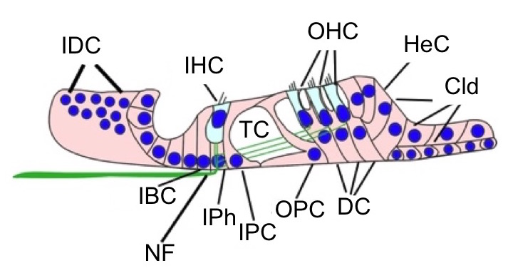
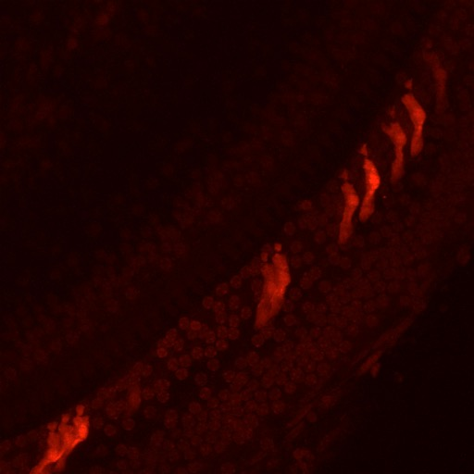

LNP delivery of Cas9/sgRNA into adult cochlea
a
b
g
tdT
50 μm
MYO7A/SOX2/tdT/DAPI
c
d
h
IHC
DC
tdT
10 μm
MYO7A/SOX2/tdT/DAPI
e
f
DC
IHC
Notes:
Fig7. Delivery of Cas9/sgRNA mixed with 306-O12B into adult mouse cochlea via cochleostomy. a-f. Whole mount immunofluorescence staining of the base region of the cochlea using MYO7A (green) and SOX2 (cyan). Cochlea tissues were collected 3-7 days post injection. tdT signals were observed mainly in Deiters cells. (a-b), low magnification images; (c-d), high magnification images. (e-f) cross section view of (c-d). G, illustration of cells types with tdT signal in cochlea. H, quantification of tdT+ Deiters cells in cochlea. N=4, mean +/- SEM. DC, Deiters cells; IHC, inner hair cells.

Slide 8
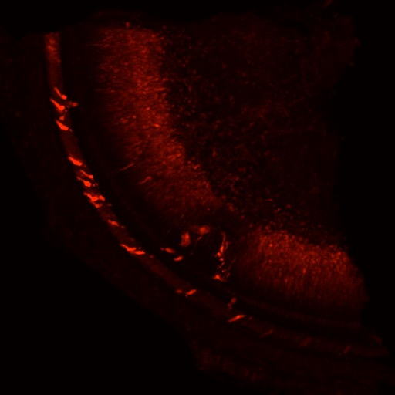
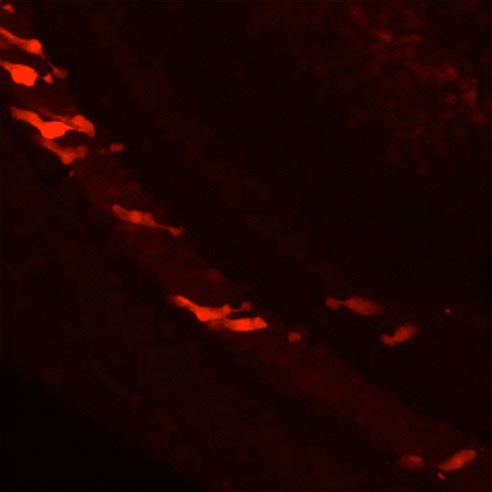

LNP delivery of Cas9/sgRNA into adult cochlea
a
b
g
tdT
50 μm
MYO7A/SOX2/tdT/DAPI
c
d
h
IHC
IHC
DC
DC
tdT
10 μm
MYO7A/SOX2/tdT/DAPI
e
f
DC
IHC
Notes:
Fig8. Delivery of Cas9/sgRNA mixed with 113-O12B into adult mouse cochlea via cochleostomy. a-f. Whole mount immunofluorescence staining of the base region of the cochlea using MYO7A (green) and SOX2 (cyan). Cochlea tissues were collected 5 days post injection. tdT signals were observed mainly in Deiters cells. (a-b), low magnification images; (c-d), high magnification images. (e-f) cross section view of (c-d). G, illustration of cells types with tdT signal in cochlea. H, quantification of tdT+ Deiters cells in cochlea. N=2, mean +/- SEM. DC, Deiters cells; IHC, inner hair cells.

Slide 9
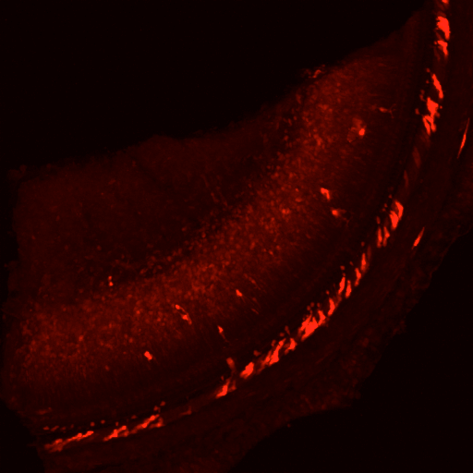
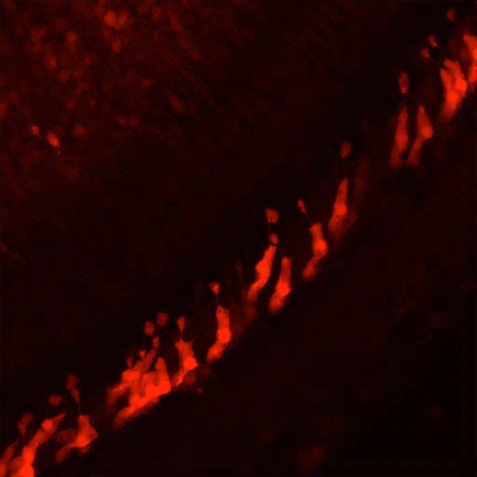

LNP delivery of Cas9/sgRNA into adult cochlea
a
b
g
tdT
50 μm
MYO7A/SOX2/tdT/DAPI
c
d
h
IHC
DC
tdT
10 μm
MYO7A/SOX2/tdT/DAPI
e
f
DC
IHC
Notes:
Fig9. Delivery of Cas9/sgRNA mixed with 306-S10 into adult mouse cochlea via cochleostomy. a-f. Whole mount immunofluorescence staining of the base region of the cochlea using MYO7A (green) and SOX2 (cyan). Cochlea tissues were collected 3-6 days post injection. tdT signals were observed mainly in Deiters cells. (a-b), low magnification images; (c-d), high magnification images. (e-f) cross section view of (c-d). G, illustration of cells types with tdT signal in cochlea. H, quantification of tdT+ cells in cochlea. N=2, mean +/- SEM. DC, Deiters cells; OPC, outer pillar cells; IHC, inner hair cells.

Slide 10
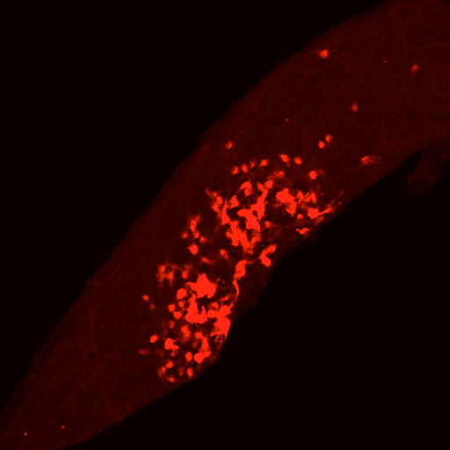
LNP delivery of Cas9/sgRNA into adult cochlea
a
b
g
SV
SV
tdT
50 μm
GJB2/ATP1A1/tdT/DAPI
c
d
h
tdT
10 μm
GJB2/ATP1A1/tdT/DAPI
e
f
Notes:
Fig10. Delivery of Cas9/sgRNA mixed with 306-S10 into stria vascularis adult mouse cochlea via cochleostomy. a-f. Whole mount immunofluorescence staining of the base region of the cochlea using GJB2 (basal cell marker, green) and ATP1A1 (marginal cell marker, cyan). Cochlea tissues were collected 3-6 days post injection. tdT signals were observed in stria region, presumably in intermediate cells and marginal cells. (a-b), low magnification images; (c-d), high magnification images. (e-f) cross section view of (c-d). G, illustration of cells types with tdT signal in cochlea. H, quantification of tdT+ cells in cochlea. N=2, mean +/- SEM. DC, Deiters cells; OPC, outer pillar cells; IHC, inner hair cells.

