Slide 1
Chen Delivery Validation Study Report
JAX Small Animal Testing Center
Somatic Cell Gene Editing Consortium
May 2021
S. Murray, C. Lutz, K. Snow

Slide 2
Chen Validation Summary Report
Study Overview
Study changes
Methods
Representative Data and Summary
Conclusions

Slide 3
Chen Project Overview and Changes
Goal is to deliver lipid nanoparticles containing components of the CRISPR/Cas9 gene editing system to the mouse inner ear, specifically the cells in and around the sensory region, including hair cells, supporting cells and cells in stria vascularis and spiral ganglion. Editing will be detected via activation of tdTomato in Ai14 mice.
Changes from original study plan
Reduced number of study arms and original pilot due to shortened timeline at SATC. Cochleostomy route of injection not feasible at SATC in amount of time allotted for training.
Blank LNP controls not shipped and were removed from schedule (contralateral ear was evaluated as negative control as well as Ai14 un-injected mice instead)

Slide 4
Chen Testing Plan
Mouse Model: Ai14
Target Tissue: Inner ear
Euthanize @5 days post injection
✓
Delivery Validation Pilot
Arm | ROA | Mice | Test Article | Concentration | Freq. | Mouse age
1 | canalostomy | 8 (4M, 4F) | AAV9-GFP-Cre | 1.4 E11 vg, 2μl | 1x | 1 month
2 | canalostomy | 2 (1F, 1M) | Trypan Blue | 0.4% | 1X | 1 month
Euthanize 14 days after injection (takedown 2/2 and 2/4)
1/8 AAV injected mice showed evidence of successful surgery
1/2 Trypan injected has dye still in area
✓
Study- Revised
Arm | ROA | Mice | Test Article | Concentration | Frequency | Mouse age
1 | canalostomy | 6 (3M, 3F) | LNP1+SpCas9 mRNA+tdT gRNA (306-O12B) | 0.5mg/ml, 1μl | 1x | 1 month
2 | canalostomy | 6 (3M, 3F) | LNP2+SpCas9 mRNA+tdT gRNA (306-S10) | 0.5mg/ml, 1μl | 1x | 1 month
3 | canalostomy | 2 (1M, 1F) | LNP1 | 0.5mg/ml, 1μl | 1x | 1 month
4 | canalostomy | 2 (1M, 1F) | LNP2 | 0.5mg/ml, 1μl | 1x | 1 month
2 | canalostomy | 2 (1M, 1F) | Un-injected Control- Ai14 |  |  | 1 month
Notes:
Challenge with this group will be demonstrating successful delivery. Ramping up training and practice with 1 month old animals in collaboration with Assist. Prof. Basile Tarchini.

Slide 5
Chen Project- Methods and Analysis
Canalostomy injections were performed in 4-6 week old Ai14 mice. Inner ears were collected and fixed in 4% PFA, decalcified in 10% EDTA, and then whole mounted in 3 sections and immunostained 5 days after NP were delivered. Cochlea from both AAV9-GFP-Cre injected and LNP injected mice were processed in the same manner.
Inner ear dissections- assistance from Basile Tarchini Lab
Whole mount/IF of specimens and imaging- assistance from Basile Tarchini Lab
Whole mounted cochlea were imaged using confocal microscopy and serial z stacks collected for each region.

Slide 6
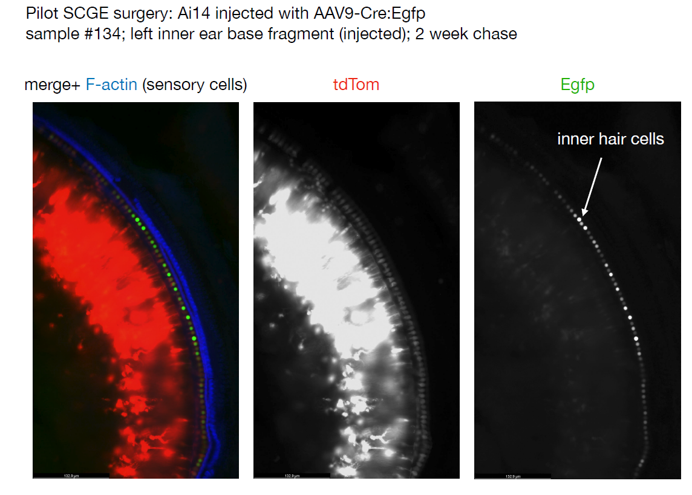

Slide 7
Pilot & Study results summary
Only 2 surgeries were successful from AAV-cre pilot / Trypan Blue injections (n=10)
Additional training and evaluation was given by Tarchini lab and technique was modified slightly. Following retraining, 3/4 trypan blue injected mice showed evidence of dye in inner ear canal
Proceeded with injection of study test articles 306-O12B and 306-S10 (n=12)
Only 1/12 injected animals showed evidence of proper delivery (first injection of the day) suggesting that there may have been technical issues with the handling of the test articles as well as continued challenges with delivery technique. Agreed to repeat injections again with modifications to handling of the test articles and to perform injections in parallel with delivery team to rule out any problems with the material to be delivered.

Slide 8
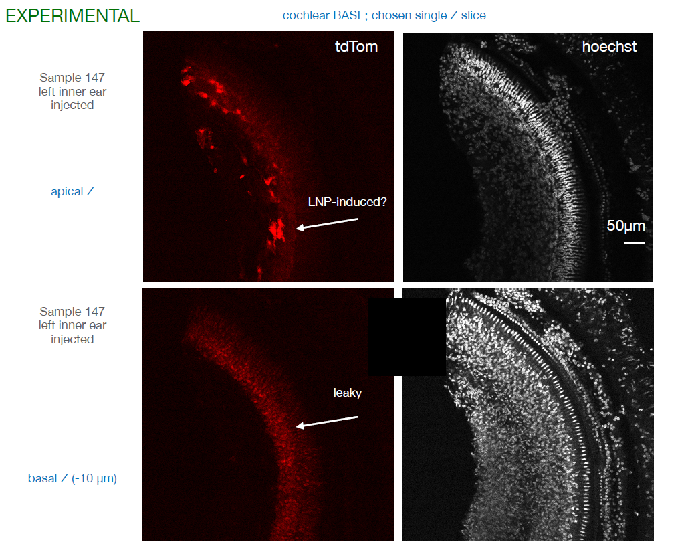

Slide 9
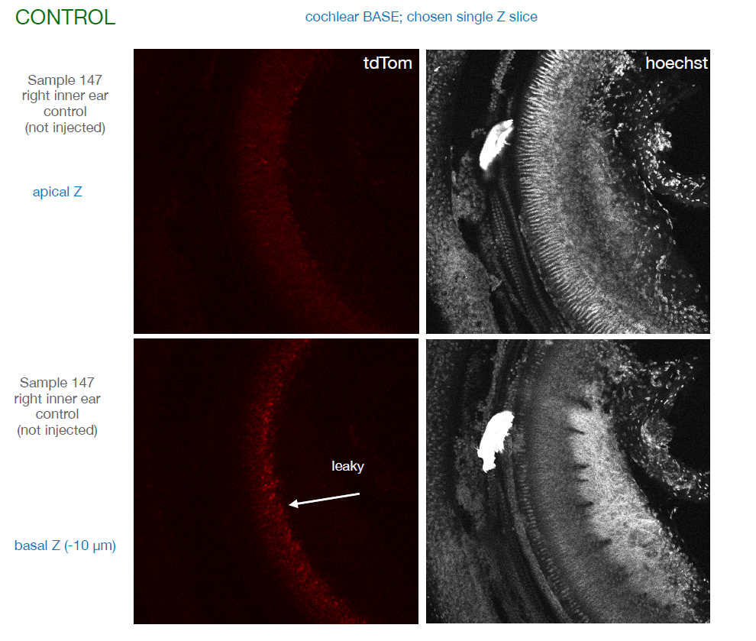

Slide 10
Repeat injections- April 2021
Arm | ROA | Mice | Test Article | Concentration | Freq. | Mouse age
1 | canalostomy | 4 (4M) | AAV9-GFP-Cre | 1.4 E11 vg, 1μl | 1x | 1 month
2 | canalostomy | 4 (4M) | Trypan Blue | 0.4% | 1X | 1 month
Arm | ROA | Mice | Test Article | Concentration | Frequency | Mouse age
1 | canalostomy | 6 (3M, 3F) | LNP1+SpCas9 mRNA+tdT gRNA (306-O12B) | 0.5mg/ml, 1μl | 1x | 1 month
2 | canalostomy | 4 (2M, 2F) | LNP1 control | 0.5mg/ml, 1μl | 1x | 1 month
After discussion with Tarchini and Chen groups, suspect handling of the LNP interfered with activity of the NP on day of injections.
Parallel injections of LNP and controls taking place in Chen lab as backup in case our delivery technique is not adequate.

Slide 11
Second Round of injections
tdTom
Hoechst
Success Rate = 1/6 showed
Positive editing
Basal
Mid

Slide 12
Conclusions
Overall success rate for delivery to the inner ear of our control materials and the Chen lab’s test article points to technical challenges that we were not able to overcome in the time frame given for this study
Due to COVID19, we were not able to complete the planned on-site training at JAX.
Animals that did show evidence of gene editing in the inner ear targeted the same cells types and in a similar pattern observed in the Chen lab.
Quantification not performed due to the low success rate of delivery.

