Slide 1
Sontheimer Delivery Validation Study Report
JAX Small Animal Testing Center
Somatic Cell Gene Editing Consortium
May 2021
S. Murray, C. Lutz, K. Snow

Slide 2
Sontheimer Validation Summary Report
Study Overview
Study changes
Methods
Representative Data and Summary
Conclusions

Slide 3
Sontheimer Project Overview and Changes
Goal: Deliver fully modified DNA/RNA guides along with CRISPR/Cas9 components to target CNS, muscle and kidney using an imported TLR-MCV1 reporter strain generated at UMass Medical School that expresses GFP following successful gene editing.
Changes from original study plan
Mouse model changed from TLR-MCV1 to mTmG (JR-7676)
Overall study design (# of arms and test articles) and readouts changed significantly (target tissue narrowed to just brain, DAB protocol needed to be worked out and validated)
Analysis changed correspondingly to HDAB counting in Striatum using FIJI macro developed by Sontheimer team.

Slide 4
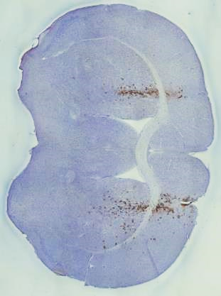
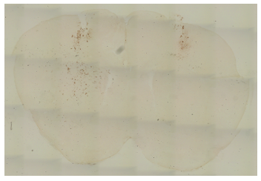
Sontheimer Testing Plan
Mouse Model: TLR-MCV1, mTmG
Target Tissue: CNS
Euthanize @12-14 days post injection
Finalized 1/20/21
Arm | ROA | Mice | Test Article | Concentration, volume | Frequency | Mouse age
1 | Bilateral IS | 6 (3M, 3F) | mTmG c20/T2 SpyCas9 RNP | 100 uM, 2 ul + 2 ul | 1x | 6-8 weeks
2 | Bilateral IS | 6 (3M, 3F) | DNMT1 c20/T2 SpyCas9 RNP control | 100 uM, 2 ul + 2 ul | 1x | 6-8 weeks
Data from Sontheimer lab to be validated:
GFP expressing cells in mouse brain following DAB IHC rxn.
Notes:
Intraventricular (ICV) – into CSF for CNS (both small and large volume)
Intrastriatal (IS) – into the striatum for CNS
ICV less risky technically.

Slide 5
Representative Images from mTmG c20/T2 RNP injected group: DAB staining only
Target: Striatum

Slide 6
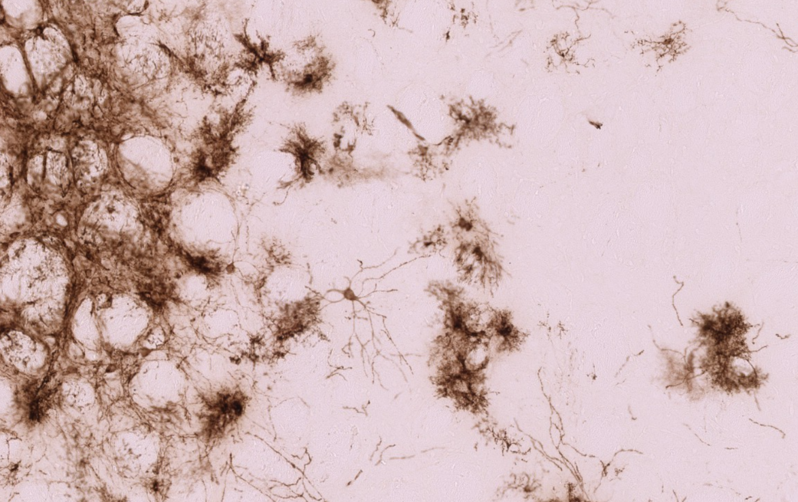
GFP is expressed in cell membranes of targeted cells which is a limitation of this model. Quantification of individual cells in non-neuronal cell types is more challenging due to increase in projections from the cell body.
Protocol provided lacked nuclear counterstain therefore mounted sections (shown here) needed to be unmounted, stained with hematoxylin and then remounted and imaged for quantification.

Slide 7
Example of one brain section from mTmG c20/T2 group where the DAB+ slide was unmounted, stained with hematoxylin and remounted. GFP+ cells in striatum of both hemispheres is shown.

Slide 8
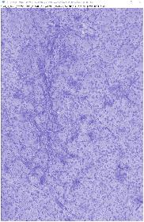
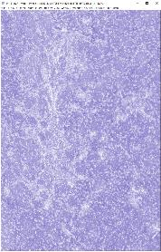
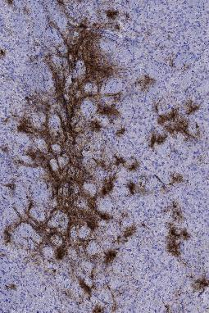
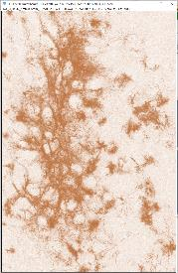
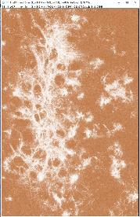
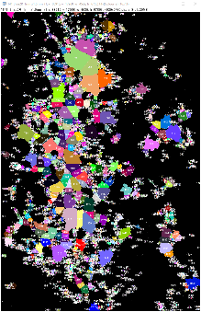
Image Analysis- Sontheimer
Find Maxima = nuclei count
Watershed & analyze particles= estimate # cells
-Color Deconvolution2
-invert
-Gaussian blur
-binary mask

Slide 9
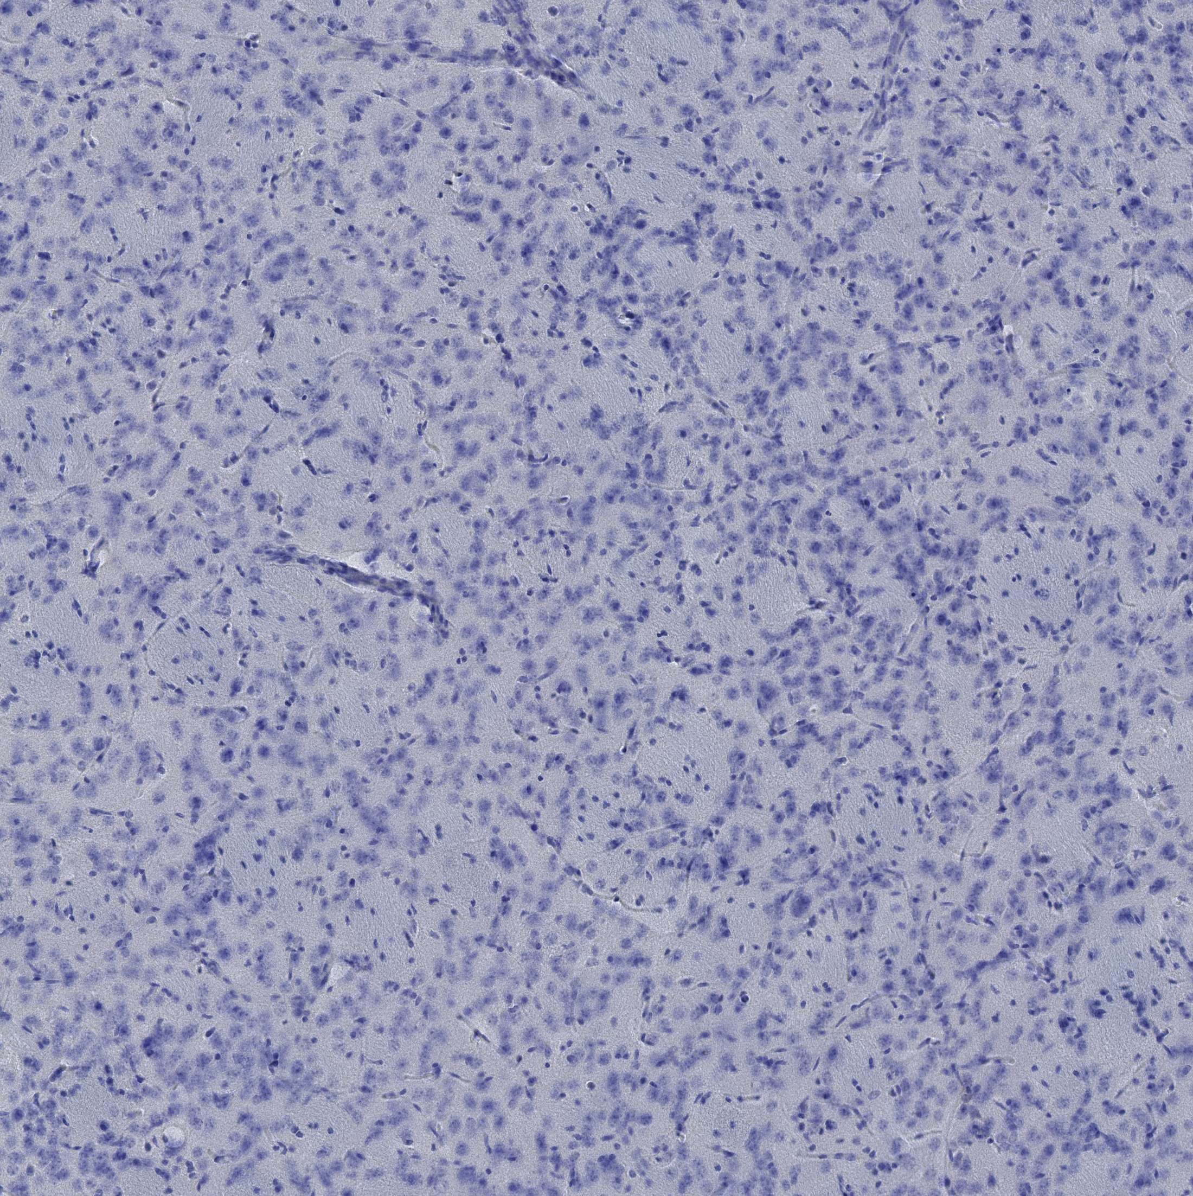
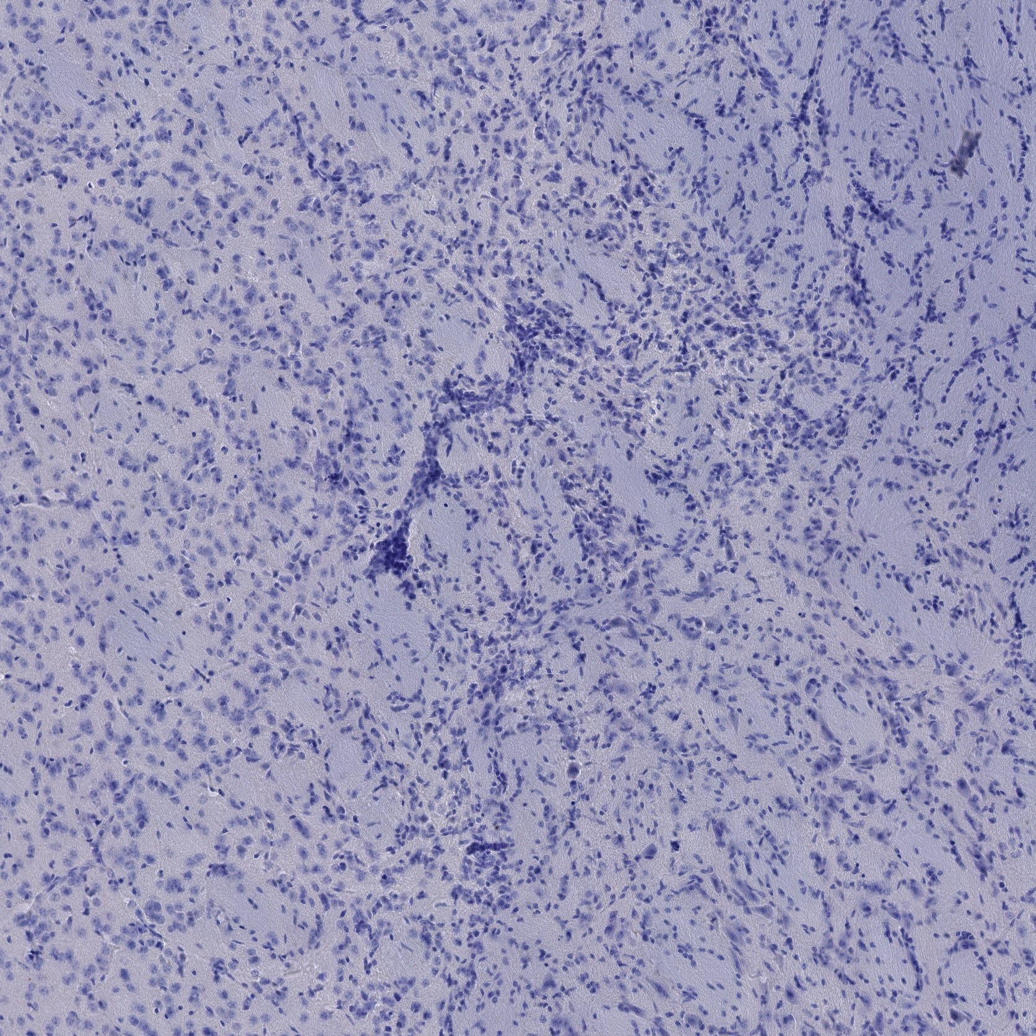
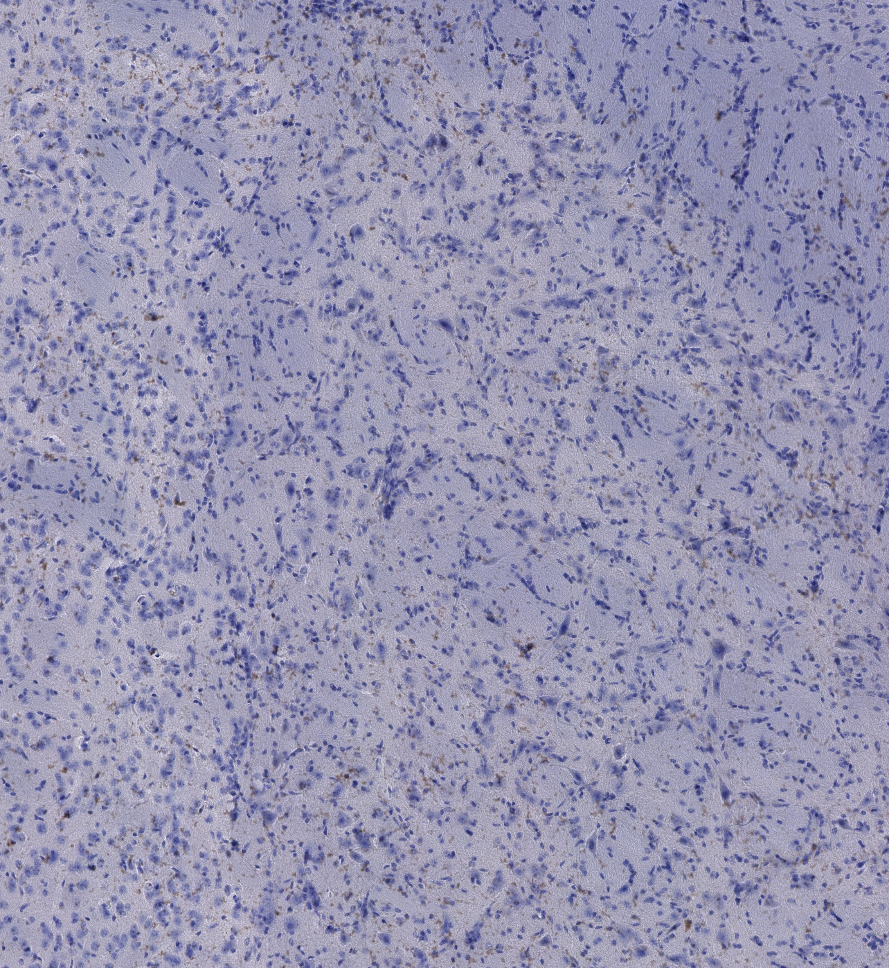
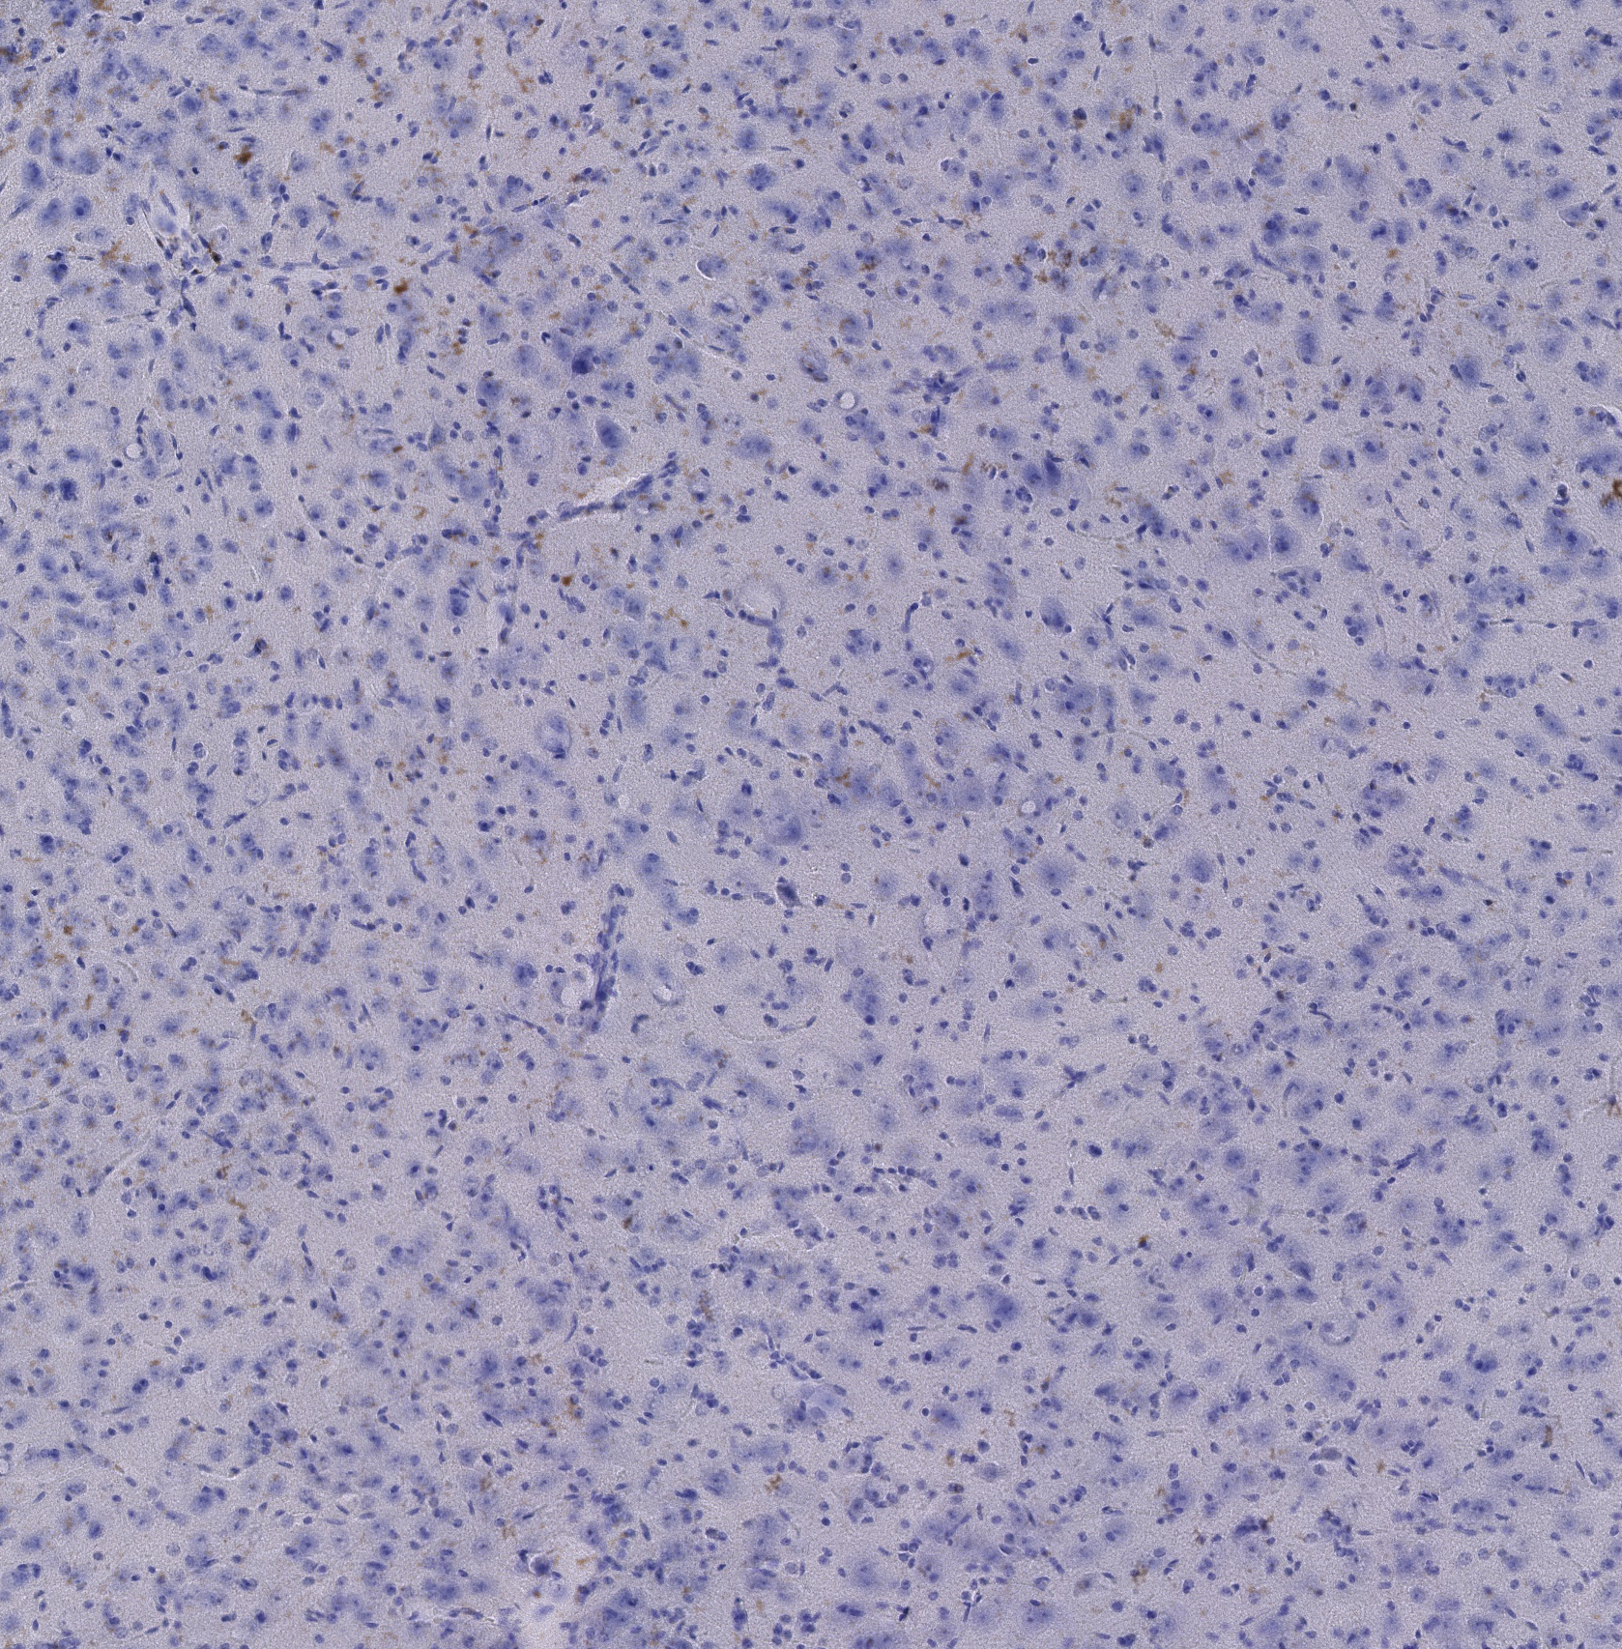
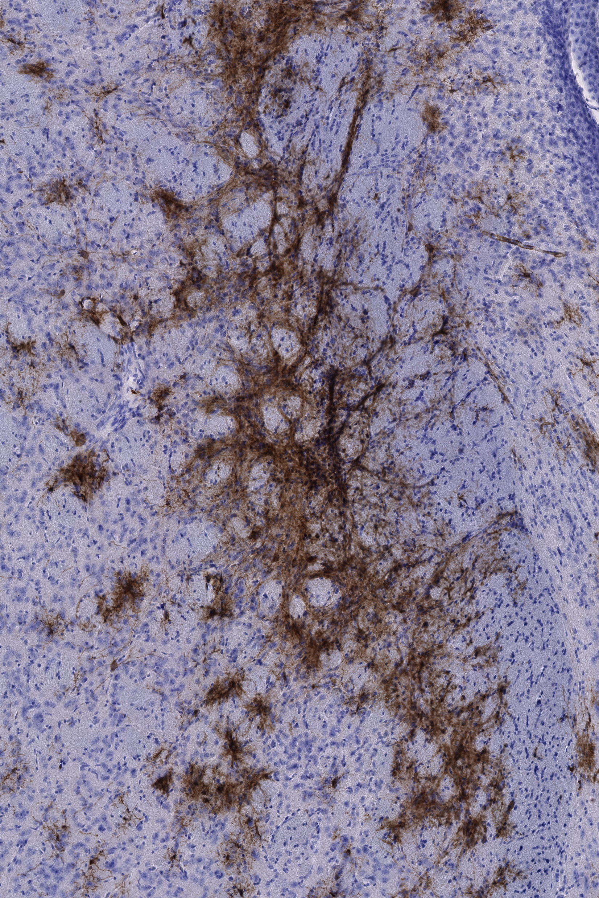
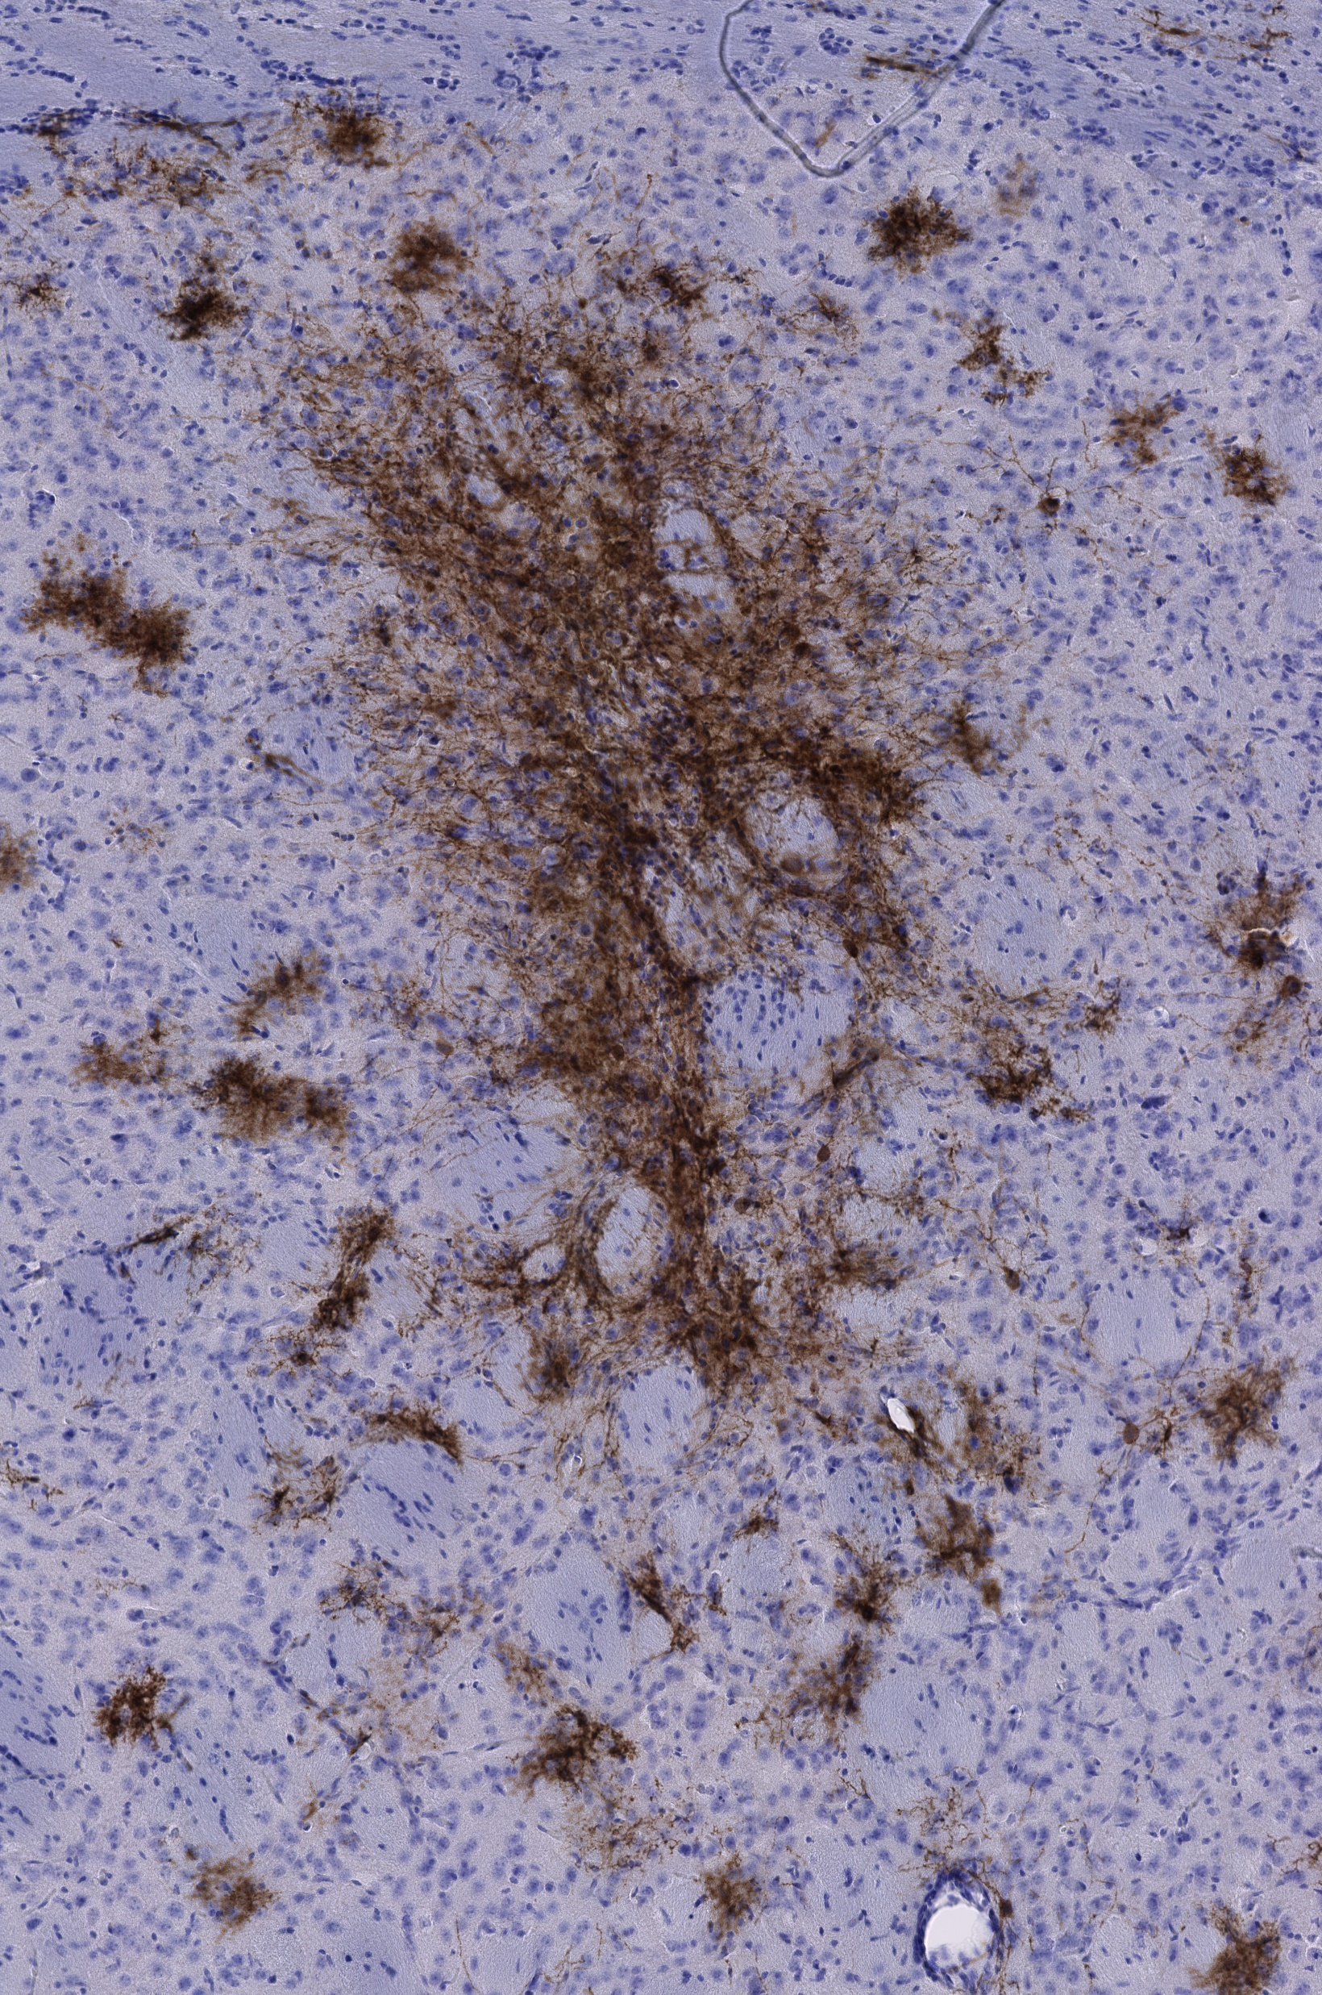
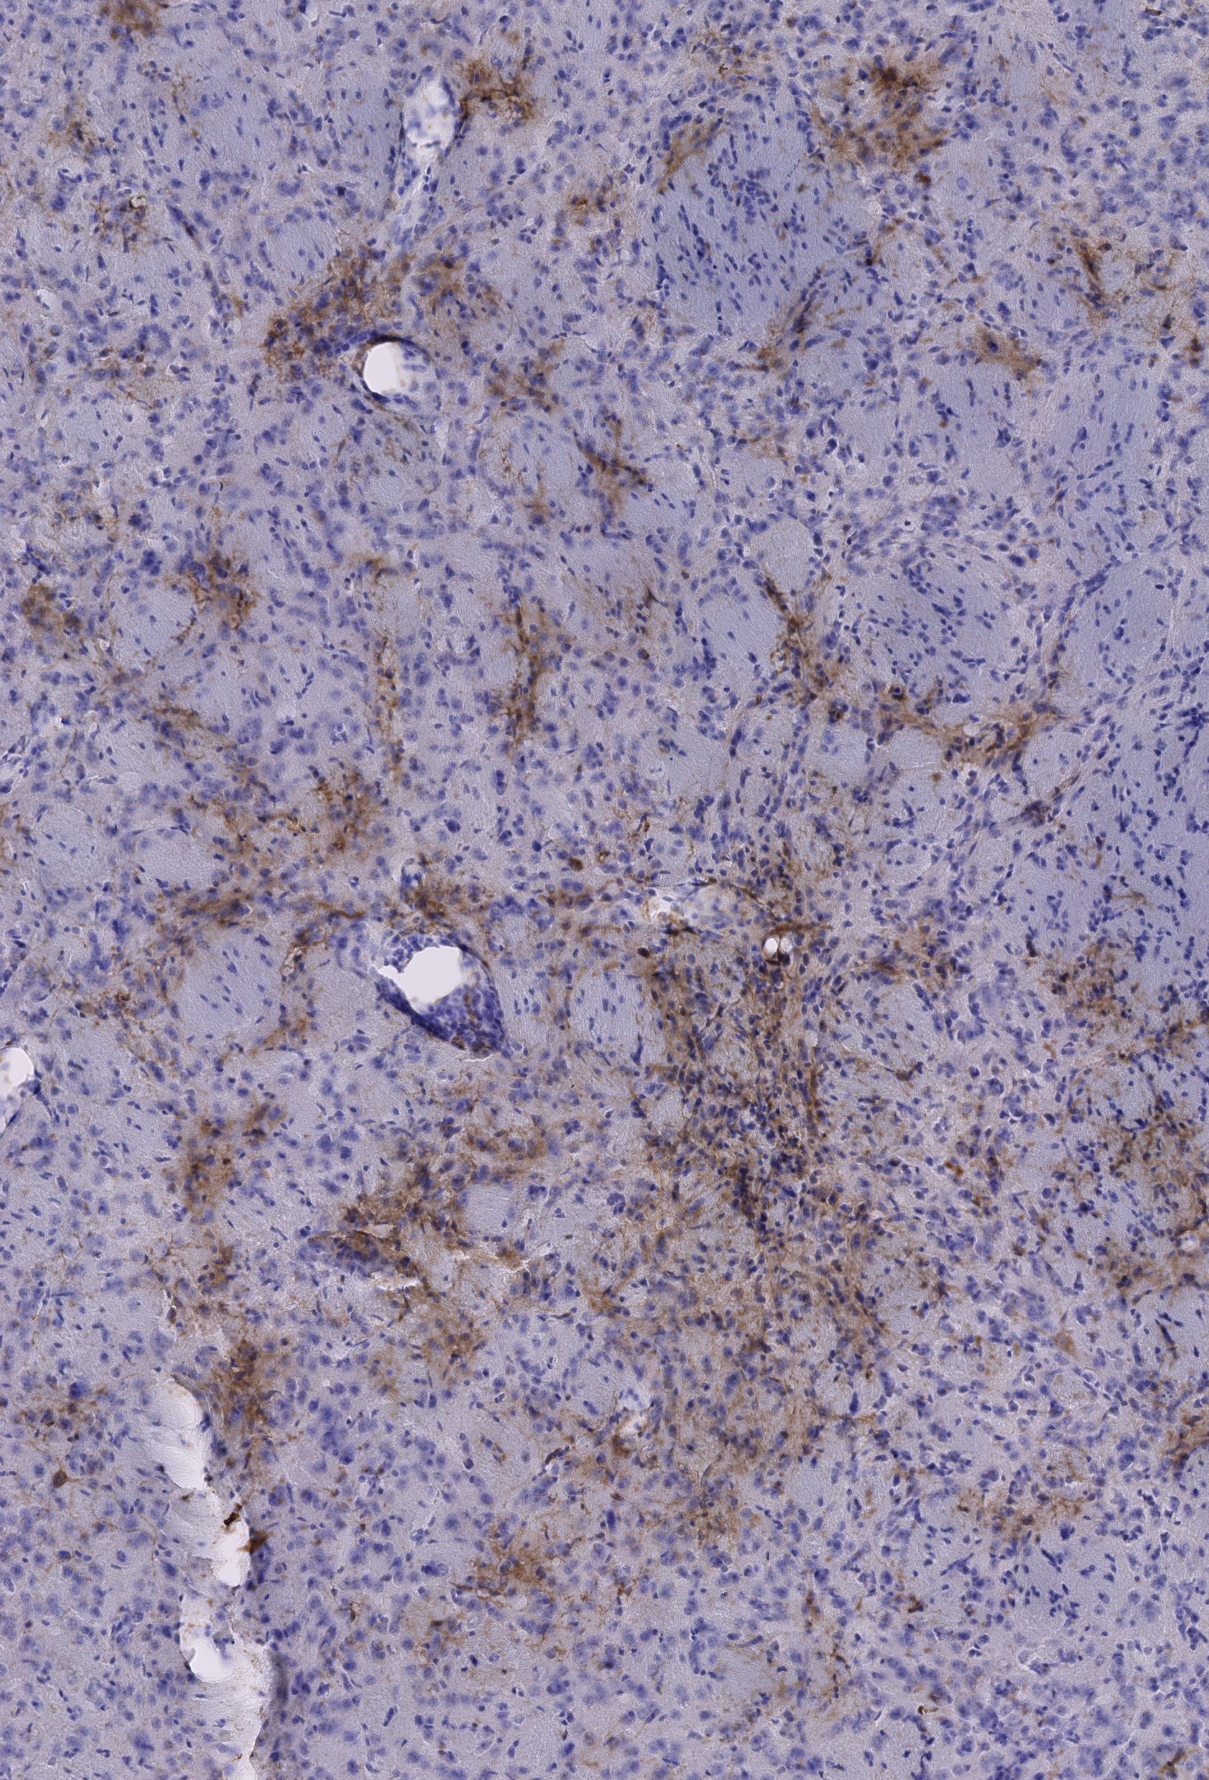
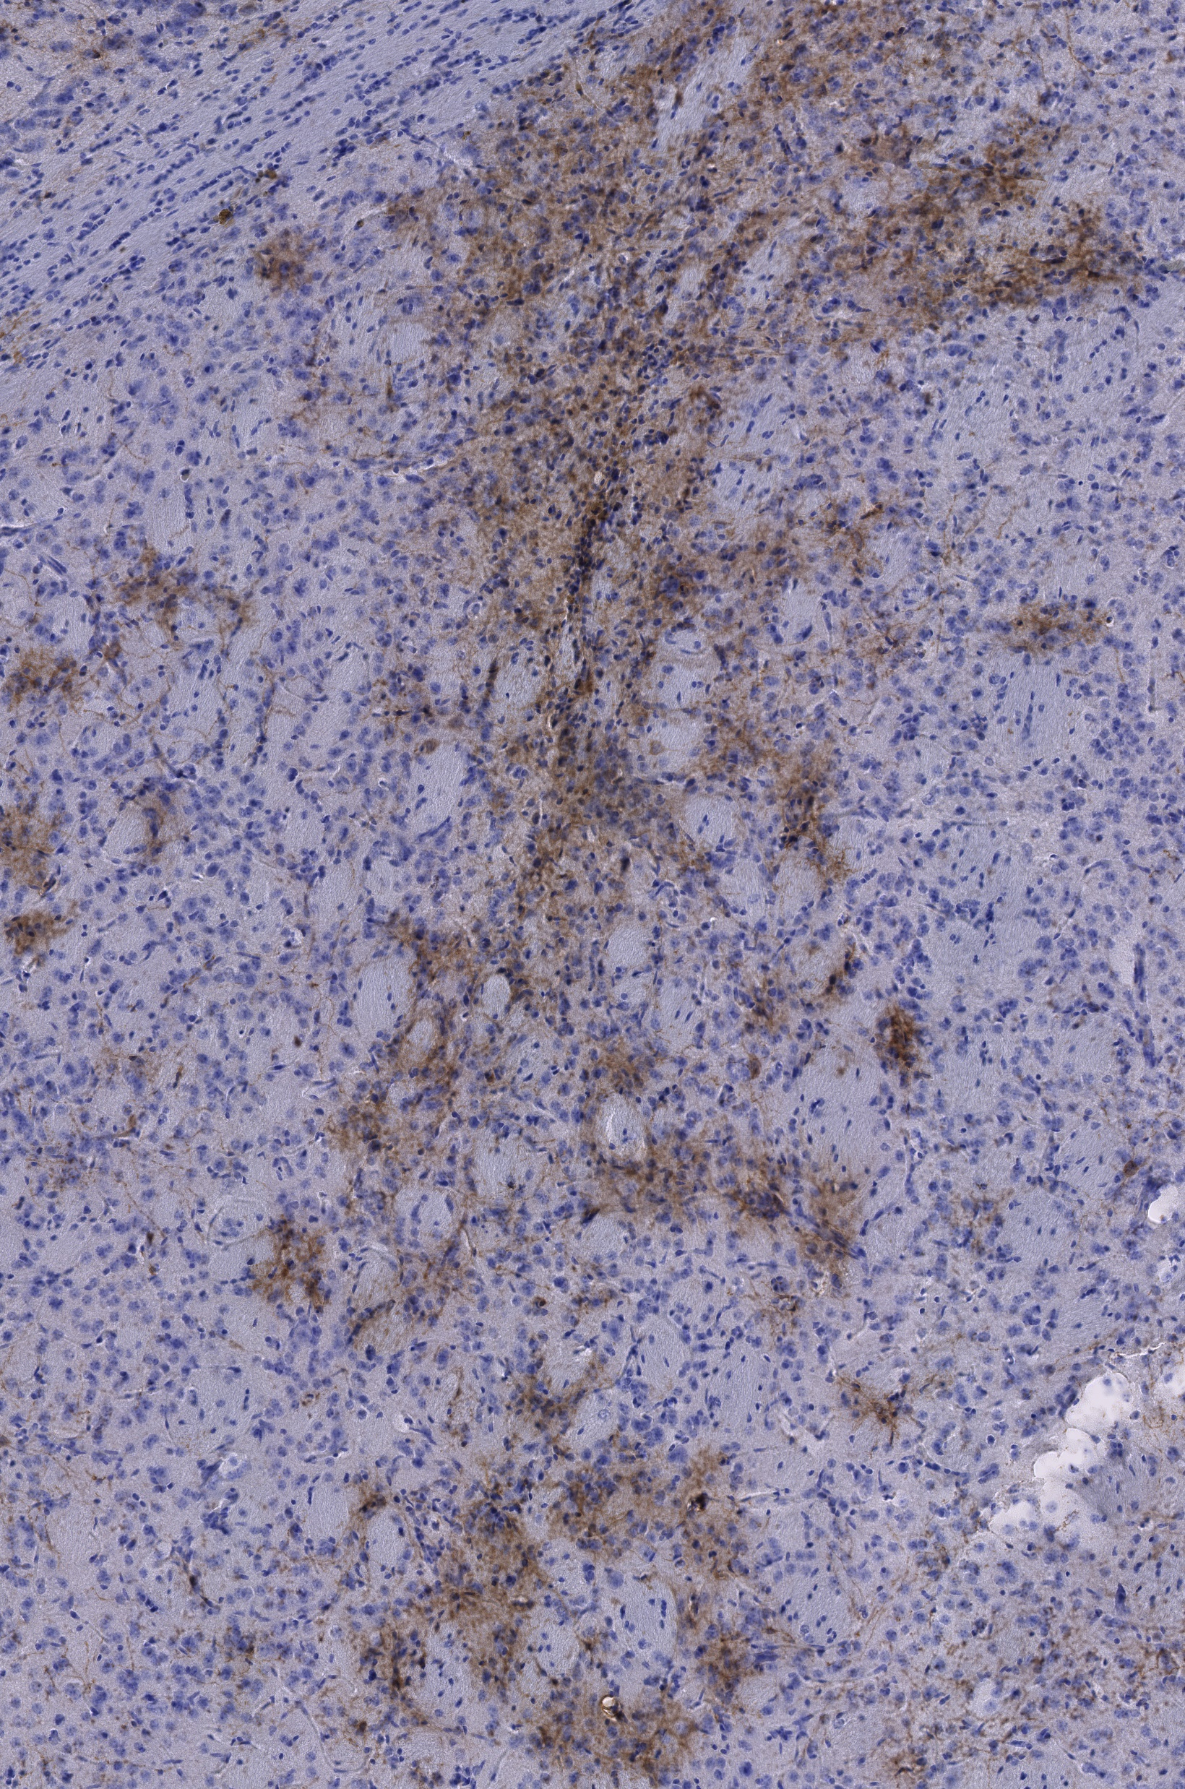
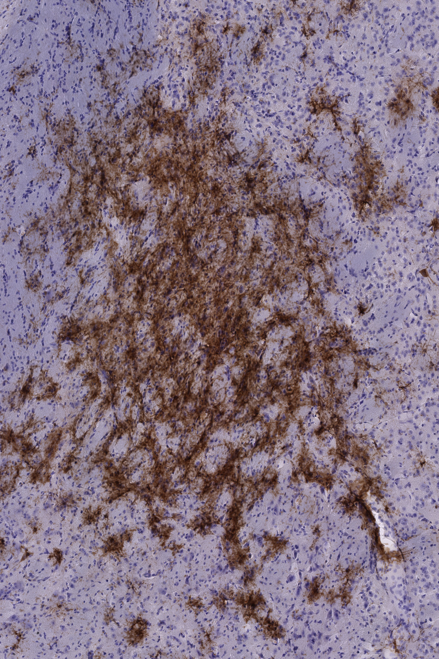
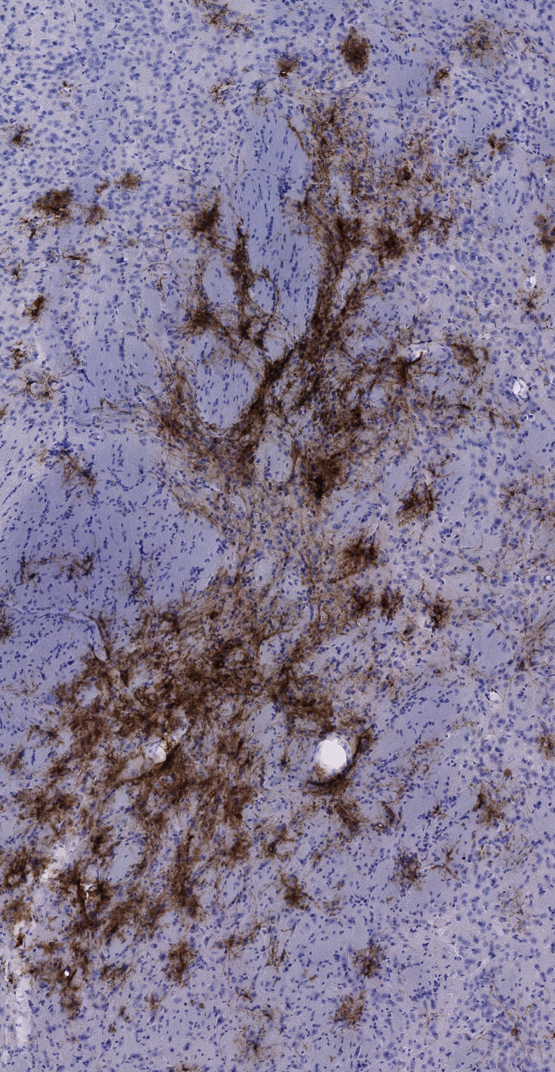
Representative ROIs taken from each animal used for image scoring
Control DNMT1 c20/T2 injected group
mTmG c20/T2 injected group
H-DAB staining

Slide 10
Robust editing observed with mTmG-targeting modified guide RNA vs control in striatum
Study Group | Sex | Average # Cells in ROI | Average #DAB+ cells in ROI | Average % edited cells
DNMT1 C20/T2 (Control) | both | 4966.6 | 141.3 | 2.68
DNMT1 C20/T2 | M | 4181.0 | 11.7 | 0.28
DNMT1 C20/T2 | F | 5752.1 | 271.0 | 5.08
mTmG C20/T2 (experimental) | both | 7162.8 | 2301.2 | 32.48
mTmG C20/T2 | M | 6743.9 | 2140.6 | 31.91
mTmG C20/T2 | F | 7721.3 | 2515.3 | 33.25
ROIs defined as rectangle 500 μm on either side of the injection plane
(1mm x height of the signal)
All animals receiving the mTmG RNP were positive for GFP expression.

Slide 11
Conclusions
Despite the last-minute changes to the study plan and strain used, the modified gRNA/RNP complex targeting the mTmG cassette was able to activate GFP robustly in cells of the striatum in all animals in the experimental group. Some very low level of DAB+ signal was present in the control injected mice that appears to be general background based on both the staining pattern as well as intensity.
Quantification of the number of DAB+ cells using the method provided by the Sontheimer group seems to underestimate the number of cells in regions of highest density, and overestimate cell number in regions where there may be cellular projections seem to be present. Overall, this method provides a reasonable approximation of DAB+ cell number that is more unbiased than manual counting of cells in the target ROIs. Of note, there are also a greater number of total cells per FOV in our study that you might expect in normal or injected brains we believe we can attribute to section compression caused by the repeated mounting and unmounting of the sections.

