Slide 1

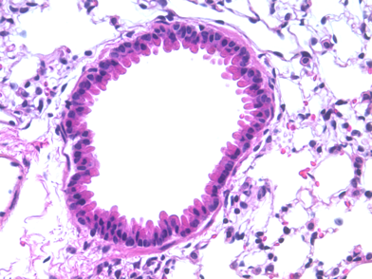
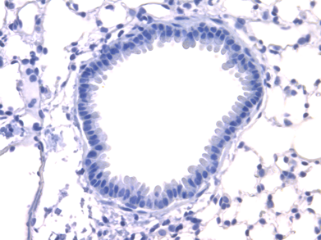
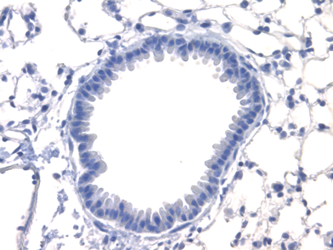
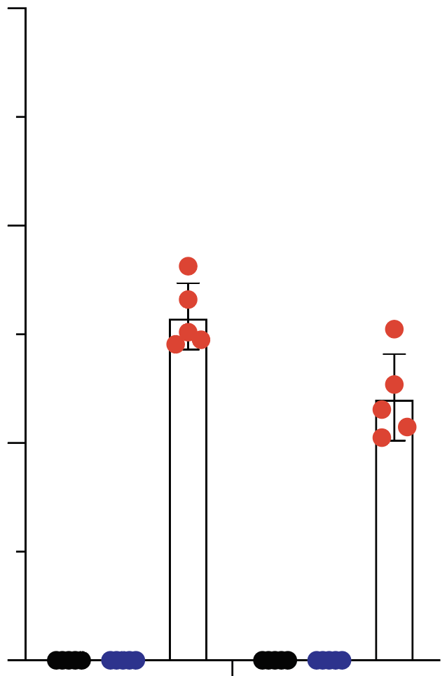
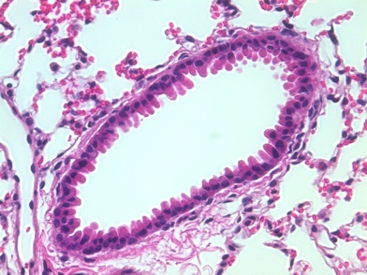
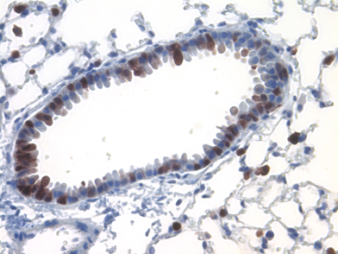
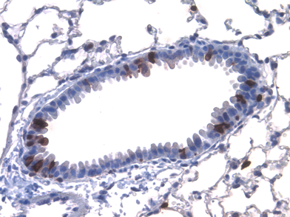
Fig. 1
a
b
NIH SCGE delivery project
sgRNA.A
sgRNA.B
UG3 phase
UH3 phase
CAG
STOP
tdTomato
Independent validation
Injection
Day 0
Collect lungs
Day 21
Ai9
Transduction (GFP⁺ cells)
Gene editing (tdT⁺ cells)
AAV5
ITR
U1a
SpCas9
pA
ITR
scAAV5
ITR
U6
sgRNA1
U6
sgRNA2
U1a
GFP
pA
ITR
c
GFP
(AAV transduction)
Tomato
(gene editing)
d
H&E
60
Saline
Saline
AAV-SpCas9
40
Dual AAV
IHC⁺ airway cells (%)
20
Dual AAV
0
GFP
Tomato
Fig. 1 Dual AAV5 delivery of spCas9 and sgRNAs supports genome editing in mouse lung. a, the SCGE UG3/UH3 delivery program. The UG3 funding phase is to support proof of concept studies in mouse models in vivo. To ensure the rigor of the in vivo gene editing toolkit, SCGE requires validation of the delivery reagents at an independent small animal testing center before the funding can be transitioned to the UH3 phase. b, Measuring CRISPR-mediated NHEJ using Lox-STOP-Lox Tomato (Ai9) reporter mice. Two sgRNAs (A and B) will delete the STOP cassettes and activate the Tomato reporter. c, Dual AAVs were intratracheally injected in Ai9 mice. Lung sections were stained for GFP and Tomato. Saline serves as a negative control. Scale bar: 100µm d, Quantification of IHC in c. Each dot is the average percentage of a mouse (n=5 mice).

Slide 2
Fig. 2
a
b
4x lens
Zoom in
AAV5-Cas9 only (control)
AAV5-Cas9+scAAV5-sgRNAs
AAV5-Cas9 + +
AAV5-sgRNAs - +
Tomato, CCSP
c
d
AAV5-Cas9+scAAV5-sgRNAs
Zoom in
acetylated tubulin, Tomato
AAV5-Cas9 + +
AAV5-sgRNAs - +
Fig. 2 AAV5 mediates genome editing in club and ciliated cells. (a) Paraffin-embedded lung sections were stained with antibodies for CCSP (green), a marker of club/clara cells and Tomato. Native GFP from AAV.sgRNA is quenched in paraffin slides. (b) Quantification of edited (Tomato⁺) CCSP⁺ cells. (c) Lung sections were stained with antibodies for acetylated tubulin (red, a marker of ciliated cell) and Tomato (green). Arrows denote double positive cells. (d) Quantification of edited (Tomato⁺) ciliated cells. b, d, n=15 sections from 3 mice. Error bars are s.e.m.

