Slide 1
in vivo experiment #21: Prep for validation at JAX Monday Dec 21st, 2020
IS bilateral injections with 3 µl in each side
Test article | Concentration | number of mice | bilateral IS (total volume/ mouse) | Mice ID
RNP1: mTmG - C20/T2 | 100 µM | 4 | 6 | 1N, 1R, 2J, 3J
Neg ctr: DNMT1 – C20/T2 | 100 µM | 2 | 6 | 1J, 3R
All mice are male 11 and 12 weeks old

Slide 2
Exp # 21: mTmG staining for GFP
Mouse 1R

Slide 3
Exp # 21: mTmG staining for GFP
mTmG-C20/T2
100 µM
3 µl IS injected
Mouse 1R
5X tile
1 mm
mTmG reporter mouse, staining for GFP
Floating sections
1/1000 antibody dilution

Slide 4
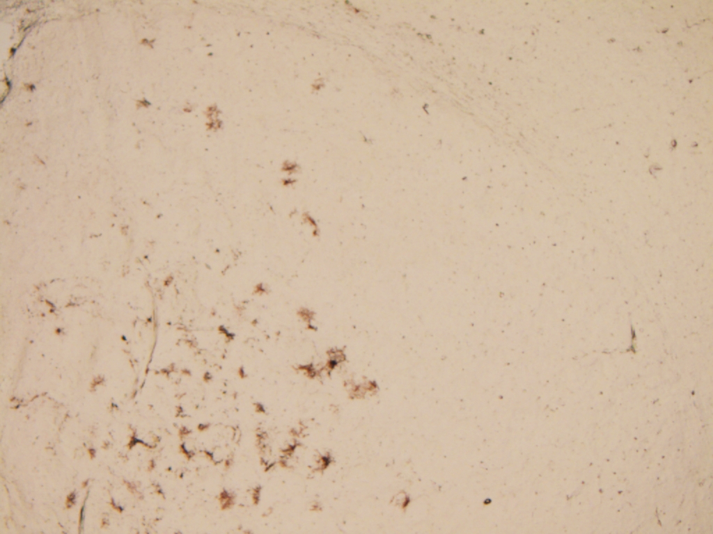
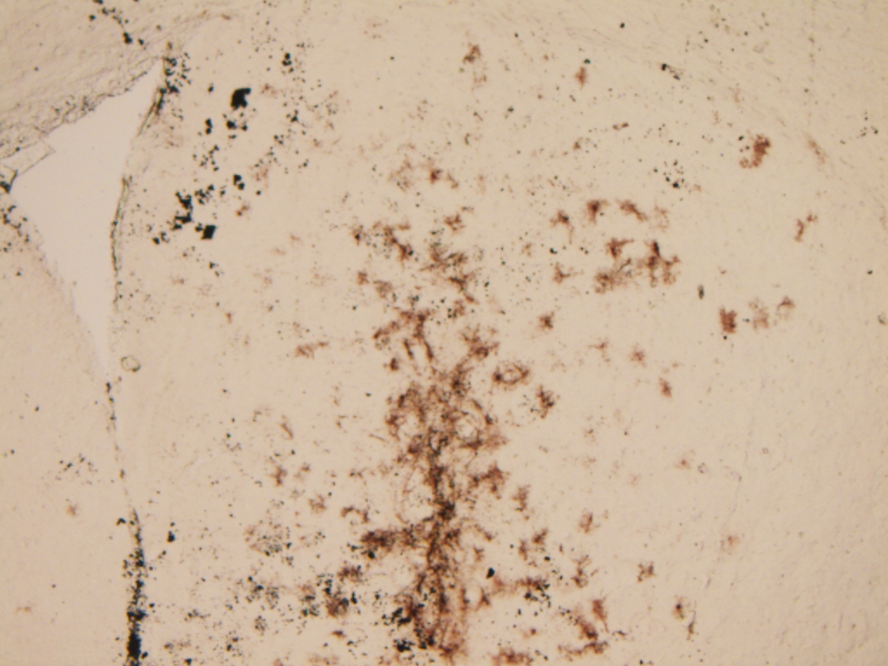
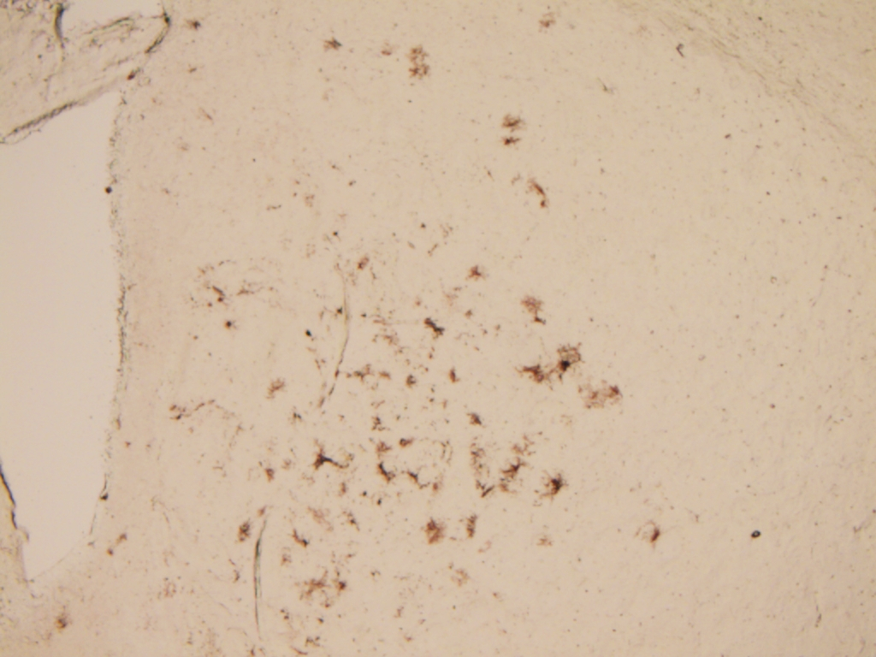
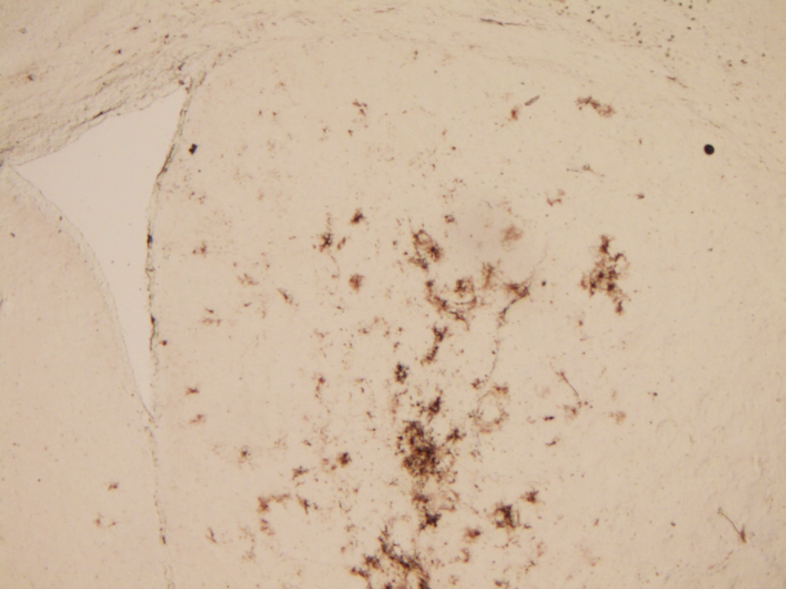
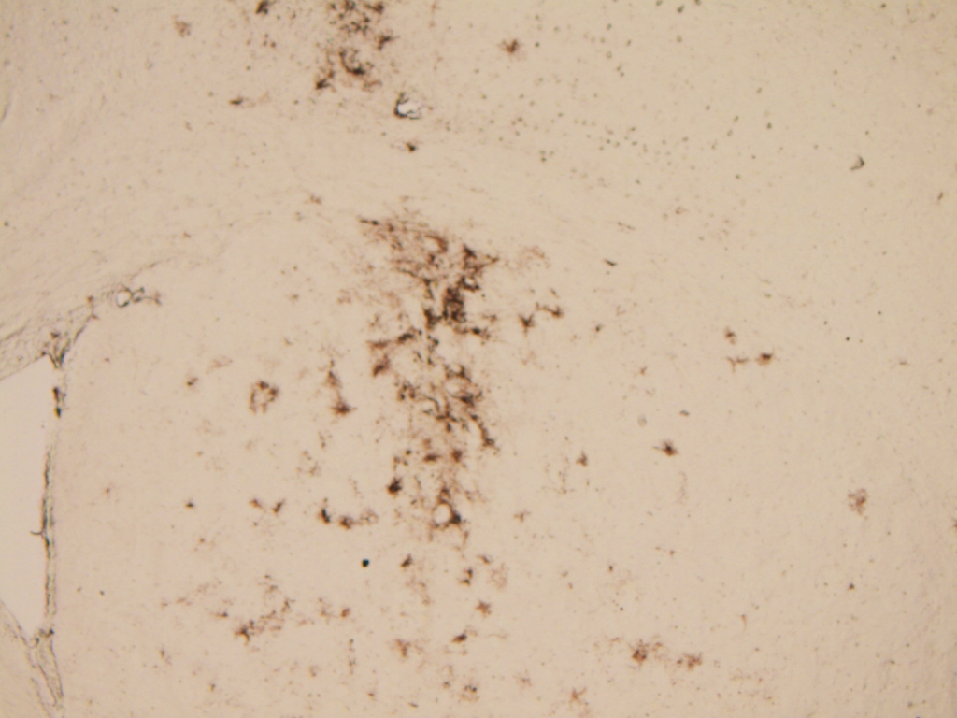
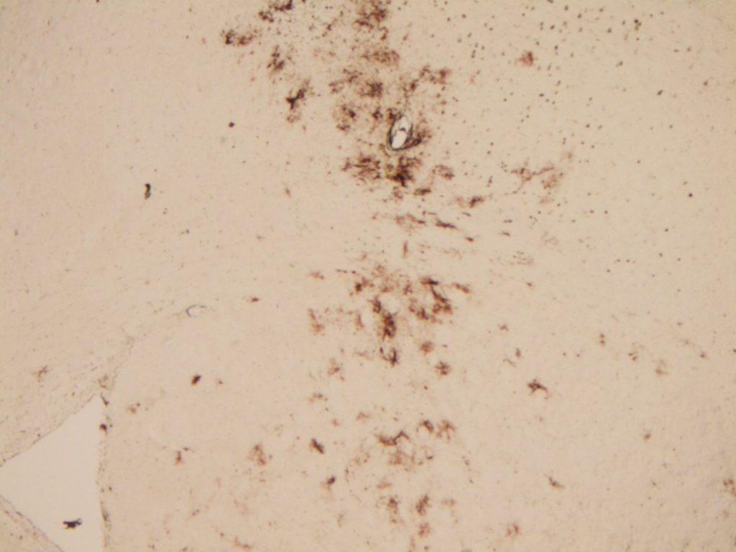
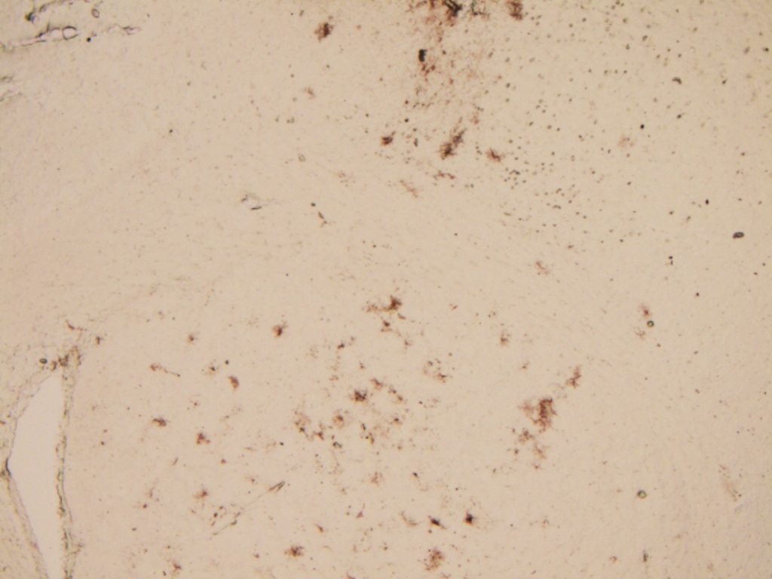
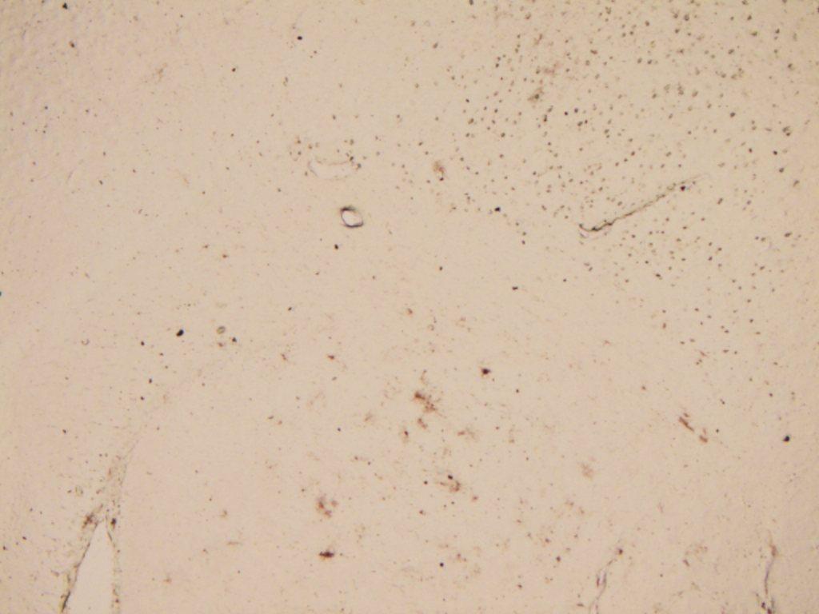
Mouse 1R
mTmG-C20/T2
100 µM/3 µl IS injected
Exp # 21: mTmG staining for GFP
Sections 1-4 (striatum, 120 um apart)
1 mm
Sections 5-8

Slide 5
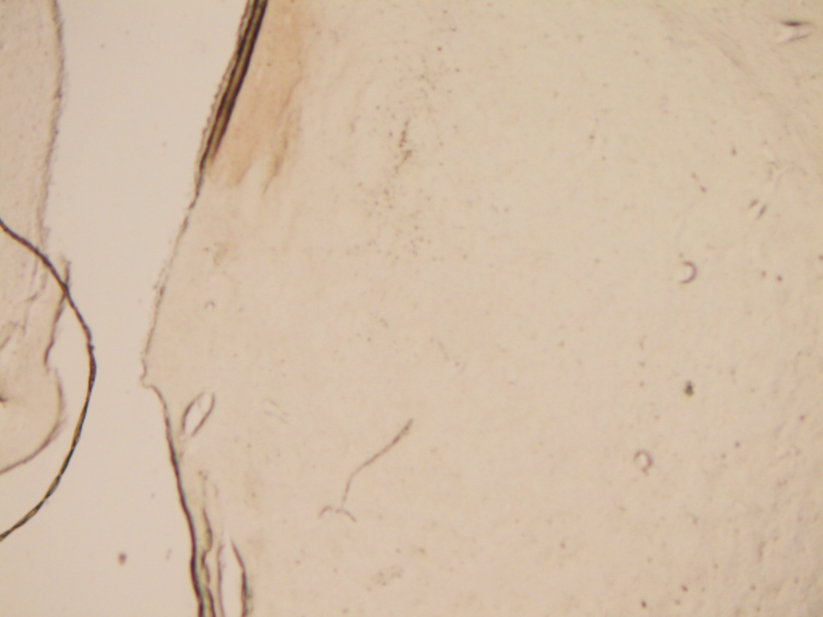
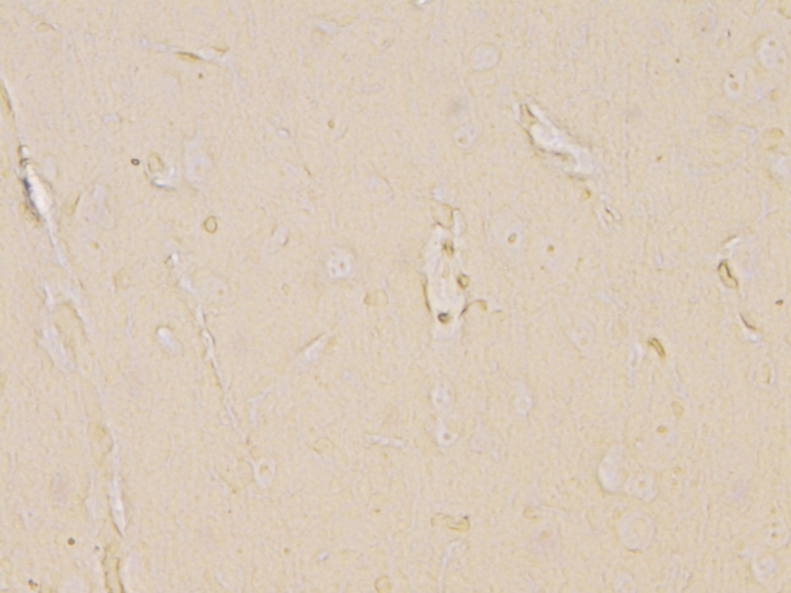
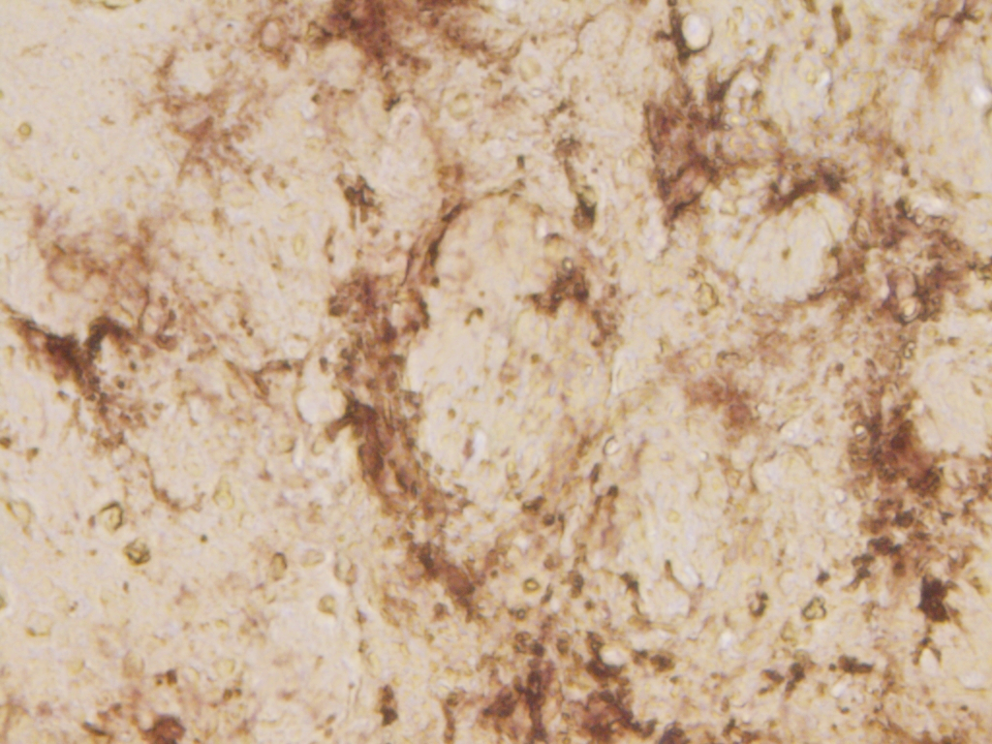
Exp # 21: mTmG staining for GFP
mTmG-C20/T2
100 µM
3 µl IS injected
DNMT1 C20/T2 (3R)
mTmG C20/T2 (1R)
5x
1 mm
5x
40x
40x

Slide 6
Exp # 21: mTmG staining for GFP
Mouse 1N

Slide 7
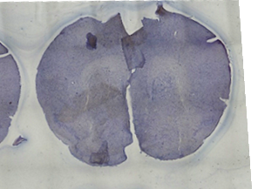
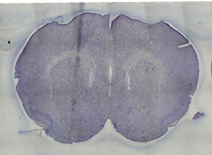
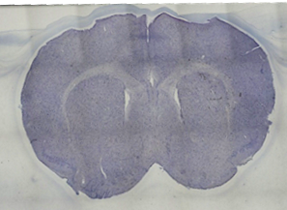
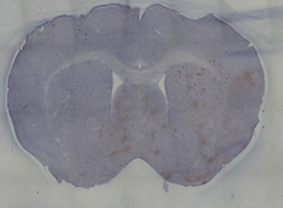
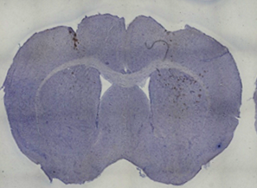
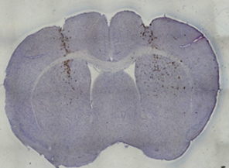
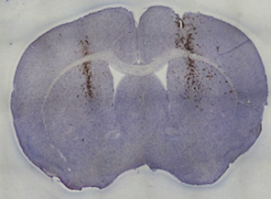
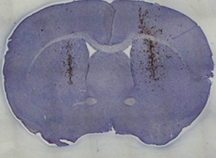
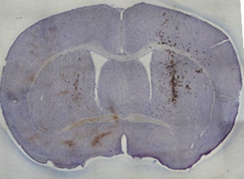
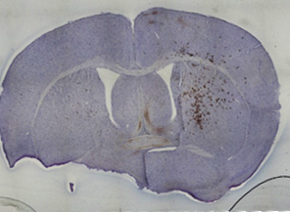
Exp # 21: mTmG staining for GFP
Mouse 1N
mTmG-C20/T2
100 µM/3 µl IS injected
Sections 1-5 (striatum, 120 um apart)
1 mm
Sections 6-10

Slide 8
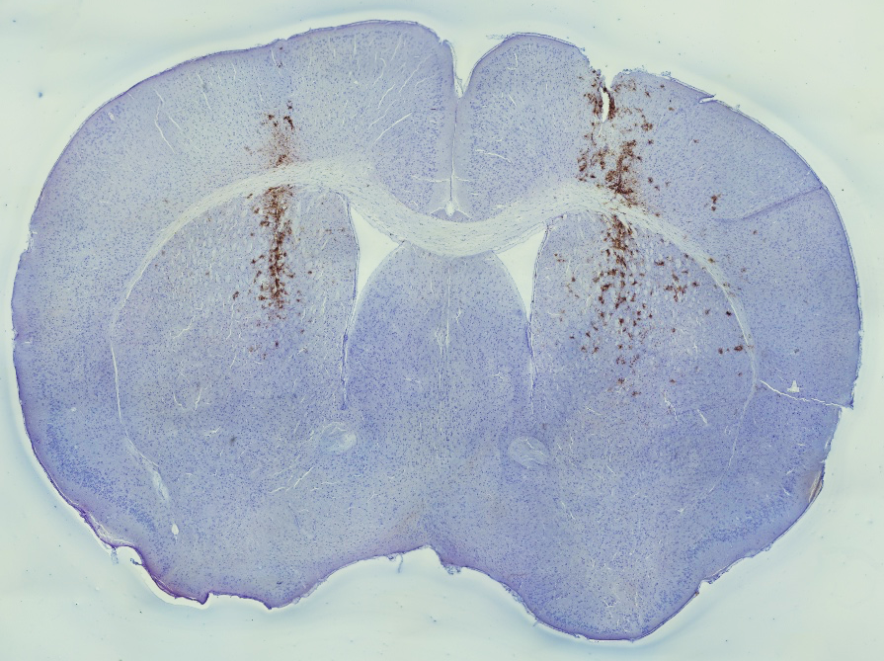
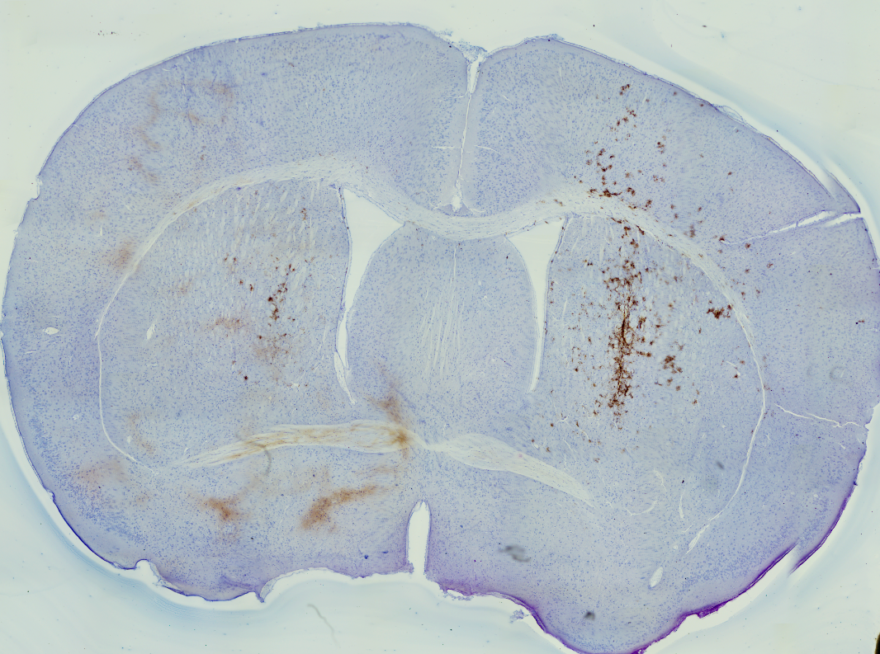
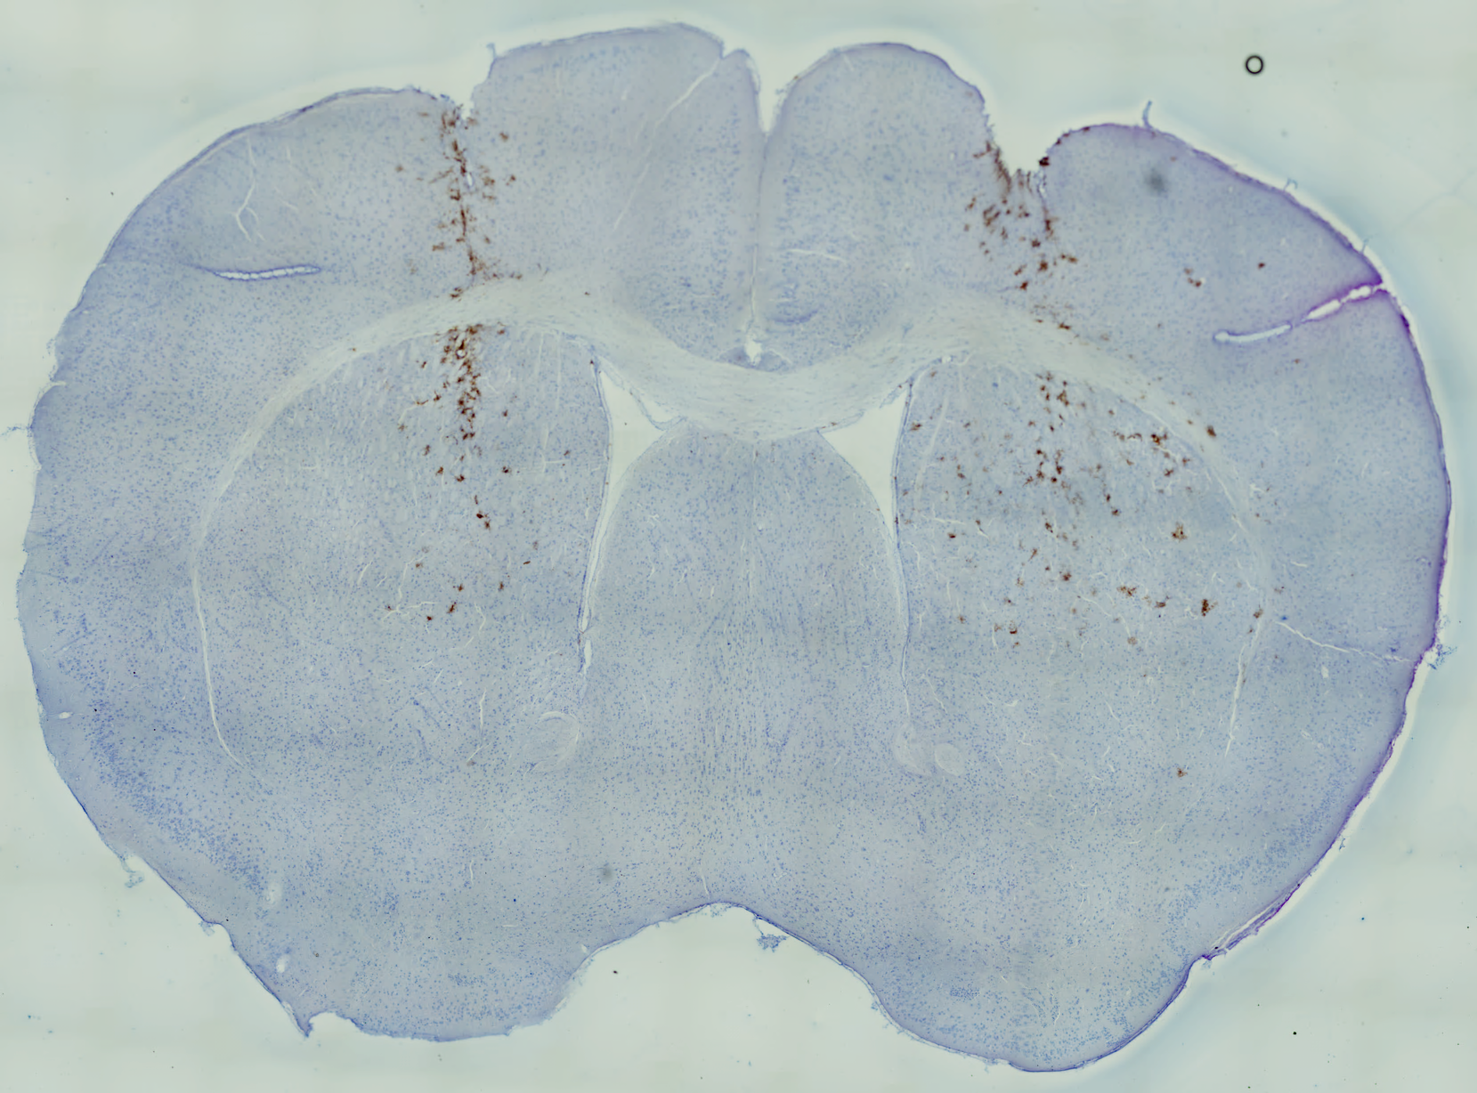
Exp # 21: mTmG staining for GFP
mTmG-C20/T2
100 µM
3 µl IS injected
Mouse 1N
5X tile
1 mm
mTmG reporter mouse, staining for GFP
Floating sections
1/1000 antibody dilution

Slide 9
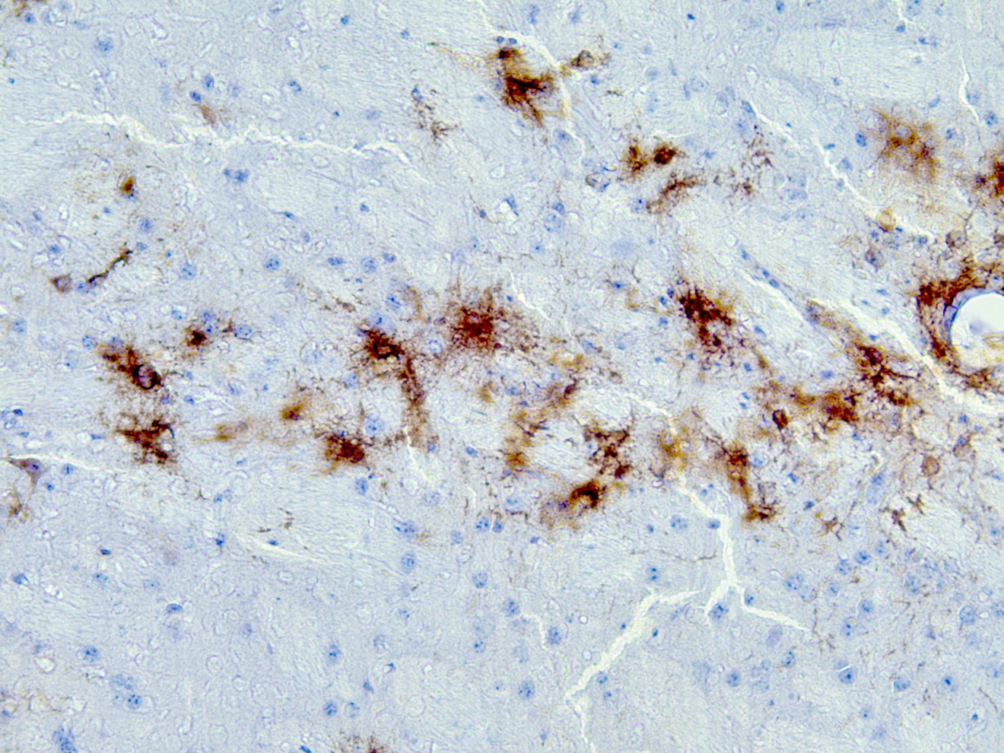
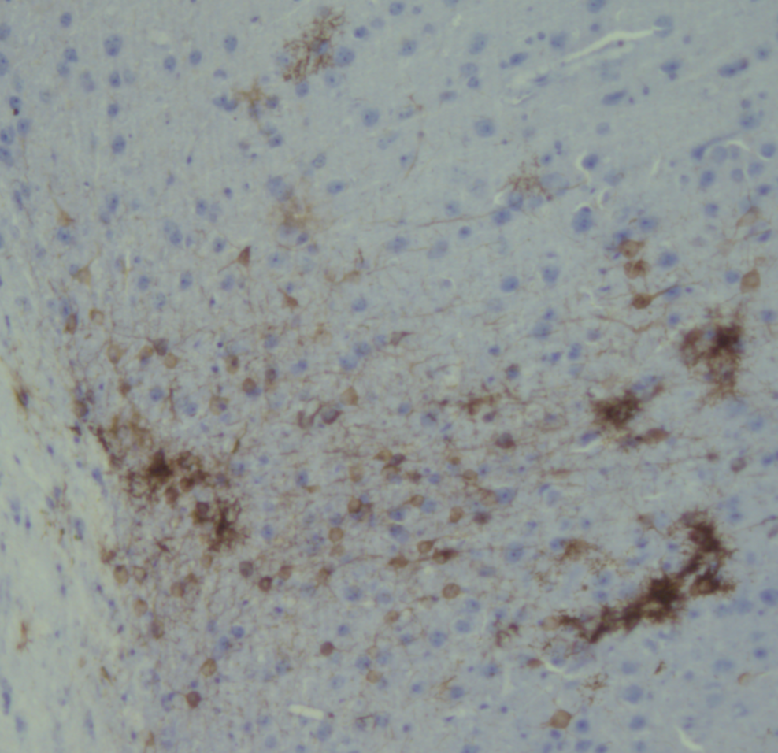
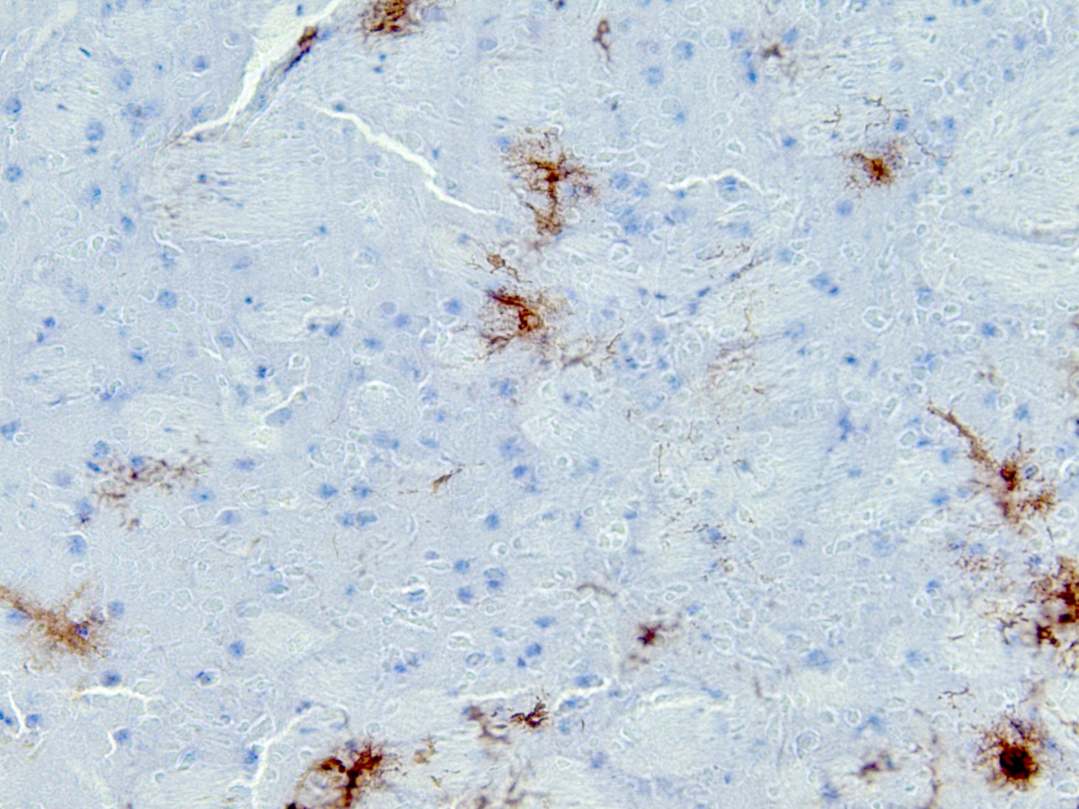
Mouse 1N
Medium spiny Neurons, Astrocytes or microglia show staining for GFP
100 µm
Iba1-Cy3
Overlay

Slide 10
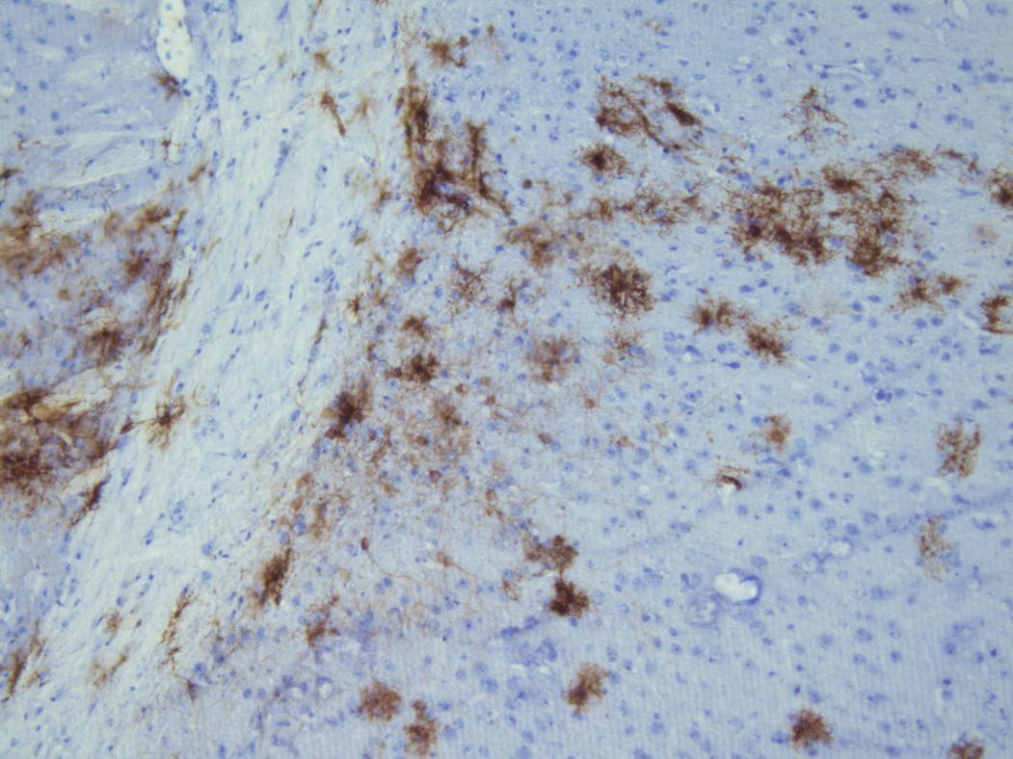
Medium spiny Neurons, Astrocytes or microglia show staining for GFP
Mouse 1N
100 µm

Slide 11
Exp # 21: mTmG staining for GFP
Mouse 2J

Slide 12
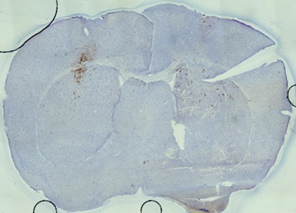
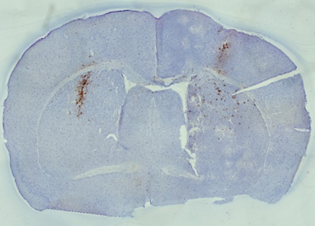
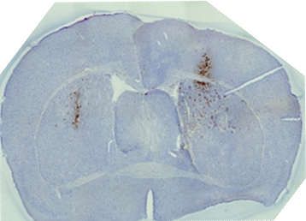
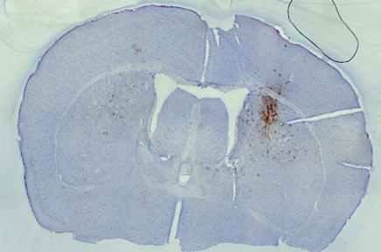
Mouse 2J
Exp # 21: mTmG staining for GFP
mTmG-C20/T2
100 µM
3 µl IS injected
Sections 1-4 (striatum, 120 um apart)
1 mm
mTmG reporter mouse, staining for GFP
Floating sections
1/1000 antibody dilution

Slide 13
Exp # 21: mTmG staining for GFP
Mouse 3J

Slide 14
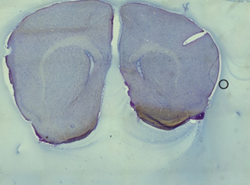
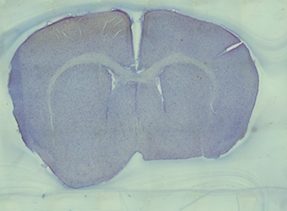
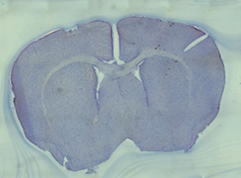
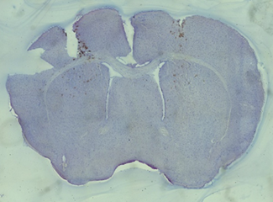
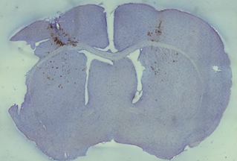
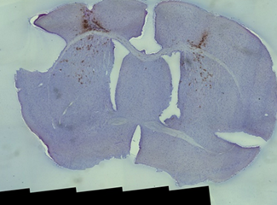
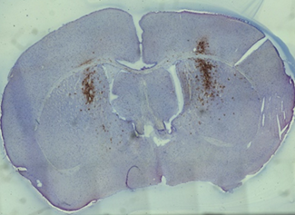
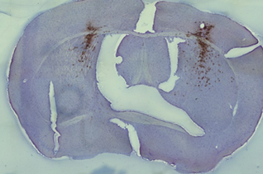
Exp # 21: mTmG staining for GFP
Mouse 3J
mTmG-C20/T2
100 µM
3 µl IS injected
Sections 1-5 (striatum, 120 um apart)
1 mm
Sections 6-9

Slide 15
Exp # 21: mTmG staining for GFP
mTmG-C20/T2
100 µM
3 µl IS injected
Mouse 3J
5X tile
1 mm
mTmG reporter mouse, staining for GFP
Floating sections
1/1000 antibody dilution

Slide 16
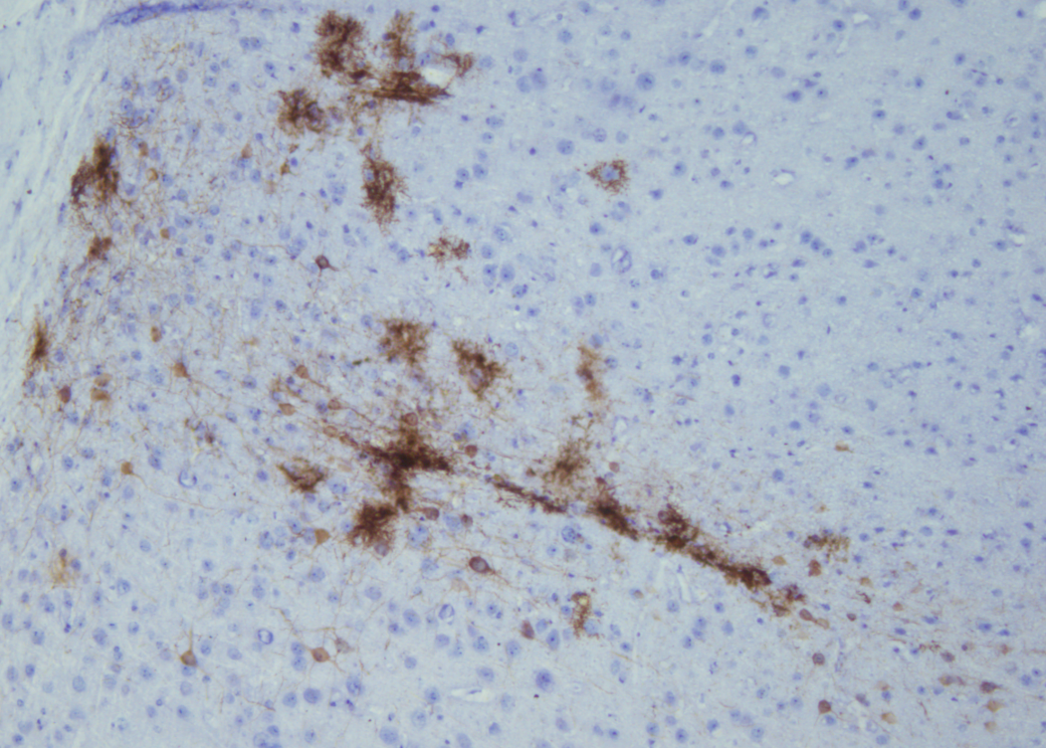
Medium spiny Neurons, Astrocytes or microglia show staining for GFP
Mouse 3J
100 µm

Slide 17
Exp # 21: mTmG staining for GFP
Mouse 1J

Slide 18
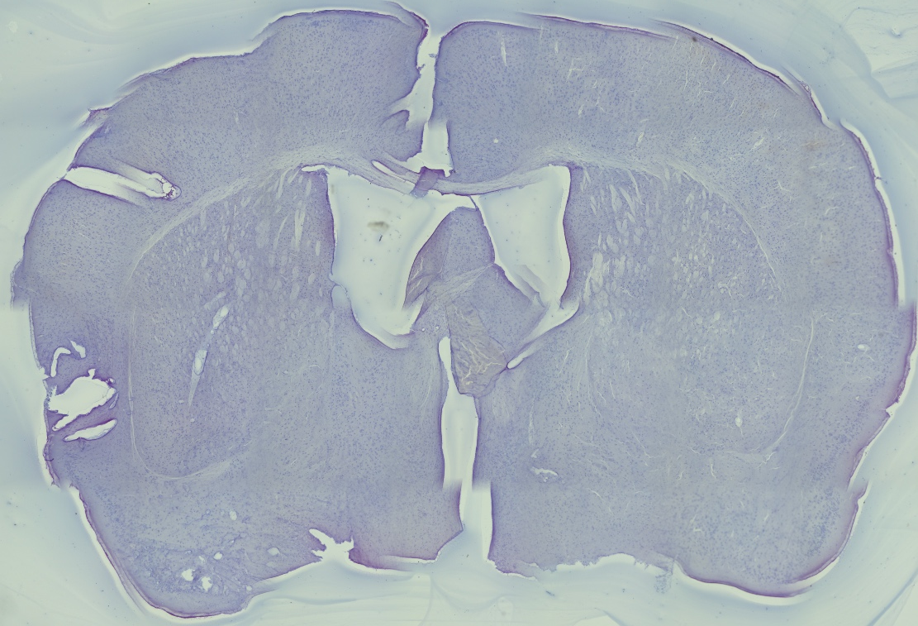
Exp # 21: mTmG staining for GFP
Control: DNMT1-C20/T2
100 µM
3 µl IS injected
Mouse 1J
5X tile
1 mm
mTmG reporter mouse, staining for GFP
Floating sections
1/1000 antibody dilution

Slide 19
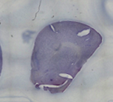
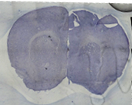
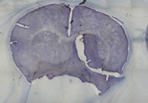
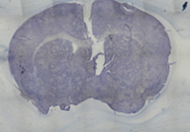
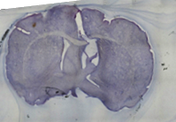
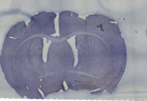
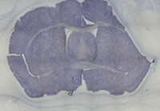
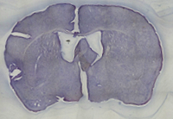
Mouse 1J
Control: DNMT1-C20/T2
100 µM
3 µl IS injected
Exp # 21: mTmG staining for GFP
Sections 1-4 (striatum, 120 um apart)
Sections 5-8
1 mm

Slide 20
Exp21-RNP1
Mouse ID missing
1 mm

Slide 21
Exp21-RNP1
Mouse ID missing
1 mm

