Slide 1
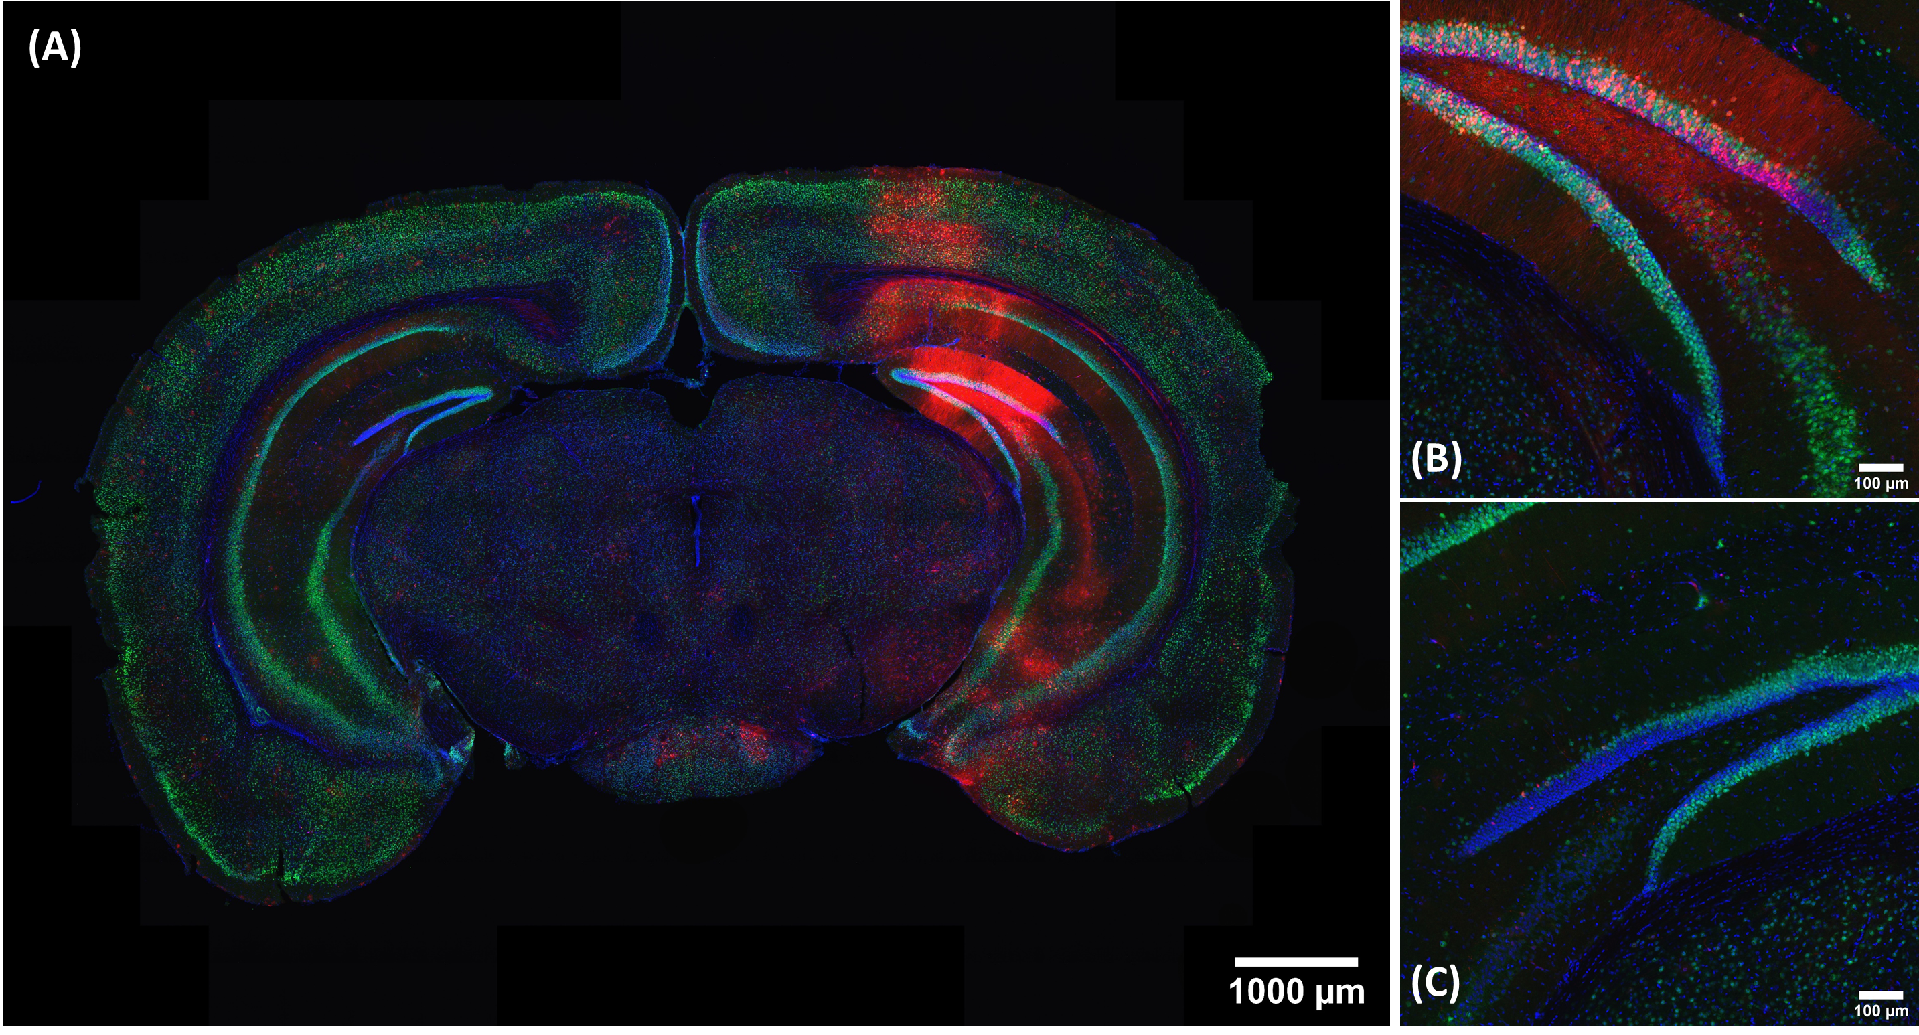
Notes:
Representative confocal image to confirm brain gene editing in male Ai9 mouse (mouse #C1R) with FUS array. (A) 10x whole coronal section image (section C1R5-5-3) to confirm Tomato activation only at the FUS-targeted site but not at the control site. The 1,200 um2 region of interest (ROI) with 20x magnification at (B) FUS-targeted and (C) control sites for neuron editing efficiency determination.

Slide 2
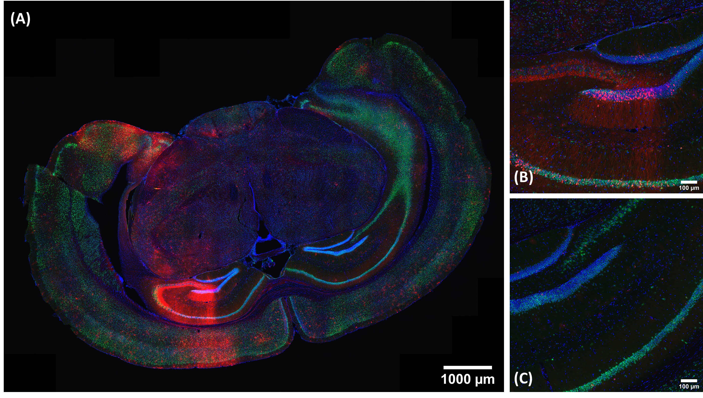
Notes:
Representative confocal image to confirm brain gene editing in female Ai9 mouse (mouse #C2B) with FUS array. (A) 10x whole section confocal image (section C2B5-5-2) to confirm Tomato activation only at the FUS-targeted site but not at the control site. The 1,200 um2 region of interest (ROI) with 20x magnification at (B) FUS-targeted and (C) control sites for neuron editing efficiency determination

