Slide 1
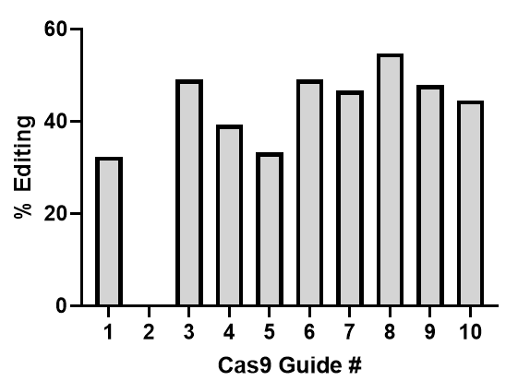
A
Guide identities
Cas9-Guide1 | GGGAGCCTCTTGCTGGAAAA
Cas9-Guide2 | GTAAACTGAACTTGCTCGCT
Cas9-Guide3 | GGGGAGCAGGAAATATCTGT
Cas9-Guide4 | GTCACCGGCACACTTGAGTC
Cas9-Guide5 | GTCATGTGCACAACTCTGAC
Cas9-Guide6 | GTTGATACACAGCCTGGGCT
Cas9-Guide7 | GAGAAAATAAACAATCATGA
Cas9-Guide8 | GAGAGTTTCTTGTAGGGGAA
Cas9-Guide9 | GGTAAGTAACCTCAGCTGCT
Cas9-Guide10 | GGAAACCCAGAGAAGACATT
Figure 1: Electroporation of plasmids containing ABE8e-Cas9 with 10 different gRNAs targeting CCR5 into rhesus primary skin fibroblasts. Editing efficiency was assessed using high throughput DNA sequencing.

Slide 2
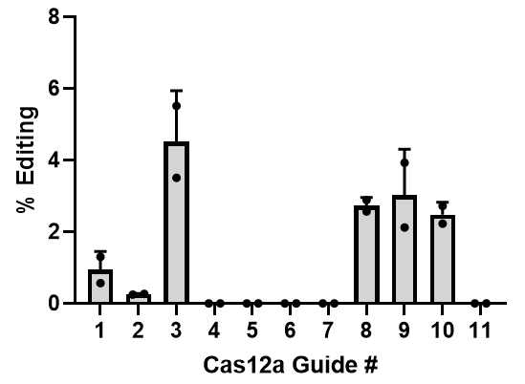
Guide identities
Cas12-Guide1 | GCCAAAAAGGGAGTTCATTCAA
Cas12-Guide2 | GTTTTGTGGGCAACATACTGGT
Cas12-Guide3 | TGGGCAACATACTGGTCGTCCT
Cas12-Guide4 | CTTCTTACTGTCCCCTTCTGGG
Cas12-Guide5 | GAAATACAATGTGTCAACTCTT
Cas12-Guide6 | TAGGCTTCTTCTCTGGAATCTT
Cas12-Guide7 | CTTTAAAAGCCAGGACAGTCAC
Cas12-Guide8 | GGGTGGTGACAAGTGTGATCAC
Cas12-Guide9 | CCTCTCTCCCAGGAATCATCTT
Cas12-Guide10 | CCAGATCTCAGAGAGAAGGTCT
Cas12-Guide11 | GCCTGAATAATTGCAGTAGCTC
Figure 2: Electroporation of plasmids containing ABE8e-Cas12a with 11 different gRNAs targeting CCR5 into rhesus primary skin fibroblasts. Editing efficiency was assessed using NGS.

Slide 3
Figure 3: Delivery of Cas9 RNP using Shuttle peptide candidates to human airway epithelial cells cultured at the air liquid interface targeting CFTR locus. Editing efficiency was assessed using NGS. Blue bar highlights the best peptide shuttle selected for the study.

Slide 4
Figure 4: Delivery of ABE8e-Cas9 RNP using Shuttle peptide candidates to human airway epithelial cells cultured at the air liquid interface targeting B2M locus. Editing efficiency was assessed using sanger sequencing. Blue bar highlights the best peptide shuttle selected for the study.

Slide 5
Figure 5: Delivery of ABE8e-Cas9 RNP using Shuttle peptide candidates to rhesus monkey airway epithelial cells cultured at the air liquid interface targeting CCR5 locus. Editing efficiency was assessed using NGS. Blue bar highlights the best peptide shuttle selected for the study.

Slide 6
Figure 6: Inhibitory effect of Cas9 RNP alone on S10- or FSD315-mediated GFP protein delivery to HeLa cells. GFP protein (10 μM), S10 or FSDS315 (10 μM) with or without Cas9 RNP (containing 2.5 μM Cas9 and 2 μM gRNA) were added to HeLa cells and GFP delivery quantified by flow cytometry.

Slide 7
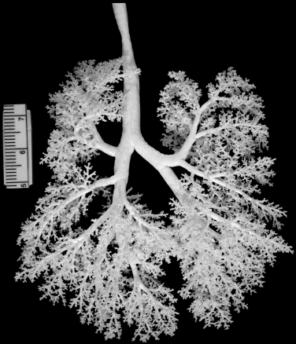
RIGHT
LEFT
1
1 - Trachea
2 - Left mainstem bronchus
2.1- Left upper lobe
2.2- Left middle lobe (lingula)
2.3- Left lower lobe
2.4- Left lower lobe subsegm airway
3 - Right mainstem bronchus
3.1- Right upper lobe
3.2- Right middle lobe
3.3- Right lower lobe
3.1
2
2.1
3
2.2
3.2
2.3
3.3
2.4
Lung cast adapted from: JP Carson et al, 2010
Figure 7.

Slide 8
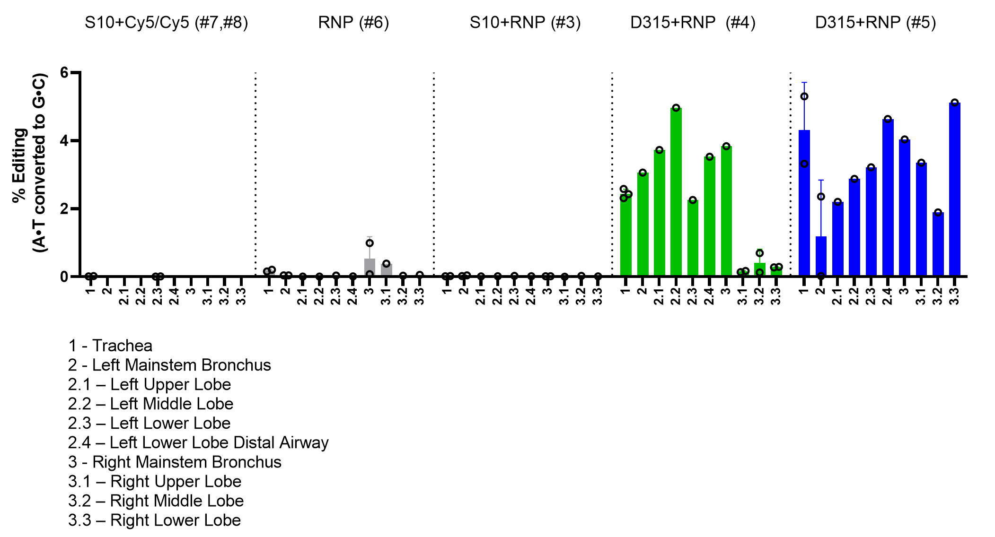
S10+DRI-NLS-Cy5
FSD315+RNP
FSD315+RNP
Figure 8.

Slide 9
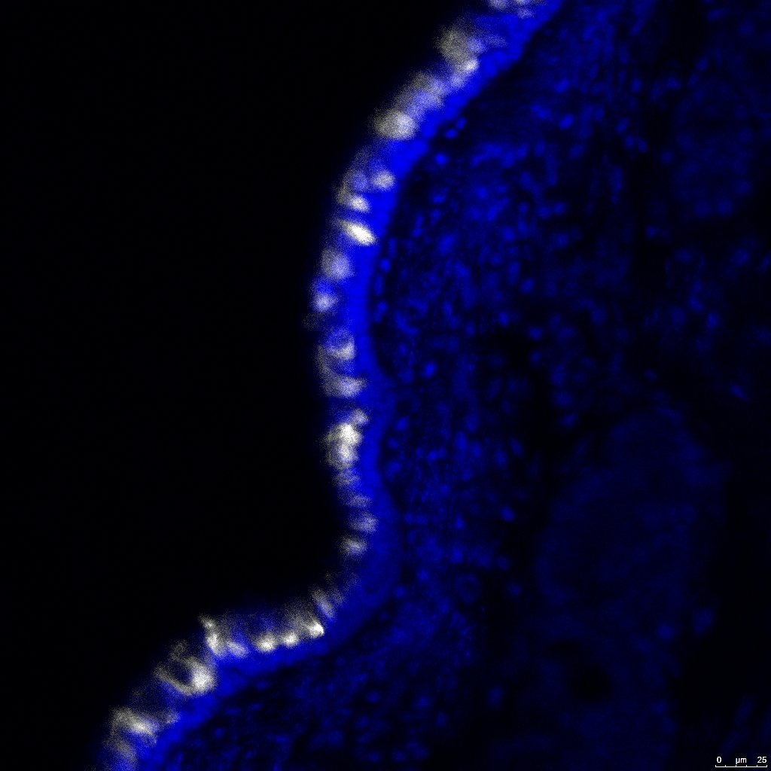
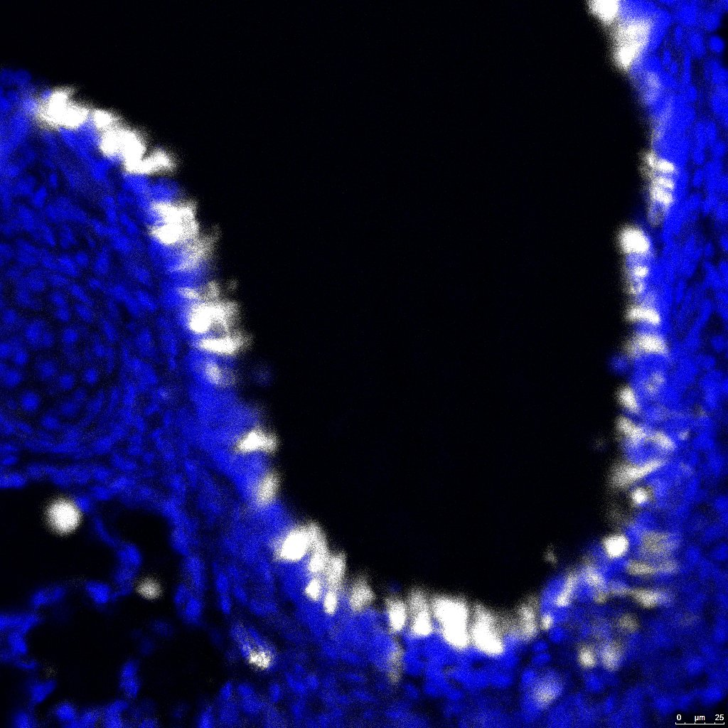
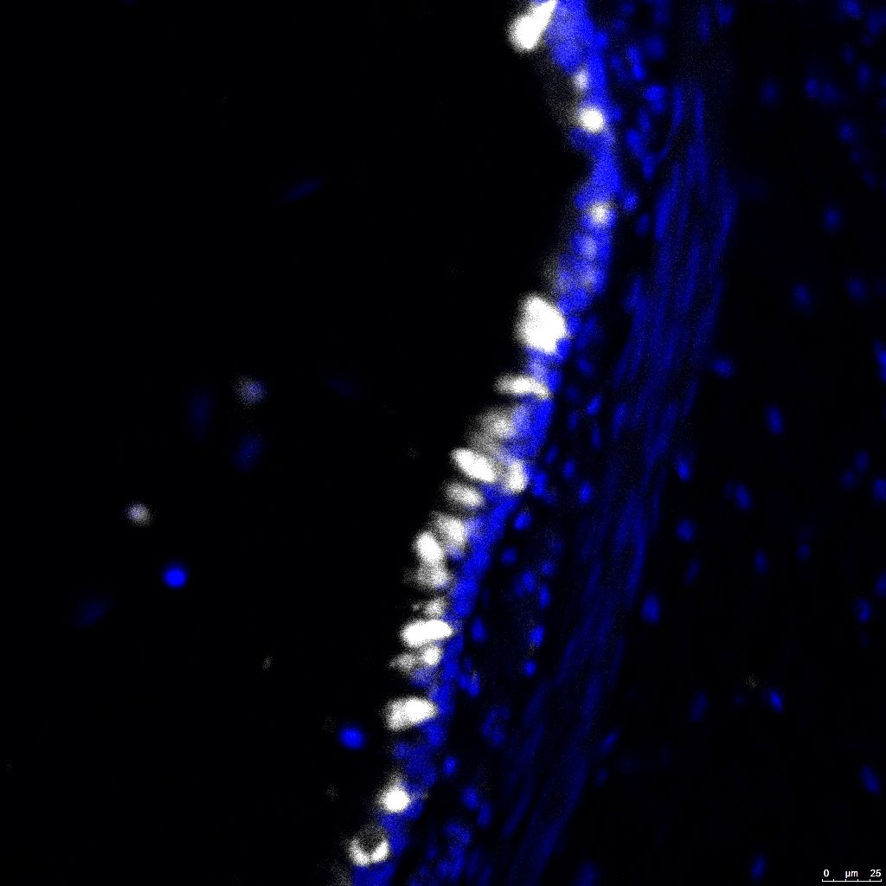
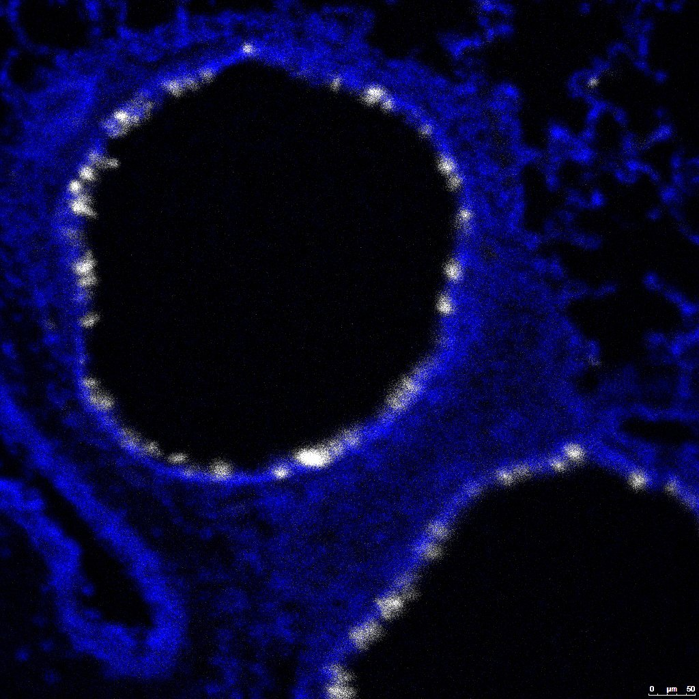
Trachea
Large Airway
Medium Size Airway
Small Airway
S10 + DRI-NLS-Cy5
DRI-NLS-Cy5
Figure 9.

Slide 10
DRI-NLS-Cy5 – white color
* Ciliated cells
# Secretory cells
DAPI - Nuclei
Figure 10.

Slide 11
# Alveolar Type 2
*
* Macrophage
#
DRI-NLS-Cy5 – white color
# Alveolar Type II Cell
* Macrophage
DAPI - Nuclei
*
*
*
Figure 11.

