Slide 1
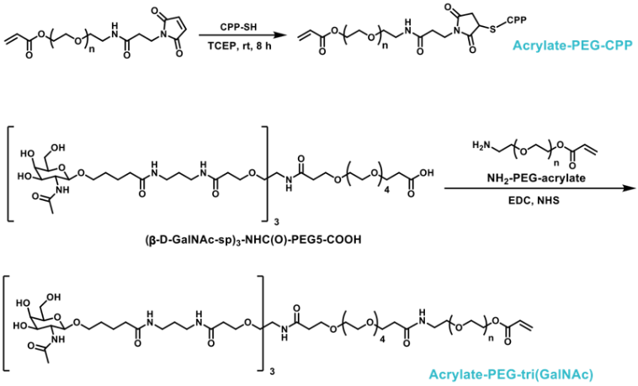
Fig. 1. Synthesis scheme for acrylate-PEG-ligand [CPP and tri(GalNAc)].
It shows the synthesis schemes for acrylate PEG-ligand (i.e., CPP or tri(GalNAc)). Acrylate-PEG-CPP was synthesized via a Michael addition reaction. Trimeric GalNAc (i.e., tri(GalNAc)) was conjugated to the terminal end of acrylate-PEG via an amine-succinimidyl ester reaction.

Slide 2
Fig. 2. A schematic illustration for the synthesis of RNP-NC
NLS-Cas9-NLS protein was mixed with the desired sgRNA at a 1:1 molar ratio and allowed to complex for 5 min. The Cas9 RNP complex (2.4 µg) was diluted in 0.2 mL sodium bicarbonate buffer (10 mM, pH=9.0). The monomers, crosslinker and initiators were accurately weighed and dissolved in degassed sodium bicarbonate buffer (2 mg/ml). Monomers were added into the above solution under stirring in the order of acrylic acid (AA), N-(3-aminopropyl)methacrylamide hydrochloride (APMA), and 1-vinylimidazole (VI) at 5 min intervals.

Slide 3
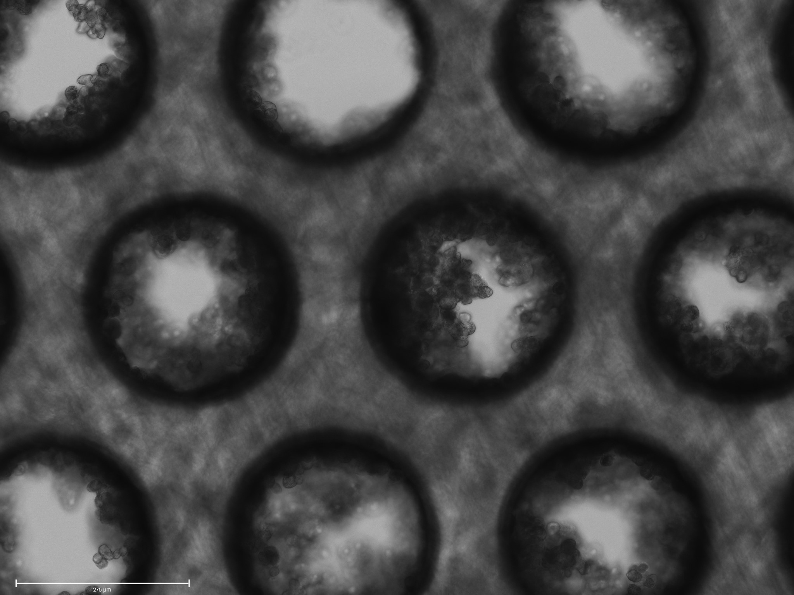
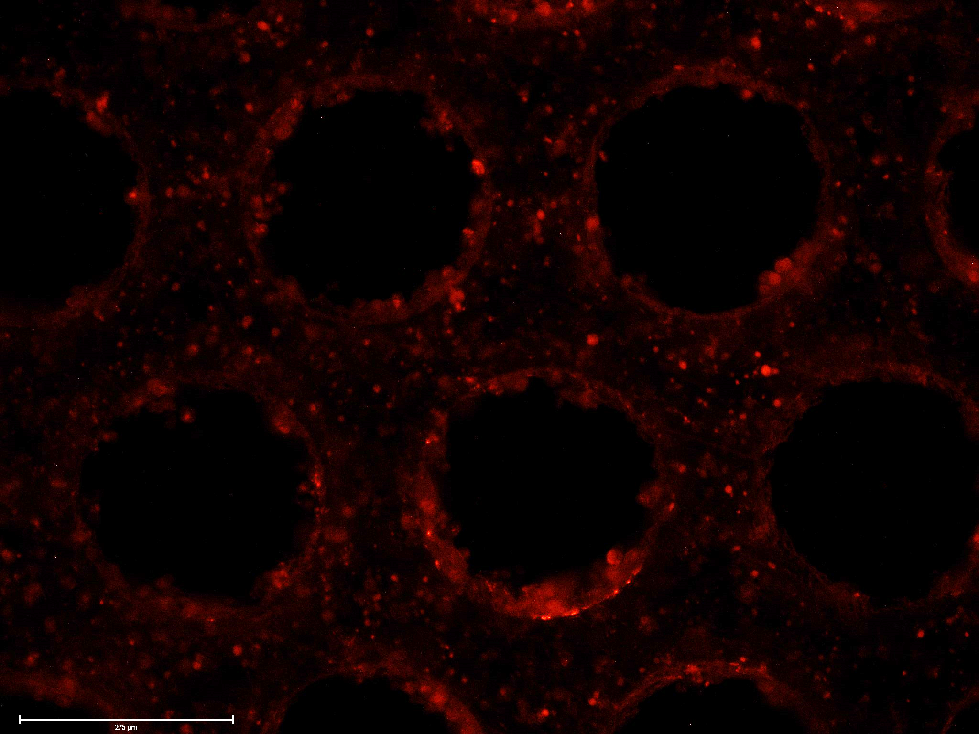
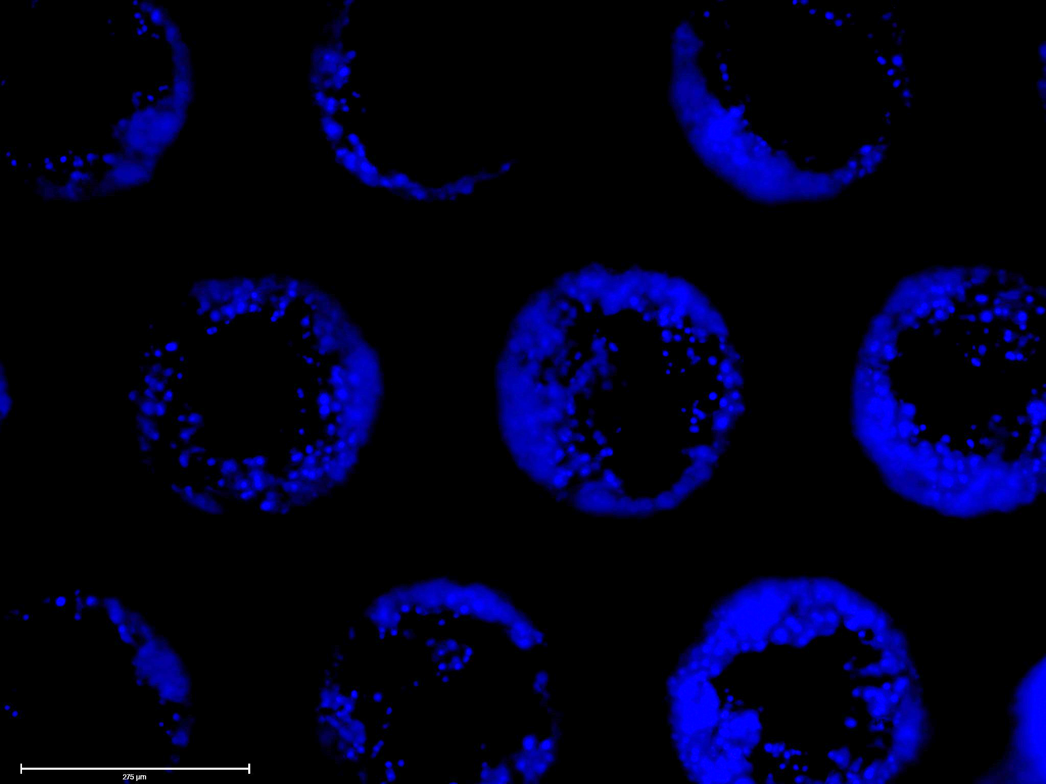
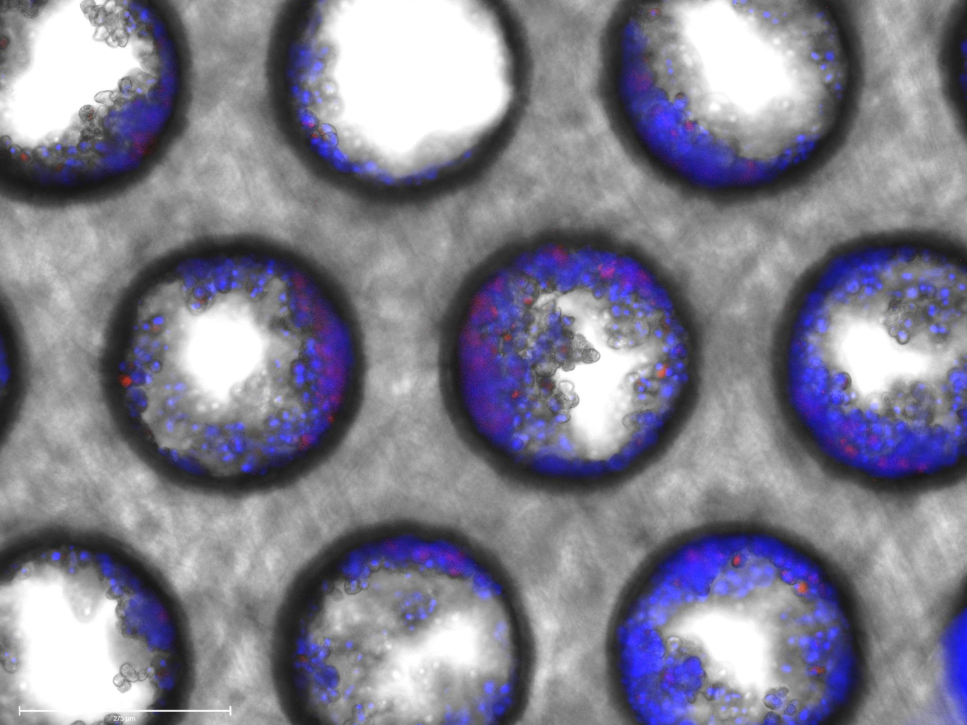
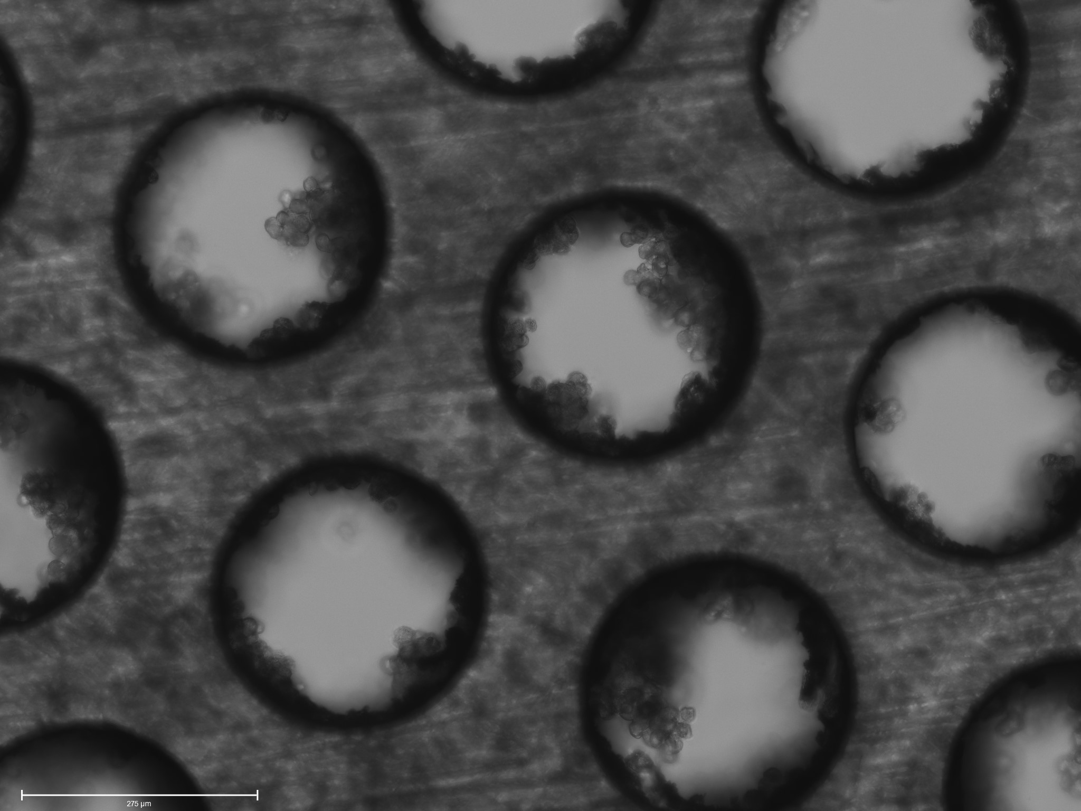
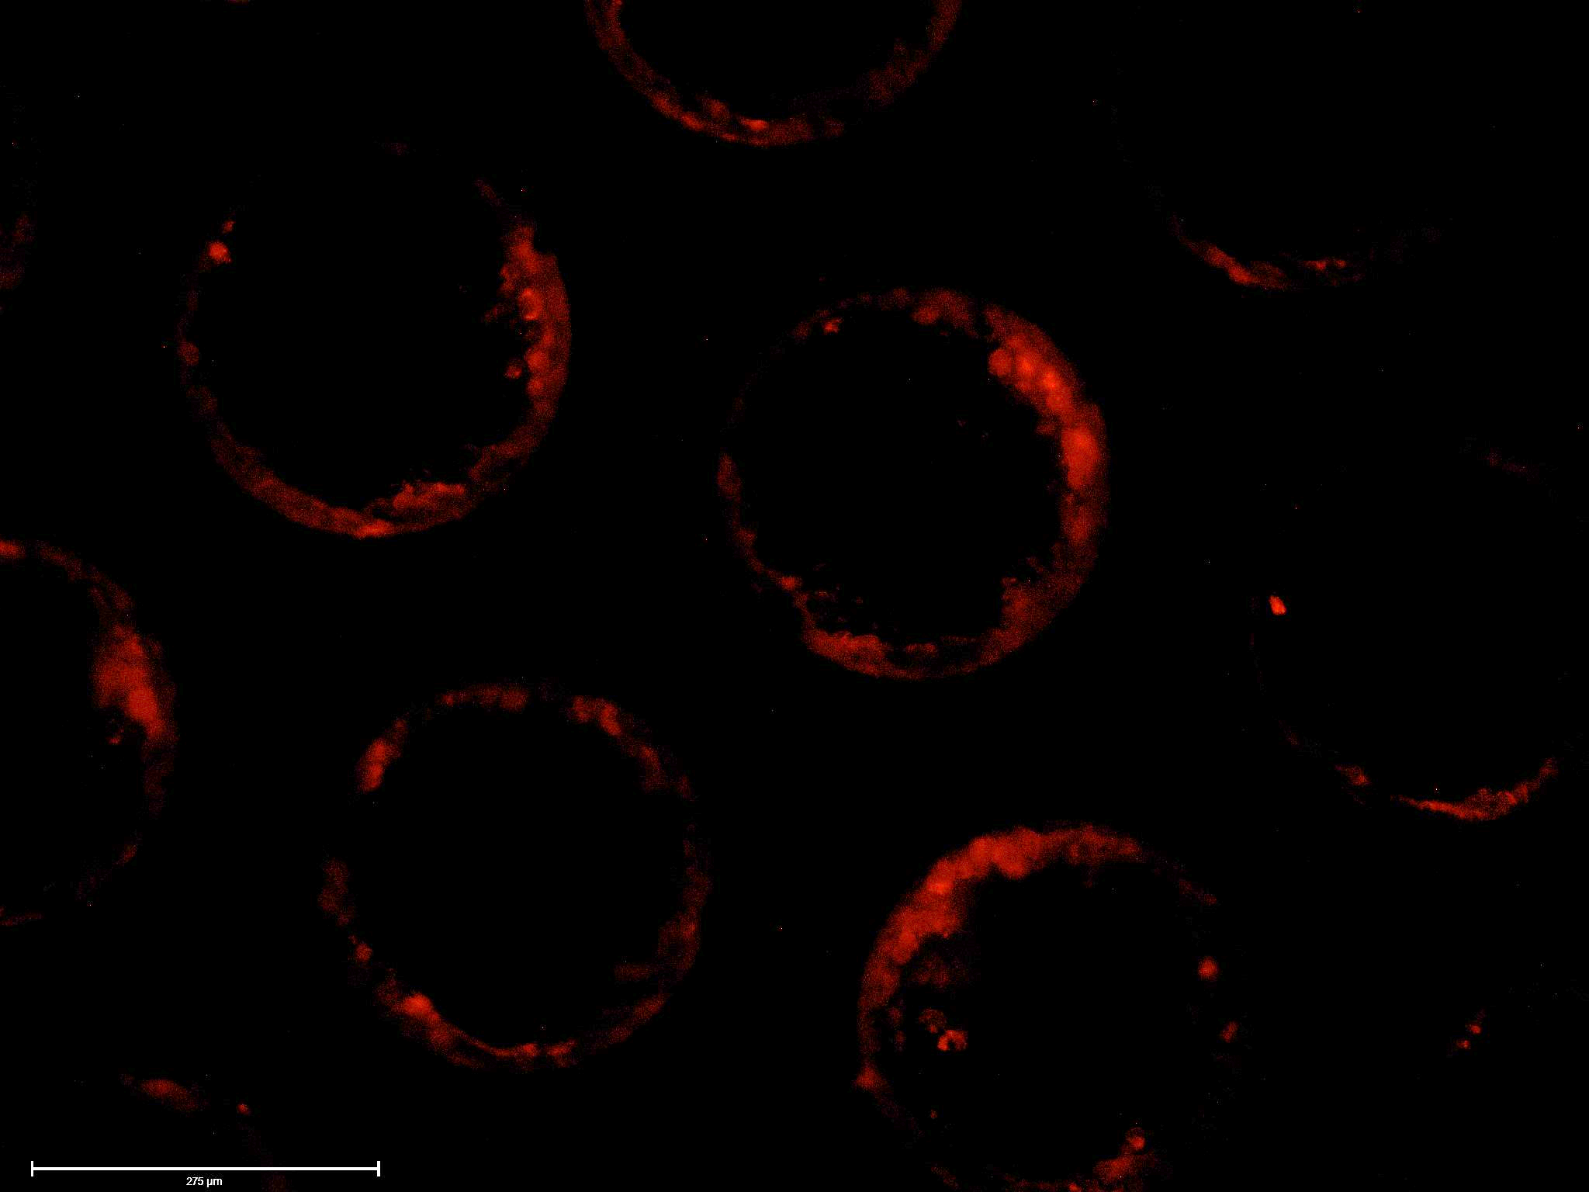
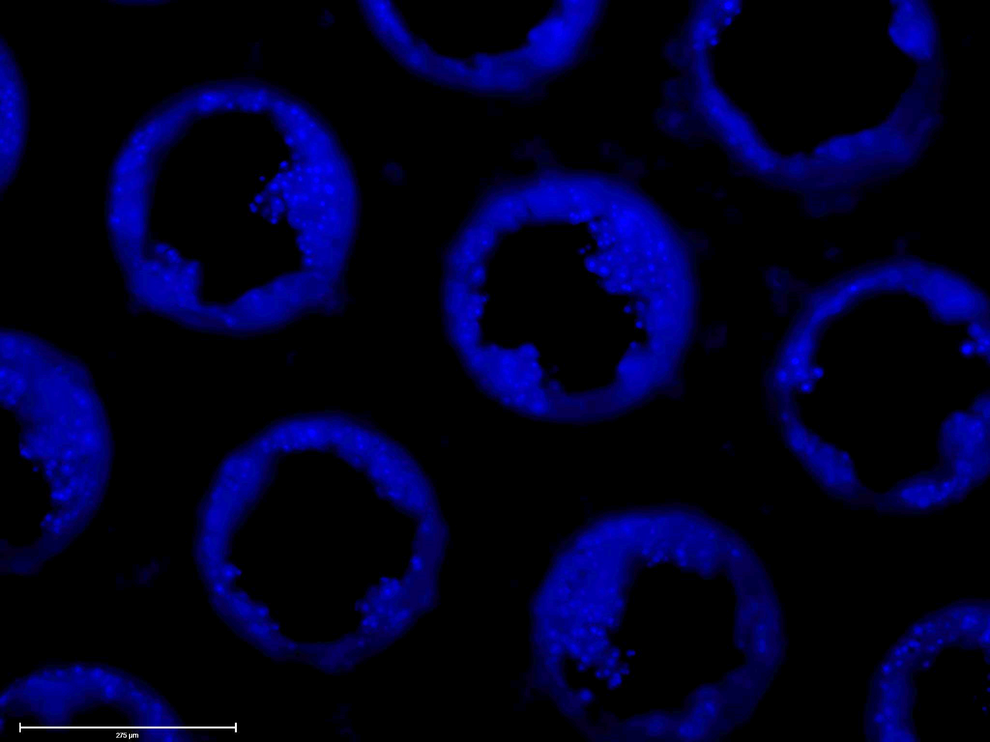
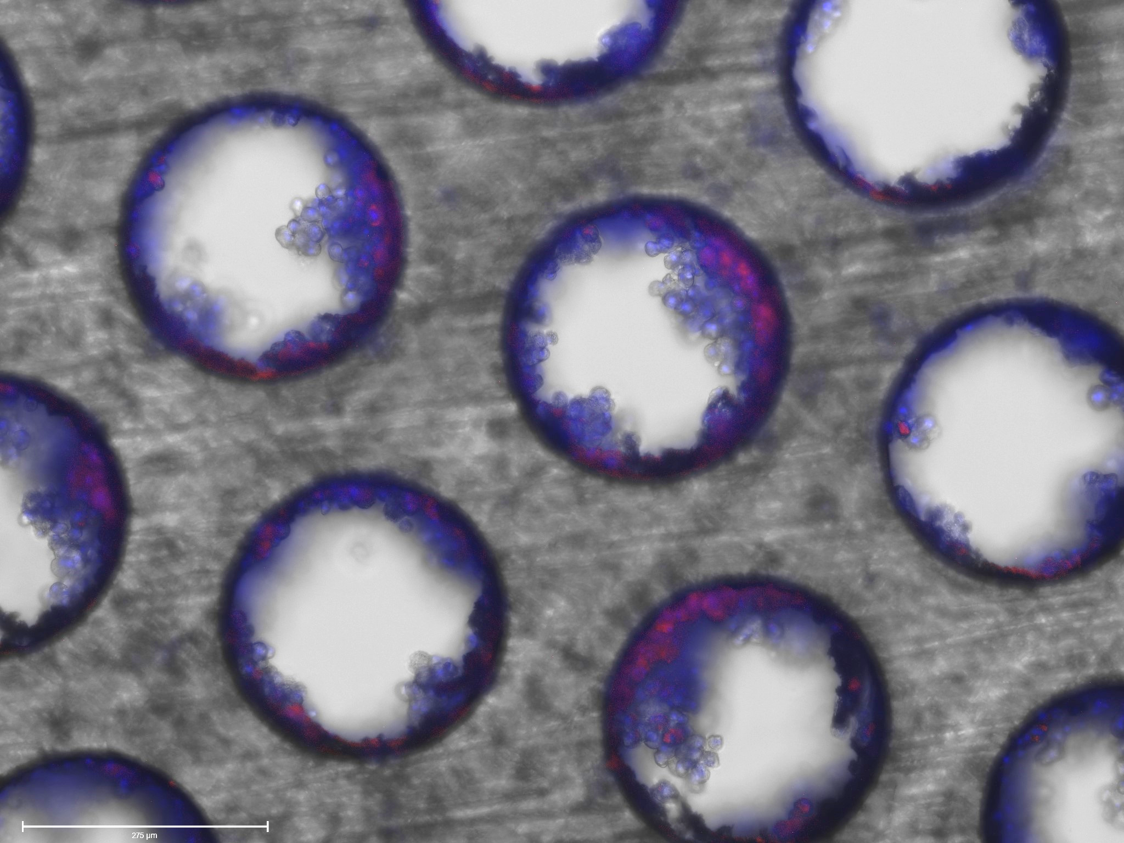
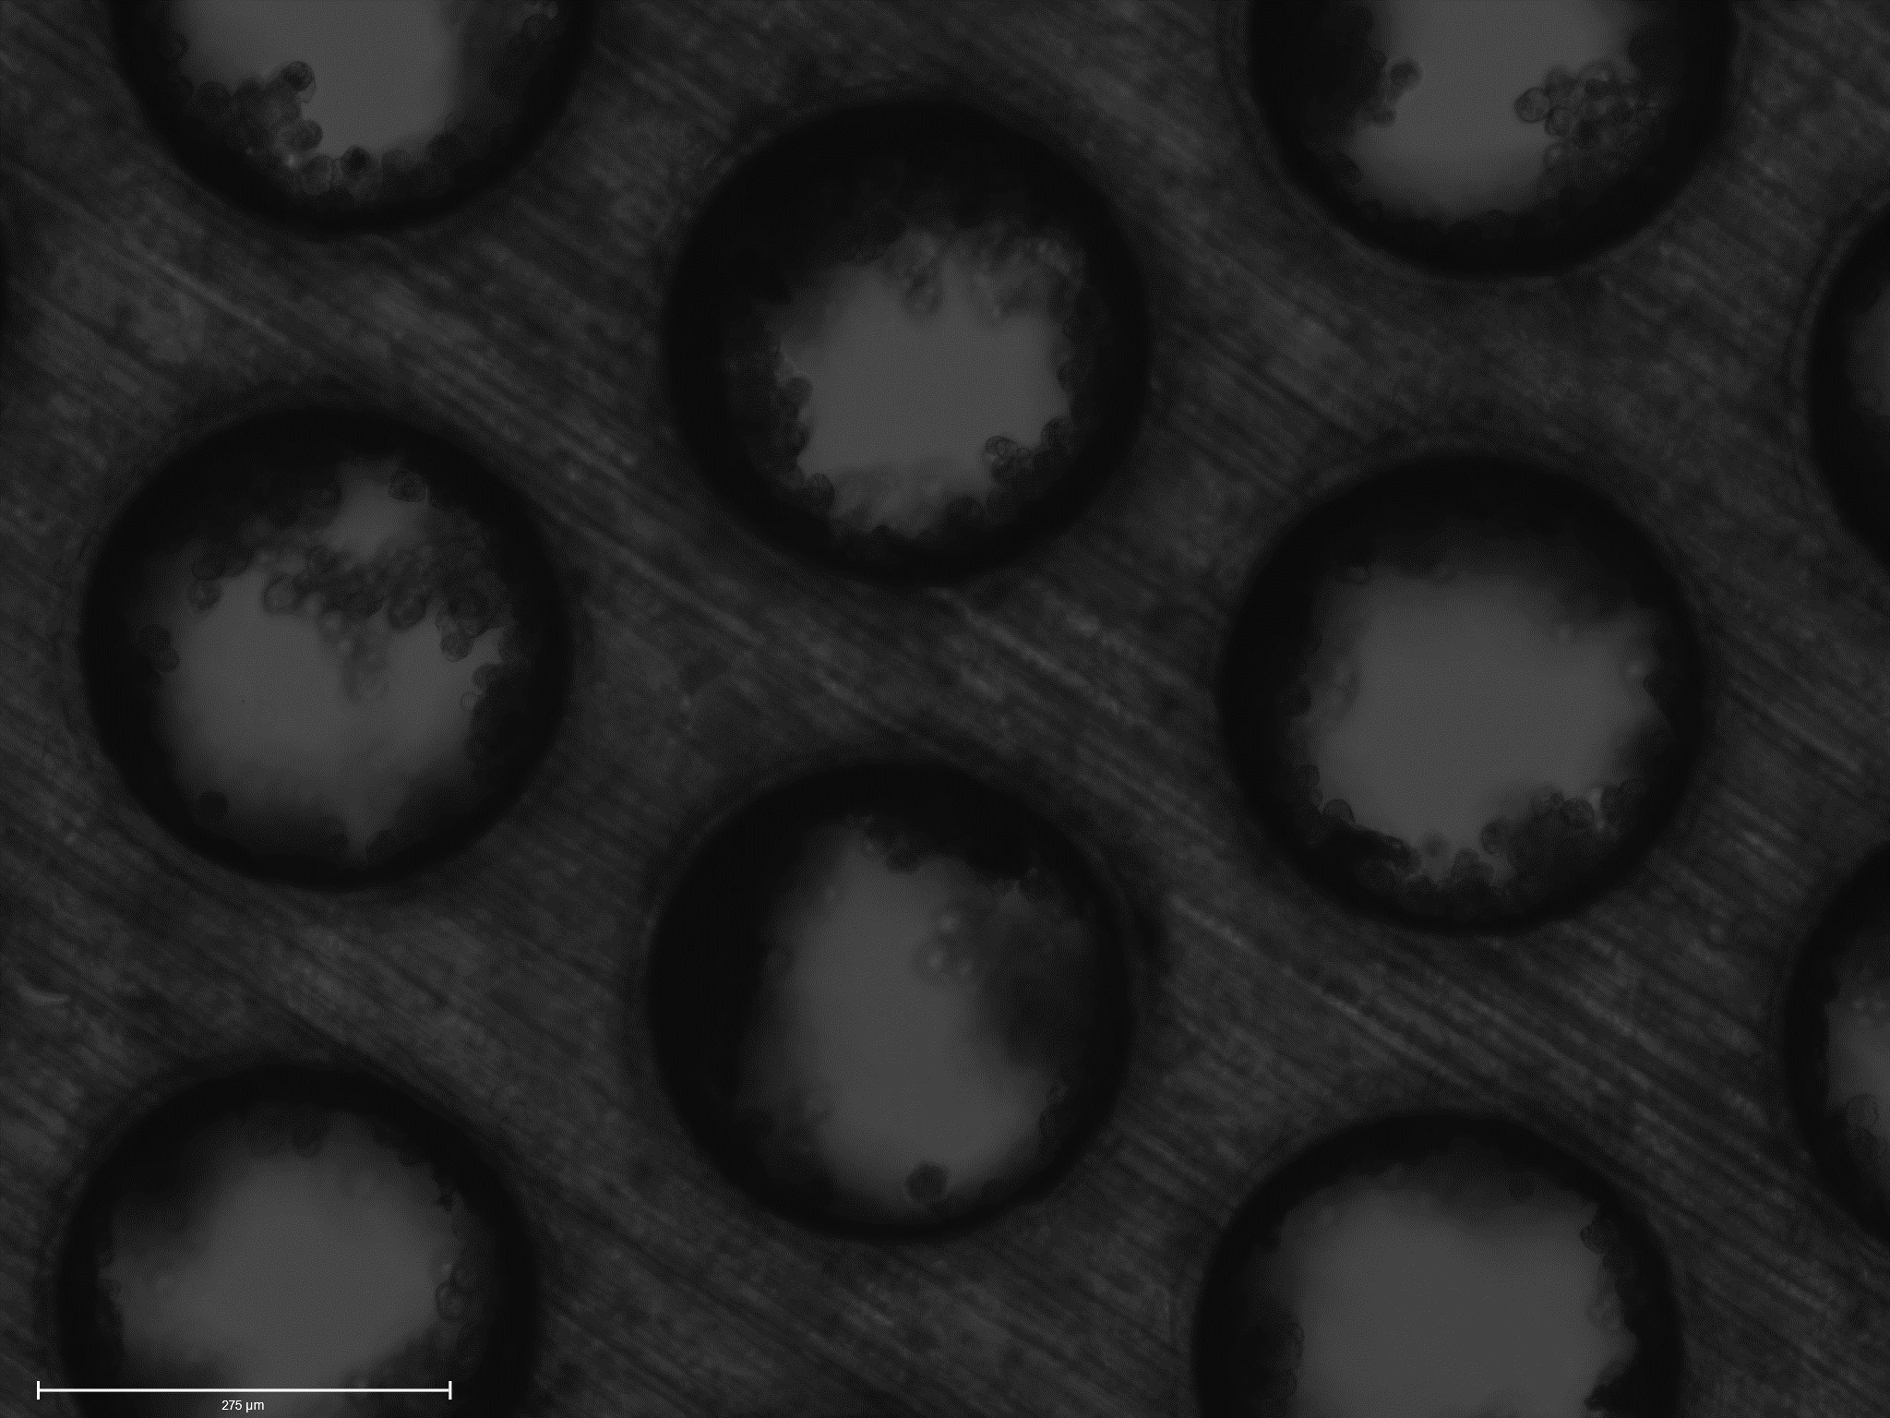
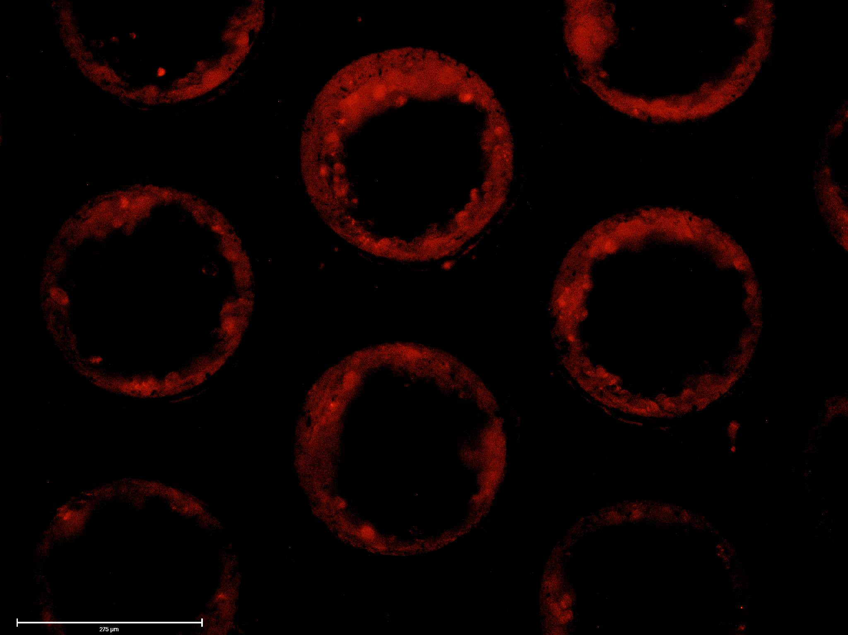
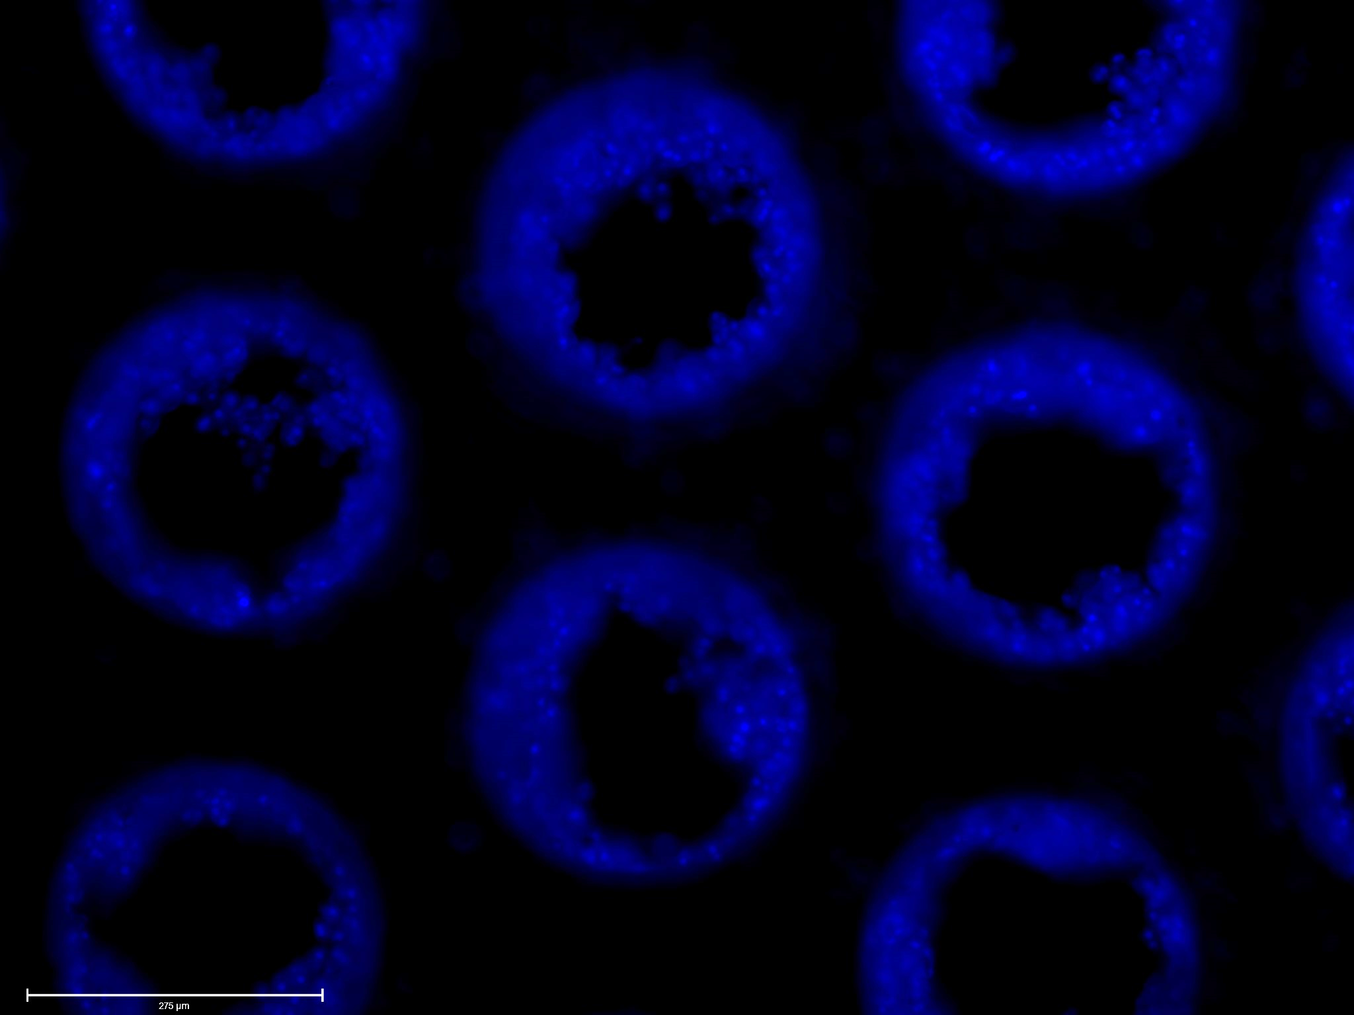
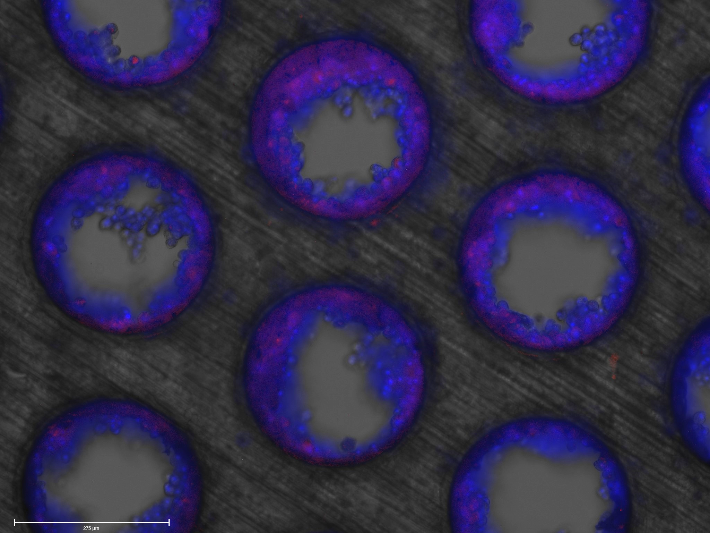
Brightfield
ATTO-550
DAPI
Merged
A
2.4 µg [RNP-NC: Lipofectamine] 1:1
10x
B
2.4 µg [RNP-NC: Lipofectamine] 2:1
10x
C
2.4 µg [RNP-NC: Lipofectamine] 5:1
10x

Slide 4
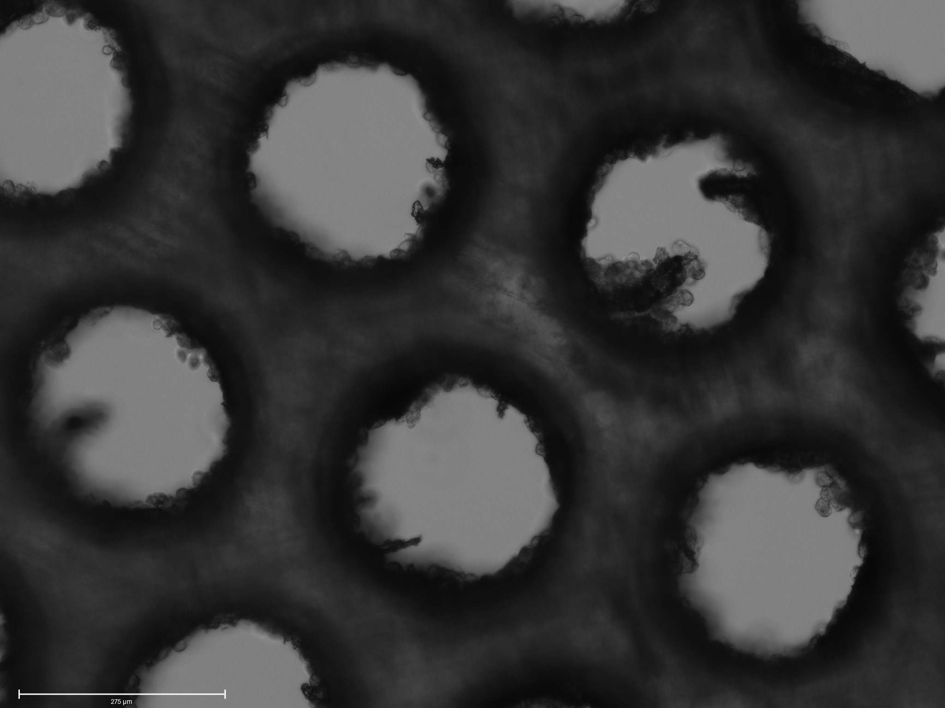
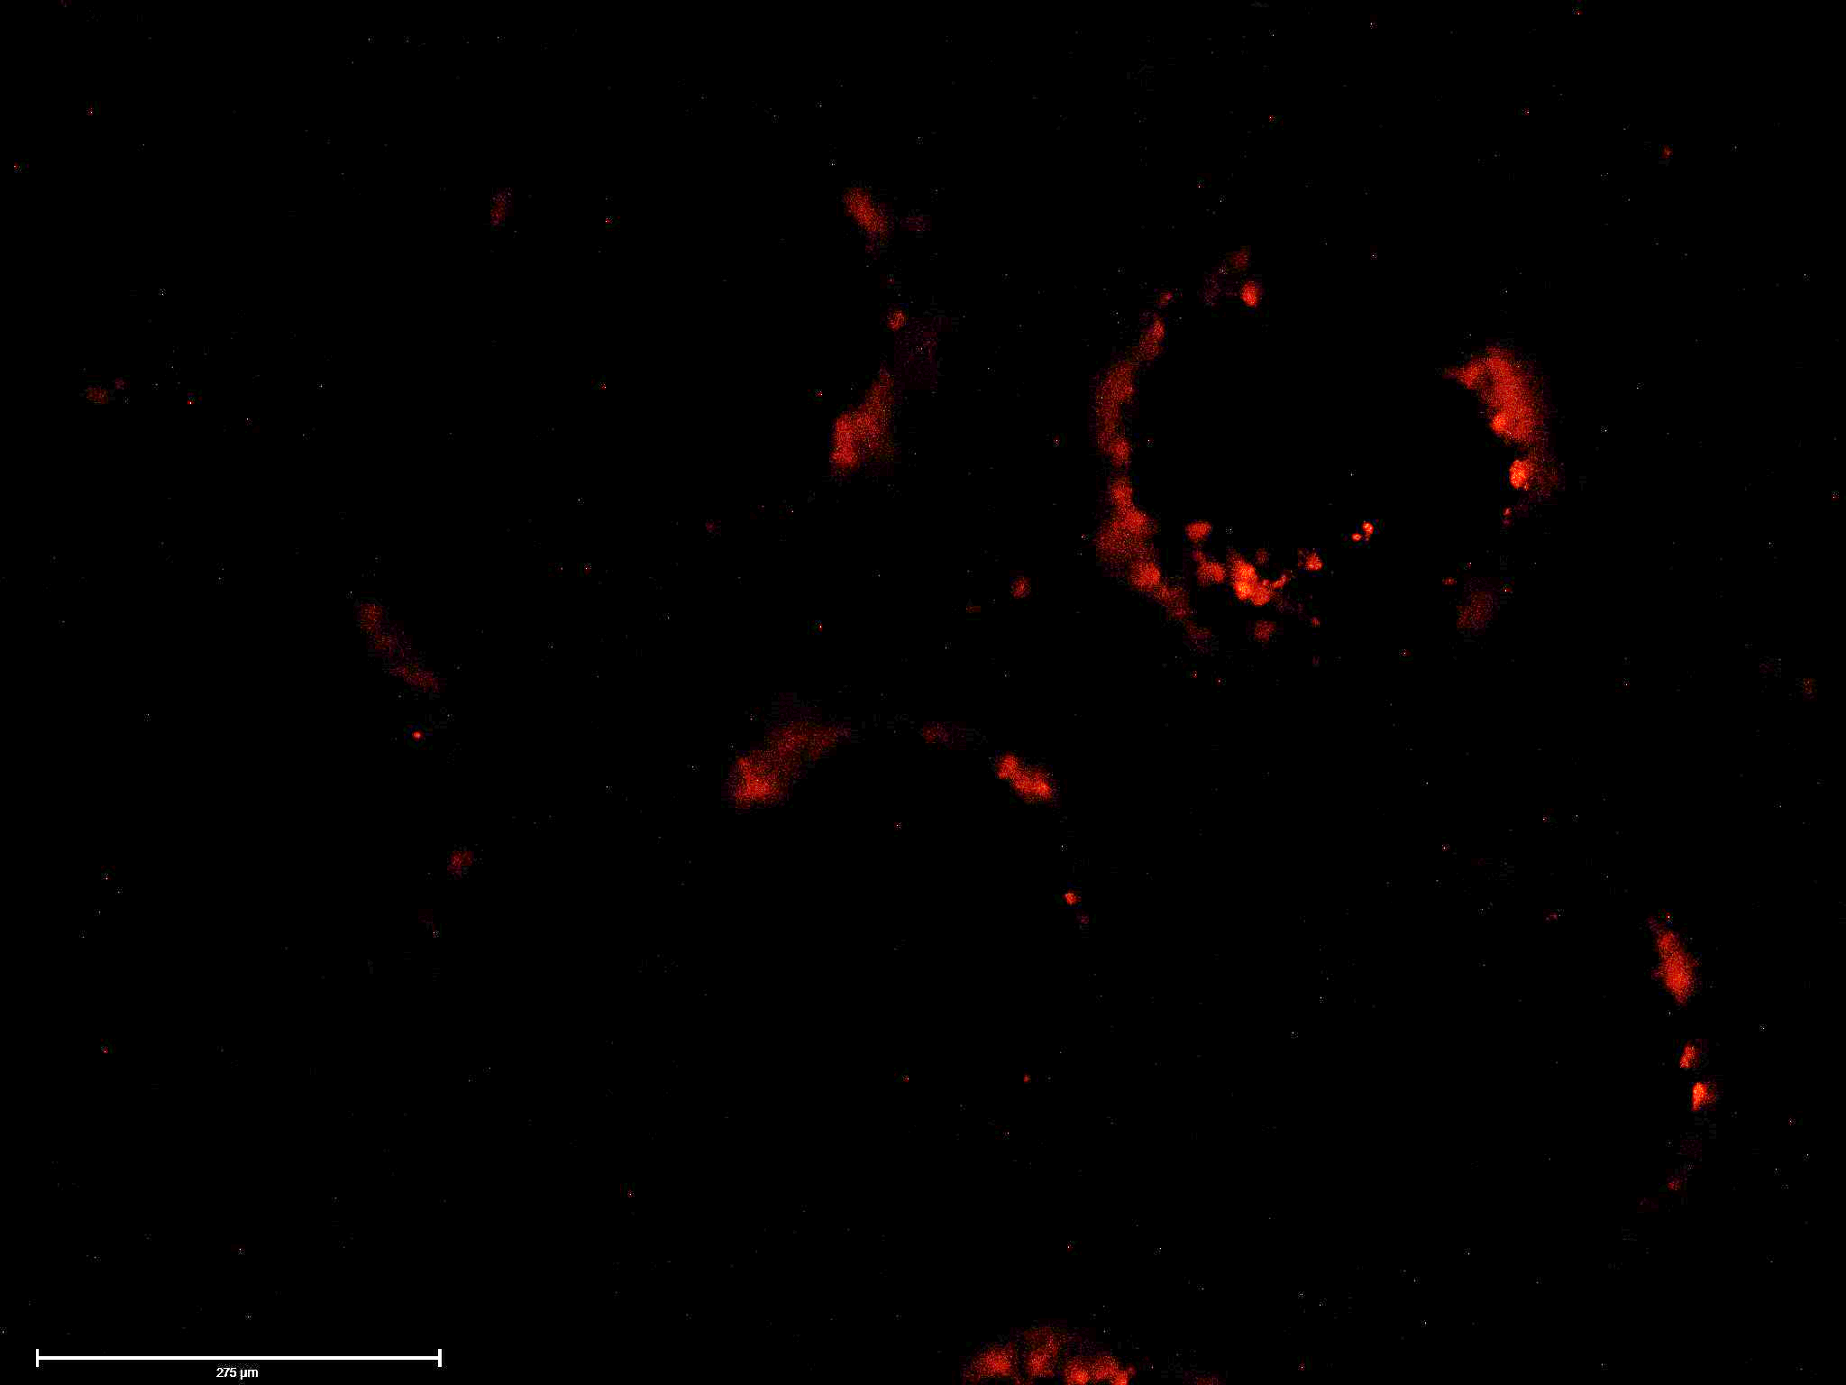

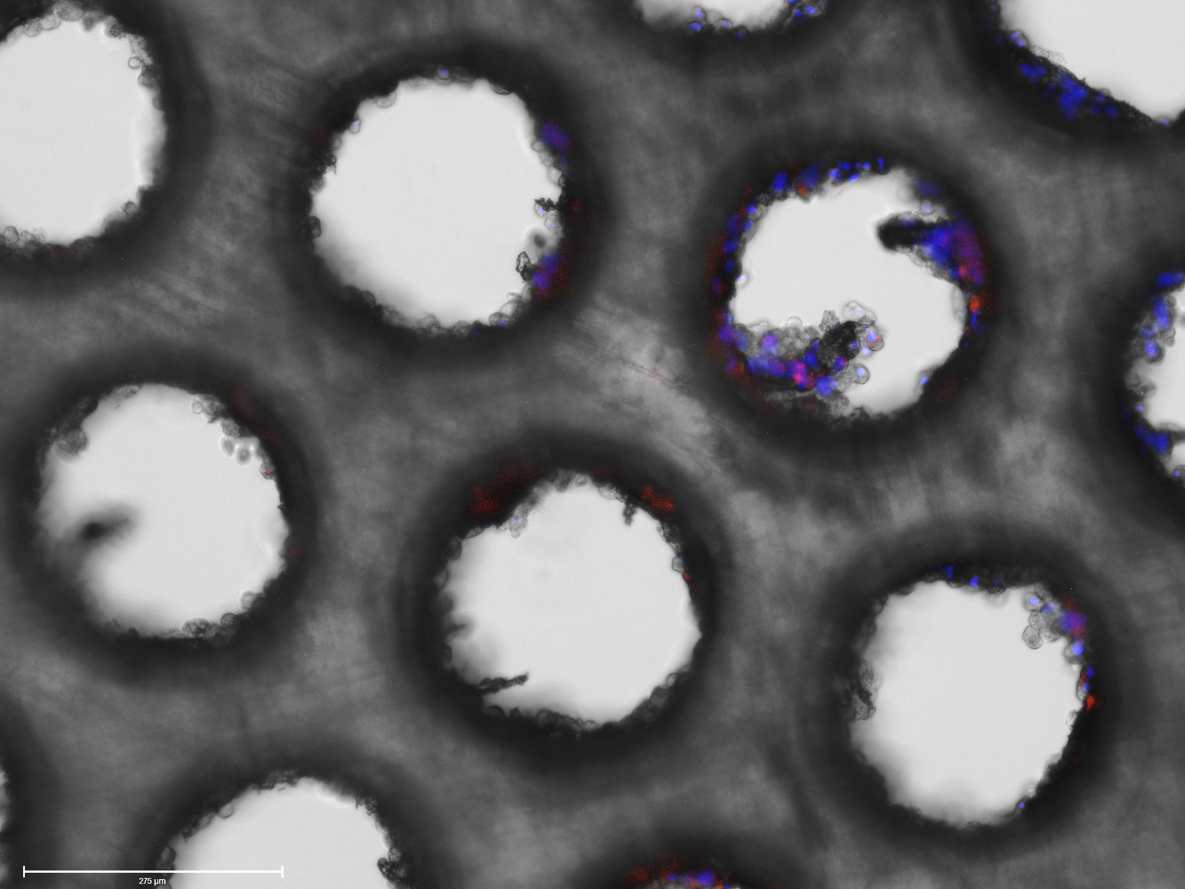
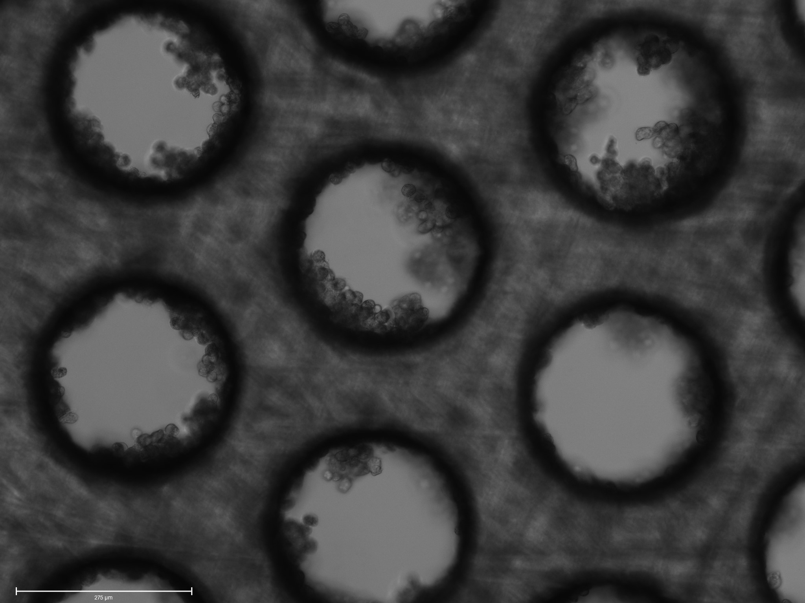
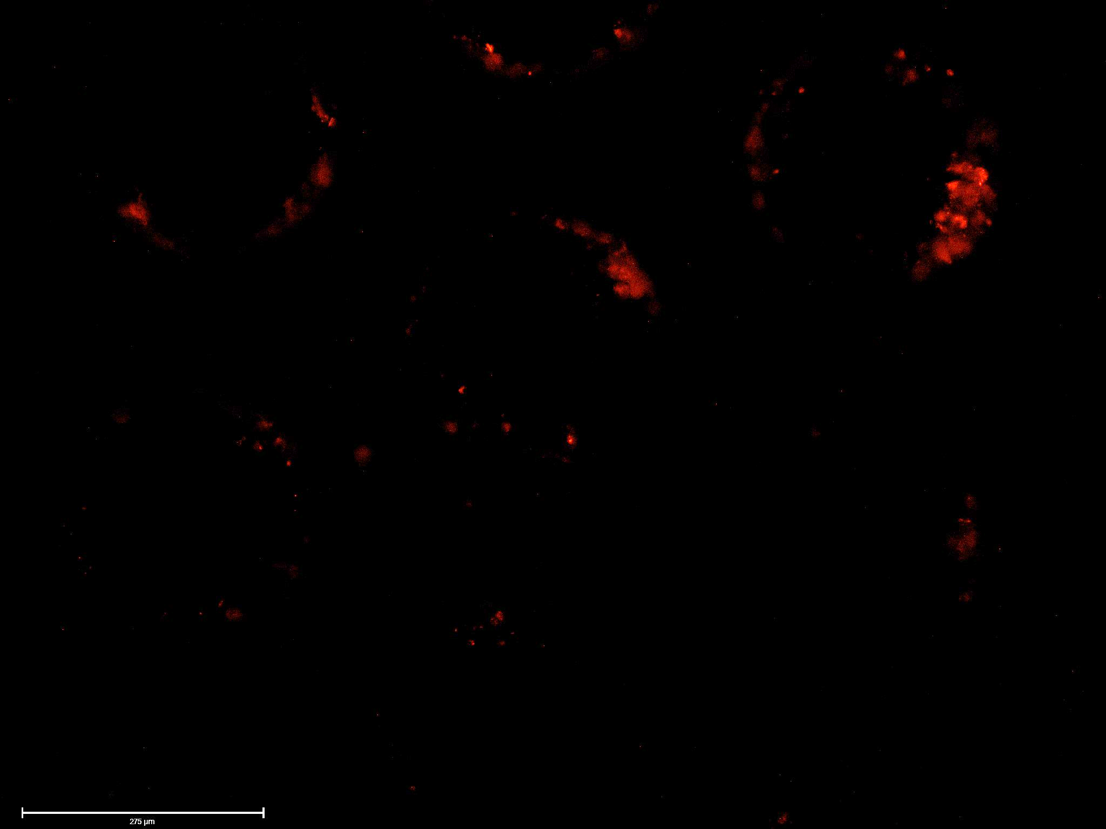
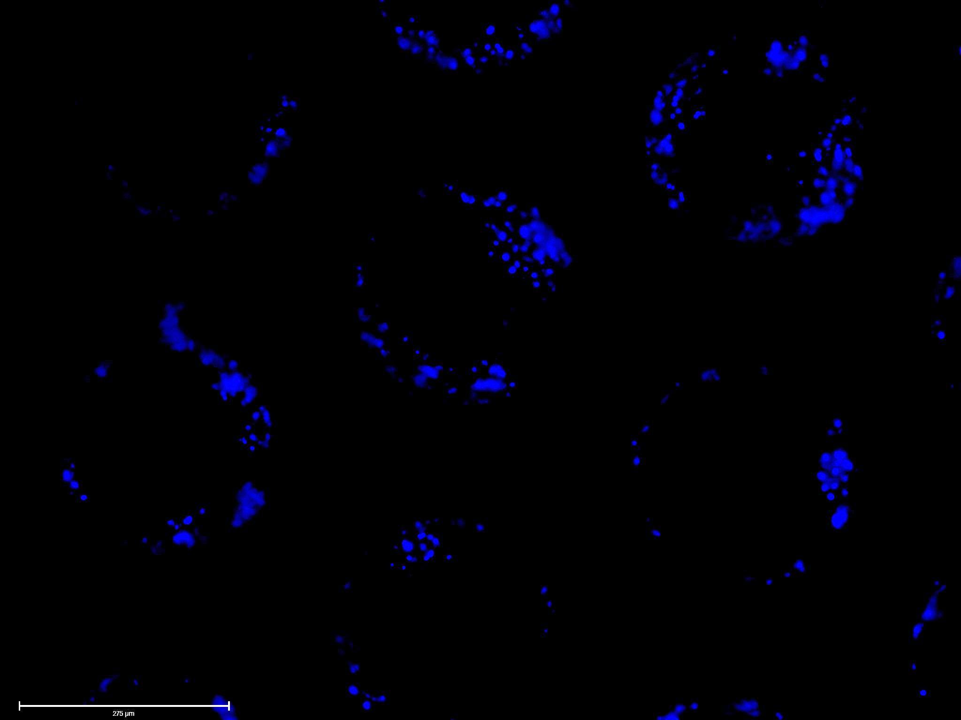
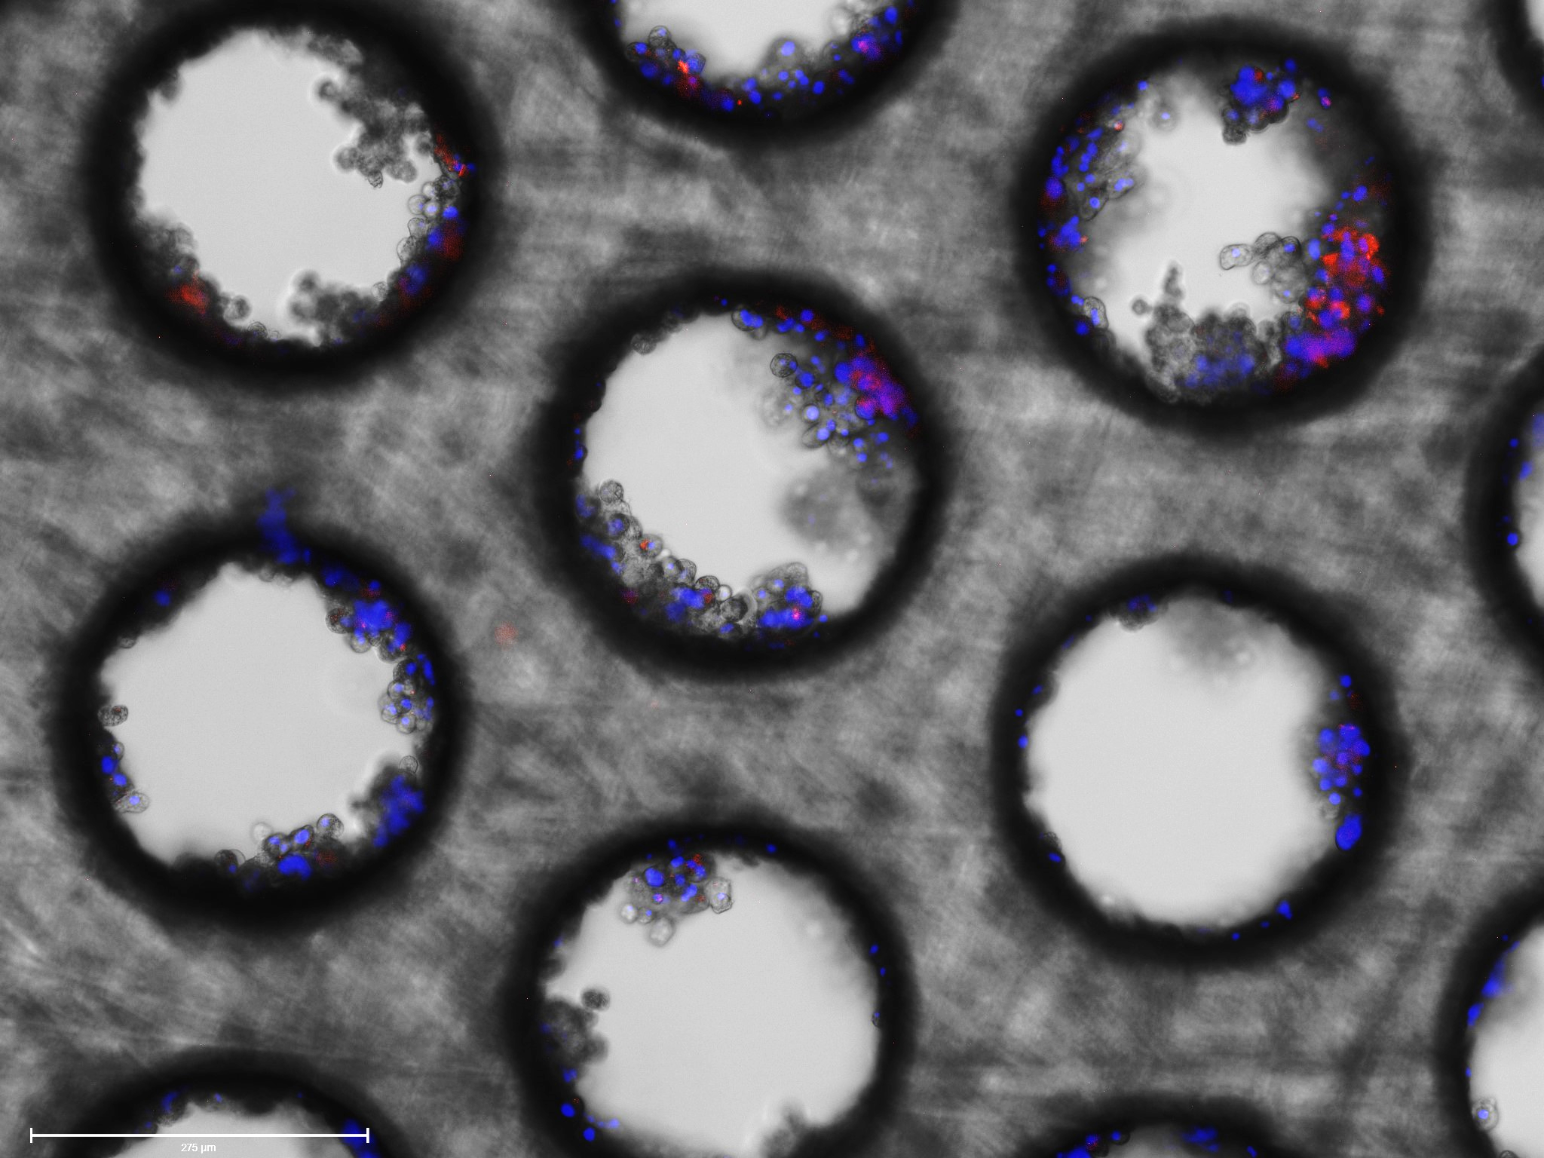
Brightfield
ATTO-550
DAPI
Merged
D
[RNP-NC: TAT Ligand] 2.4 µg
10x
E
[RNP-NC: TriGal NAC Ligand] 2.4 µg
10x
Fig. 3. Transfection of RNP NC in Primary Human Hepatocytes (PHH) shows little but detectable uptake
A) Shows transfection of 2.4 µg RNP-NC tagged with no ligand but labeled with Atto 550 in PHH when used in a 1:1 ratio with lipofectamine. B) Shows transfection of 2.4 µg RNP-NC tagged with no ligand but labeled with Atto 550 in PHH when used in a 2:1 ratio with lipofectamine. C) Shows transfection of 2.4 µg RNP-NC tagged with no ligand but labeled with Atto 550 in PHH when used in a 5:1 ratio with lipofectamine. D) Shows transfection of 2.4 µg RNP-NC tagged with TAT ligand and labeled with Atto 550 in PHH. E) Shows transfection of 2.4 µg RNP-NC tagged with TrigalNac ligand and labeled with Atto 550 in PHH.

