Slide 1
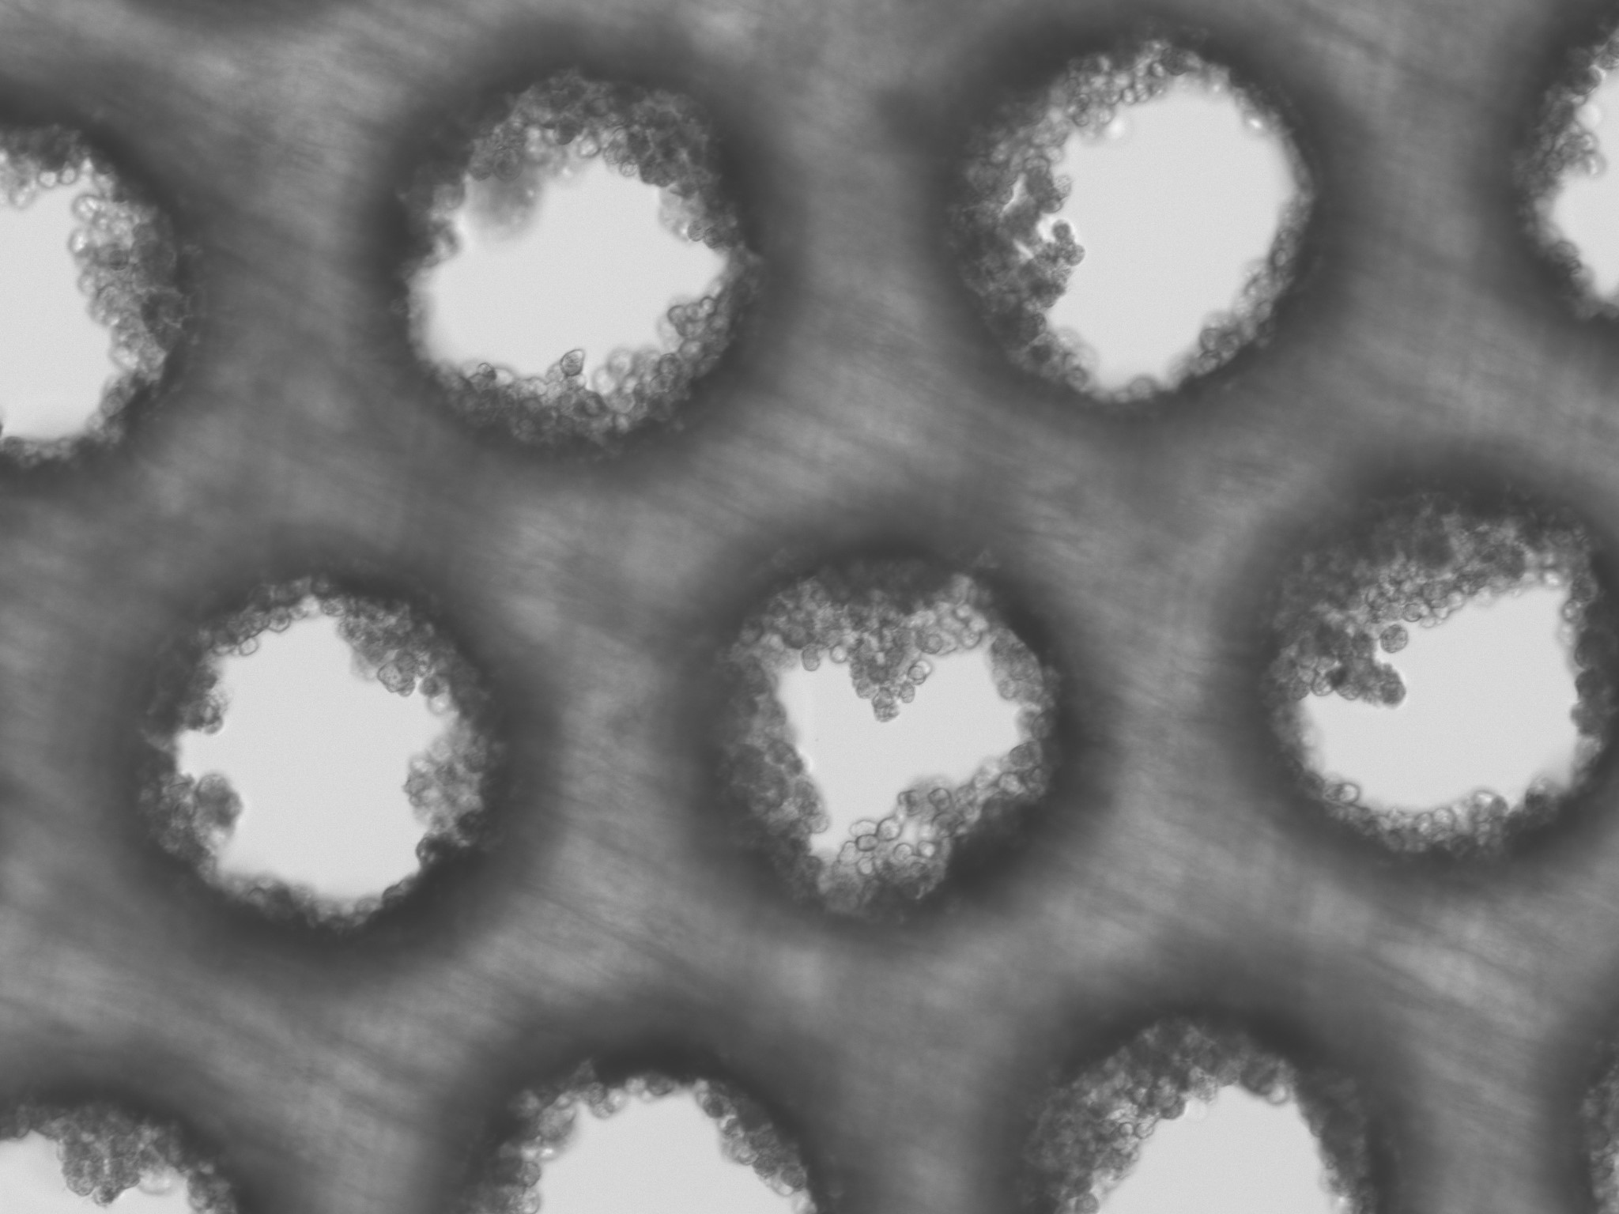
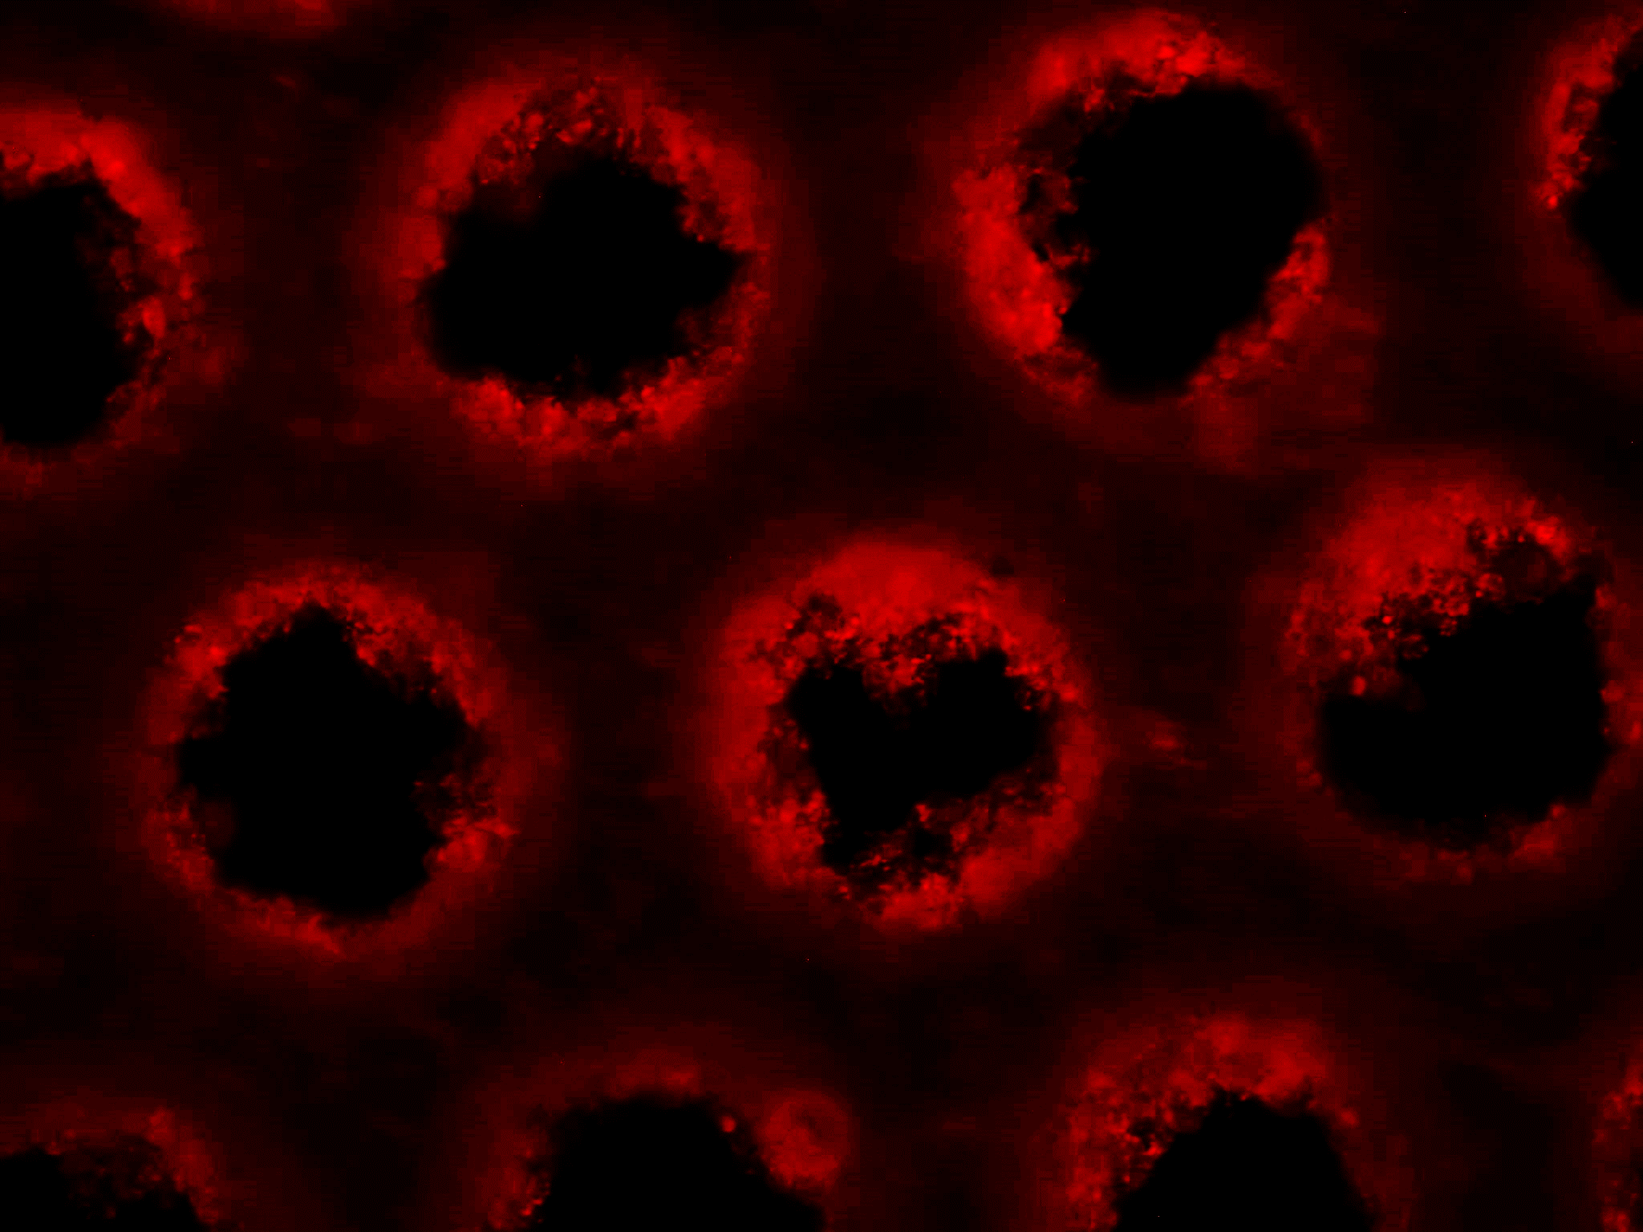
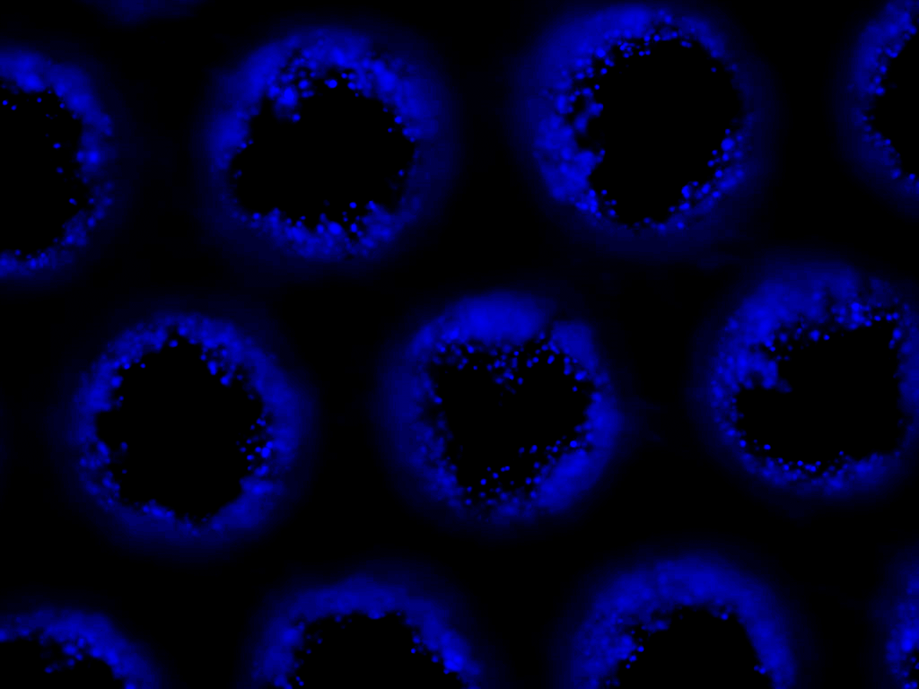
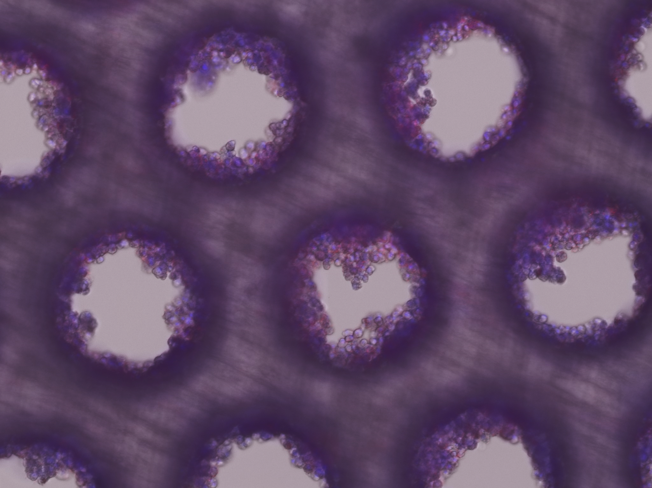
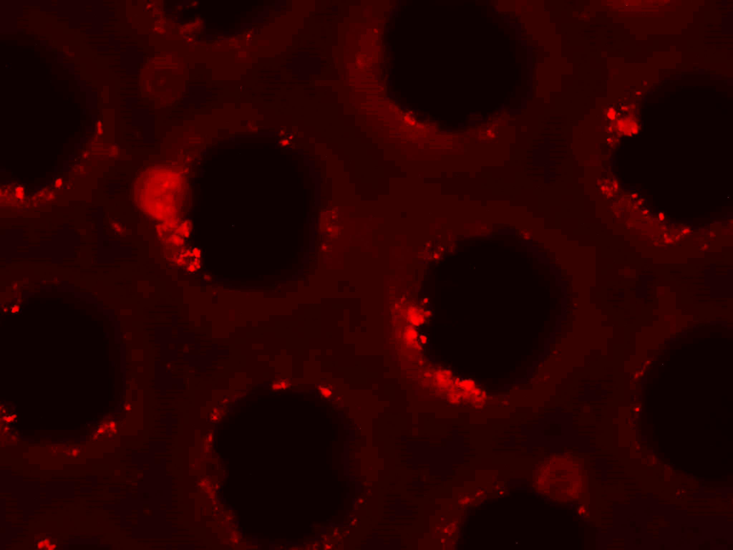
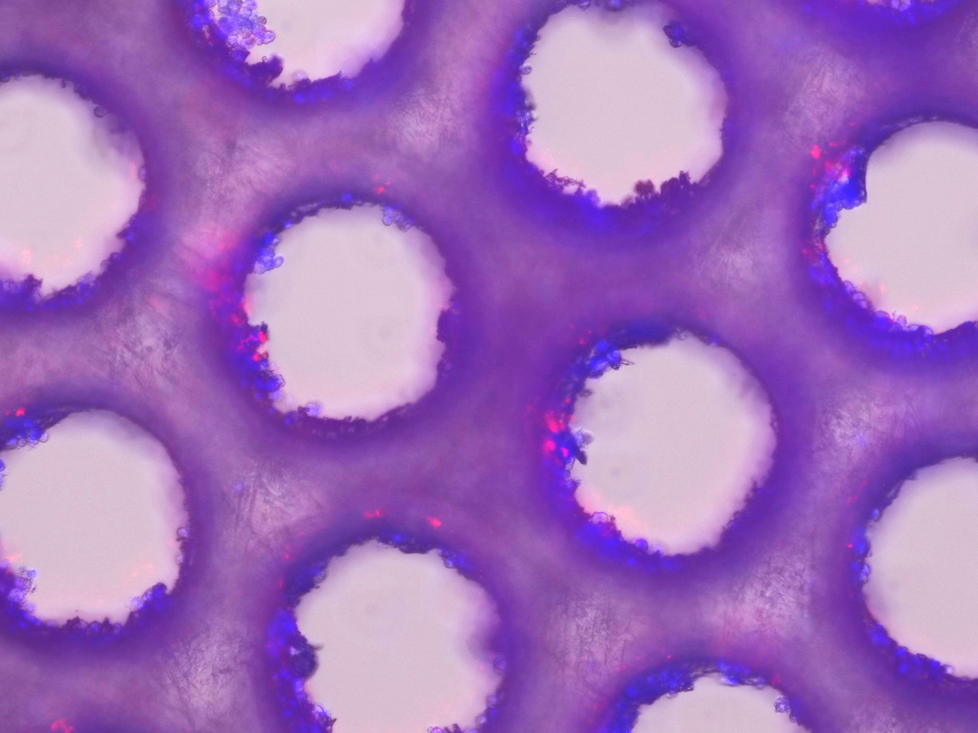
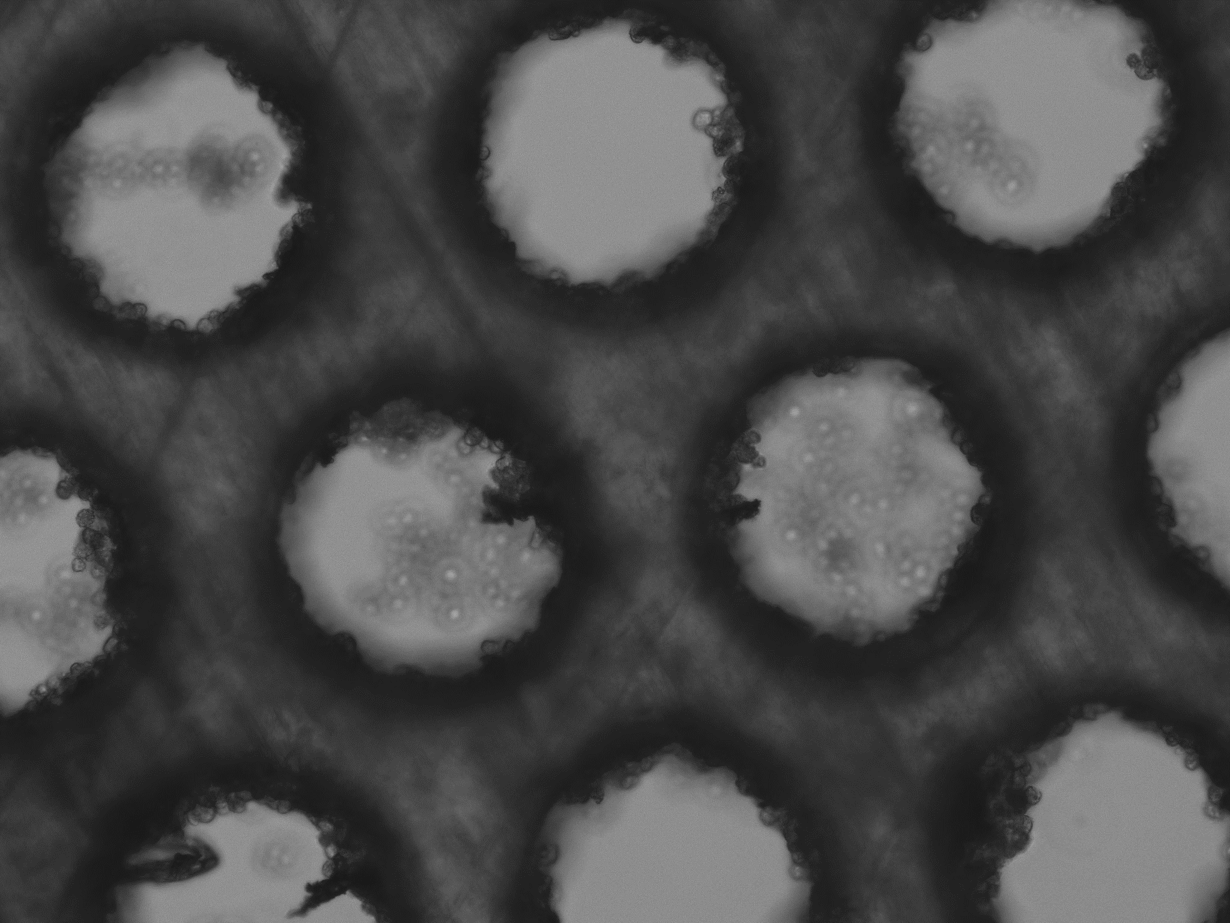
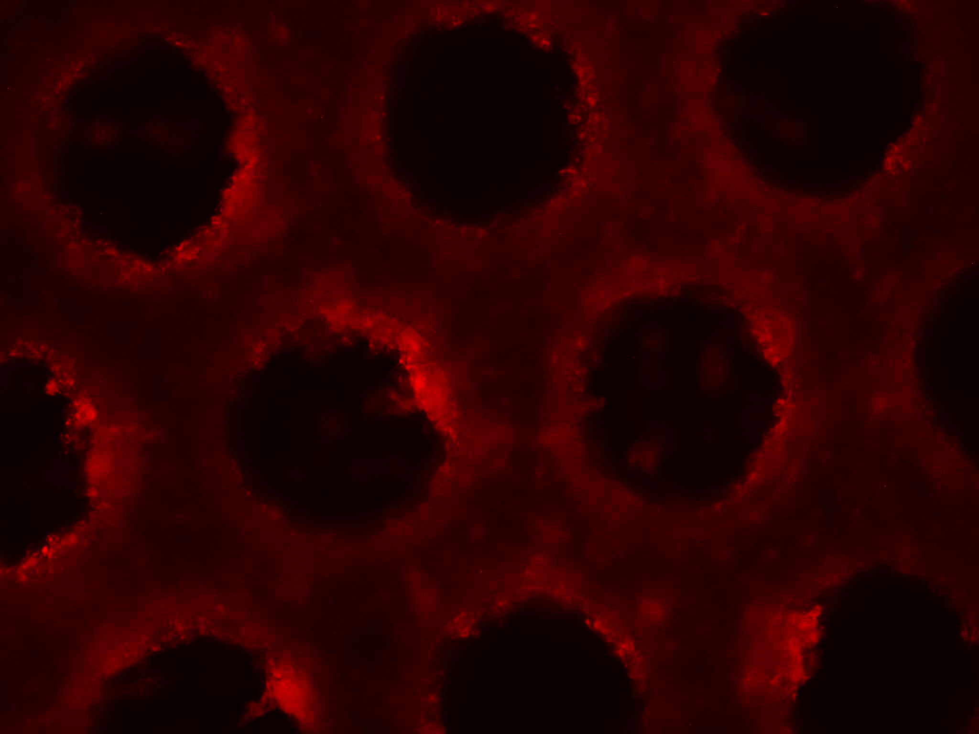
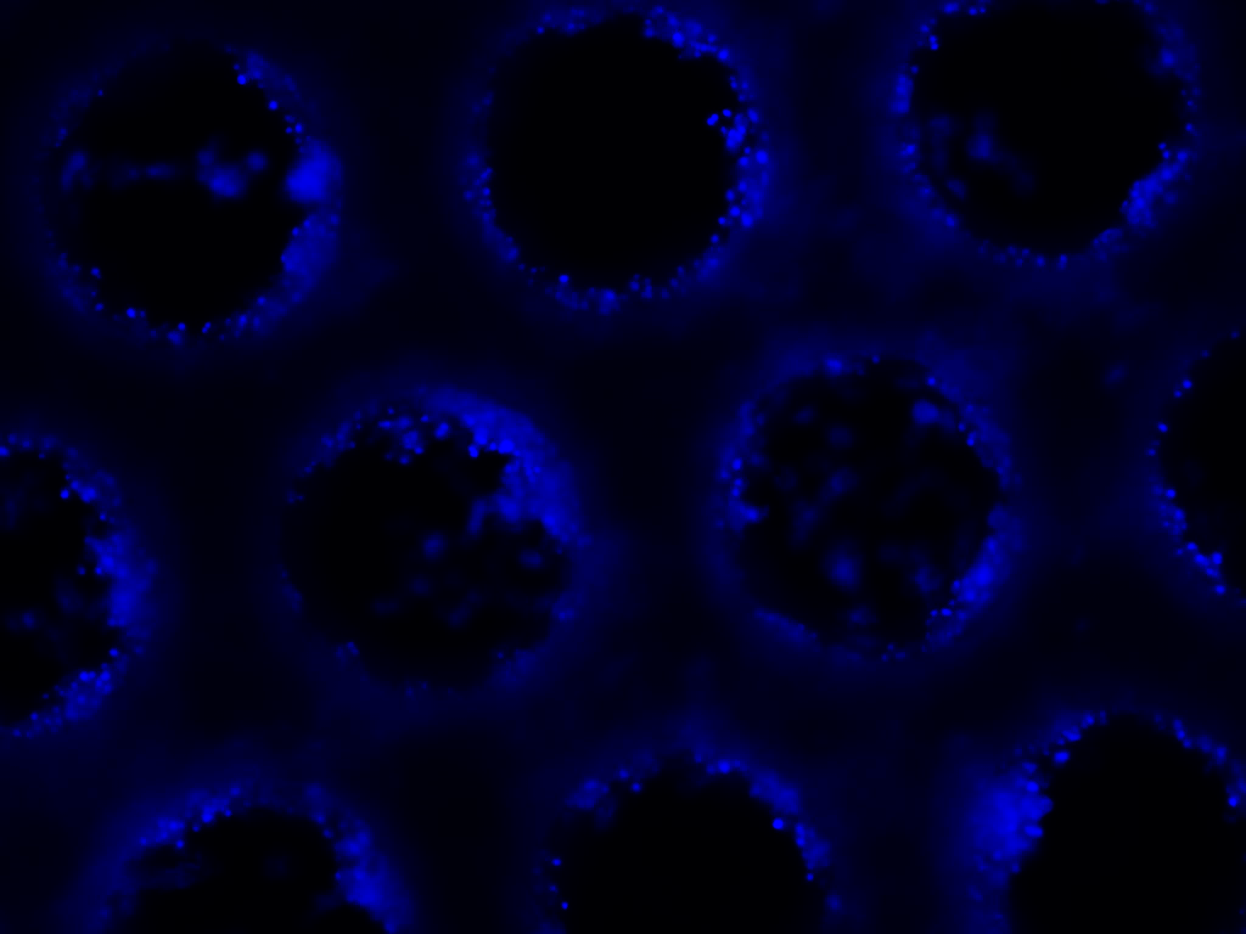
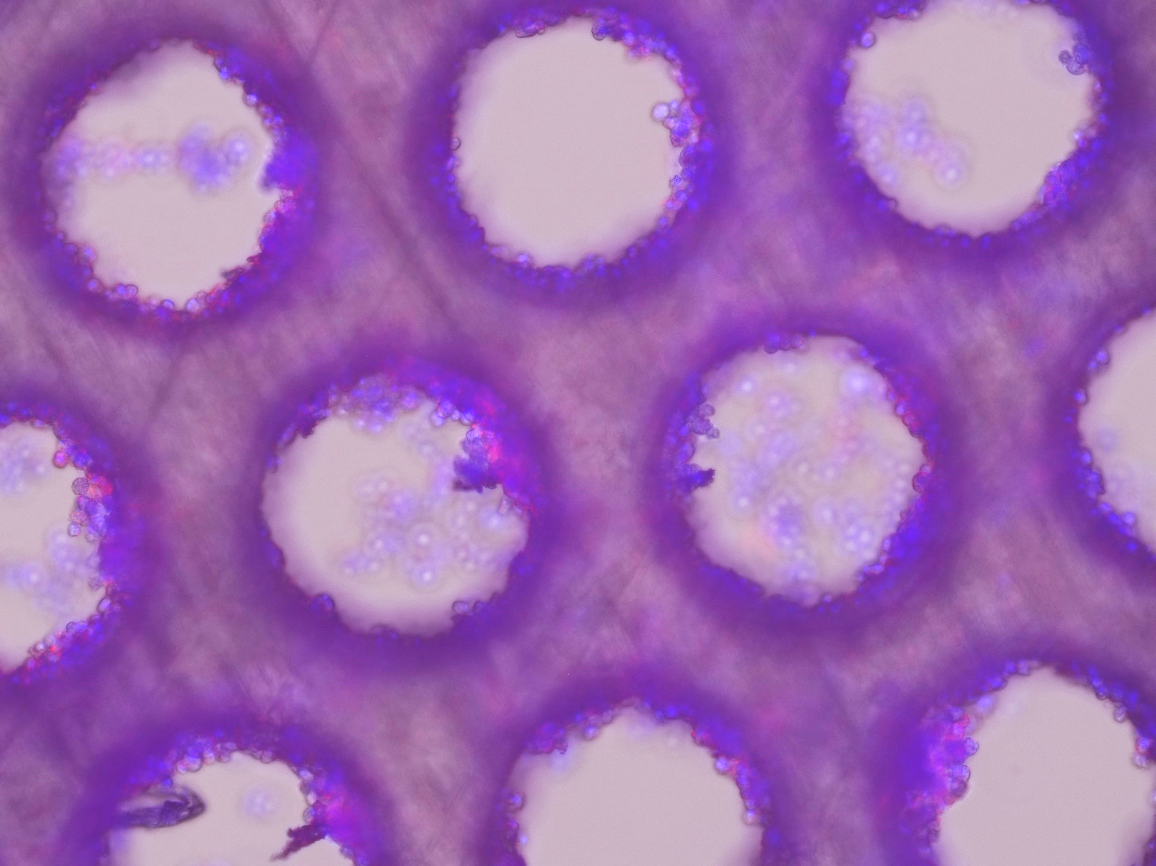
Brightfield
ATTO-550
DAPI
Merged
A
24 µg [RNP-NC: Lipofectamine] 1:1 24 µg
10x
B
24 µg [RNP-NC-TAT Cell Penetrating Peptide] 24 µg
10x
C
[RNP-NC-TriGalNac Ligand] 24 µg
10x

Slide 2
Fig. 4. Transfection of higher dose of RNP NCs in Primary Human Hepatocytes (PHH) shows higher uptake when compared to lower dose of 2.4 µg.
A) Shows transfection of 24 µg RNP-NC tagged with no ligand (RNP-NC) but labeled with Atto 550 in PHH when used in a 1:1 ratio with lipofectamine. B) Shows transfection of 24 µg RNP-NC tagged with TAT (Cell Penetrating Peptide) [RNP-NC-TAT] labeled with Atto 550 in PHH. C) Shows transfection of 24 µg RNP-NC tagged with TriGalNac ligand [RNP-NC-TriGalNac] but labeled with Atto 550 in PHH

