Slide 1
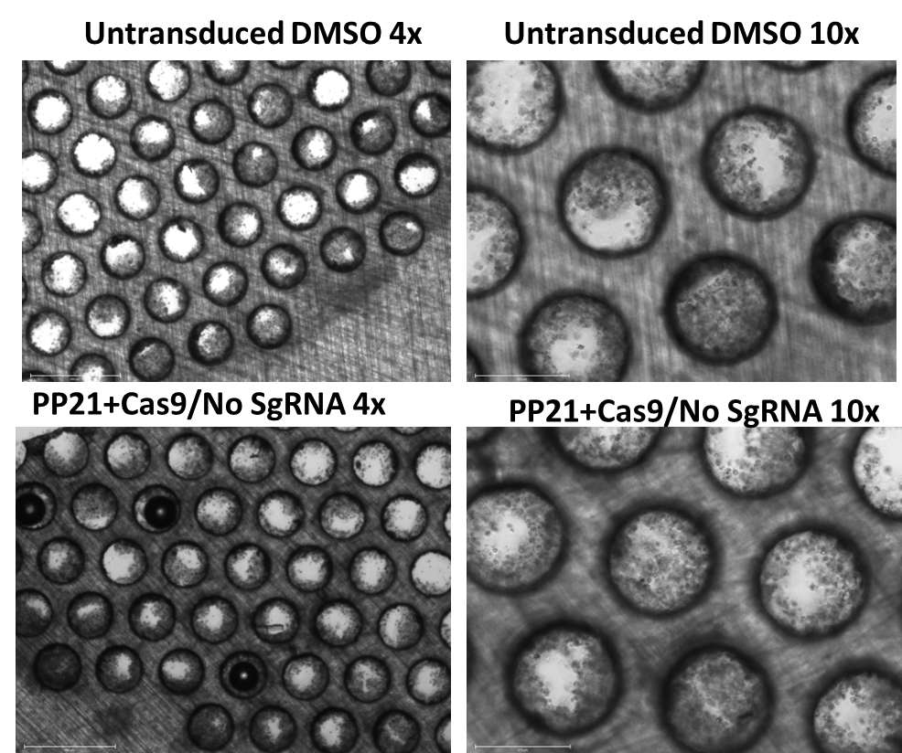
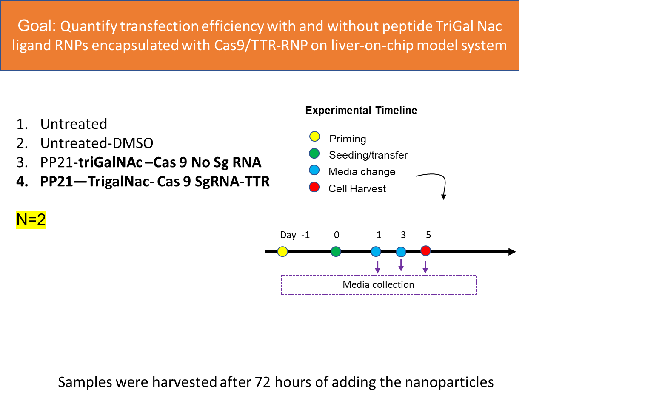
A.
B.
C.
Fig 8: Experimental outline; Colony formation and uptake of RNP-monoparticles (A) shows the outline, goal, and design as well as the timeline of the experiment (B) shows liver tissue formation was not affected after uptake of nanoparticles when compared to untransfected (C) Peptide ppTG21 attached to trigalNac conjugated RNPs showed higher uptake upto 2.5-fold compared to no ligand attached RNPs

