Slide 1
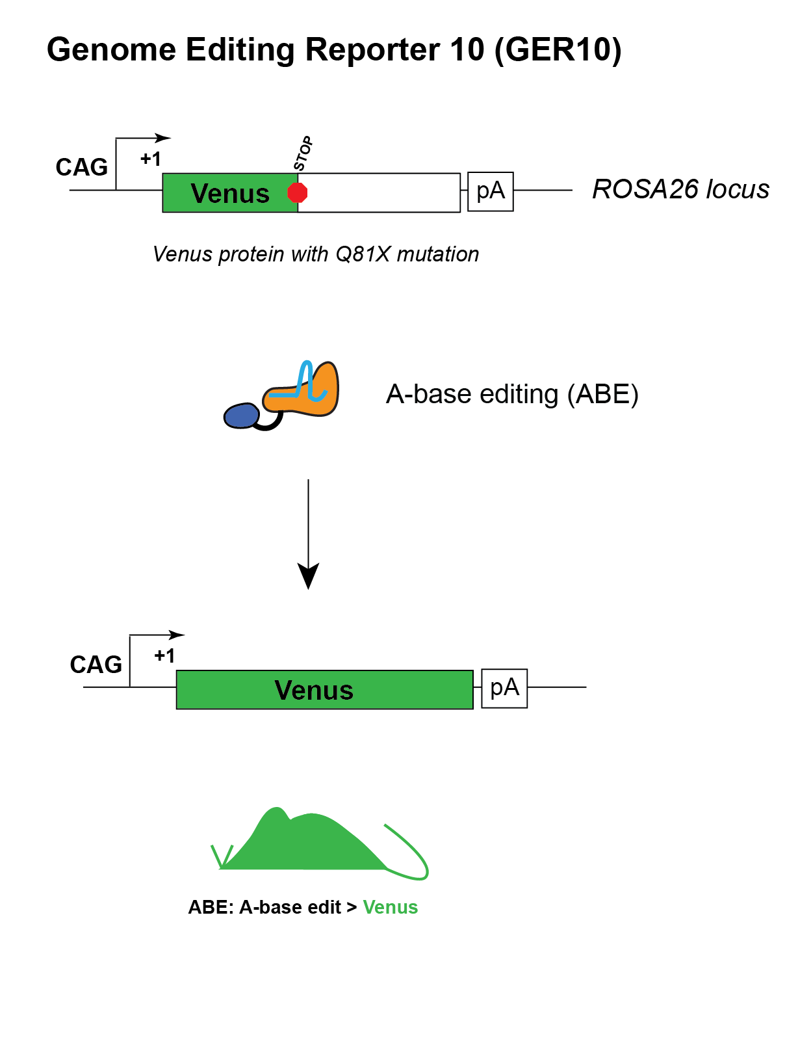
Gene Editing Reporter 10 (GER10) – Adenine Base Editor Reporter
C57BL/6N-Gt(ROSA)26Sor<em3(CAG-Venus*)Rkuhn>/MurrMmjax
Jax Stock No: 034450 | MMRRC No: 69724 – JAX
Introduced termination codon into Venus, which can be repaired via ABE
Tested using ABE7.10 RNP and mRNA
No detectable leaky expression of Venus fluorescence
Model available through MMRRC
1

Slide 2
GER10 reporter activity: blast assay
Mate HOM reporter males to HOM or WT females
Super-ovulate and harvest zygotes
Electroporate zygotes with Cas9-ABE7.10 RNP with test guides
Culture 96 hours to blast stage
Image and score fluorescence signal in each embryo
PCR amplify reporter allele in individual blasts, Sanger sequence, use Synthego ICE analysis tool to score edits

Slide 3
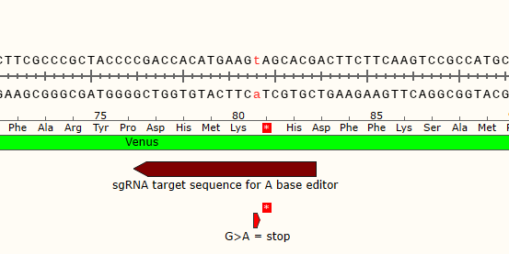
GER10 reporter activity: Guide Tested
Guide sequence for A-base editing (GER10-ABE-REV). Target adenine indicated in red:
CGTGCTaCTTCATGTGGTCG GGG
3
Notes:
Using Broad COF funds for Tier 2 GET project; GET project # 6949
310200-1120-02
6 transfers
Hom males and B6NJ females
ABE & Guide by Caleb
Shipping to FGB27.
Injections planned week of 11/15/21

Slide 4
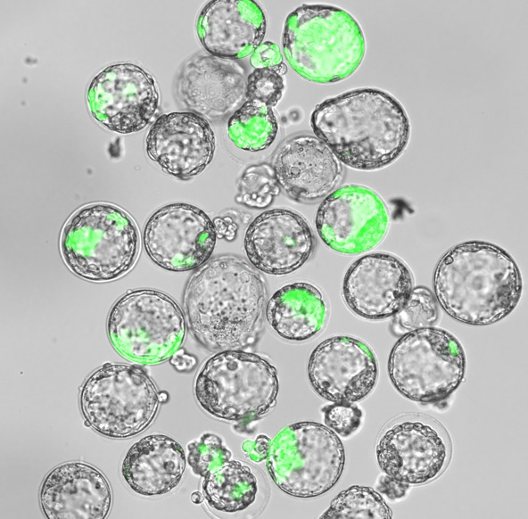
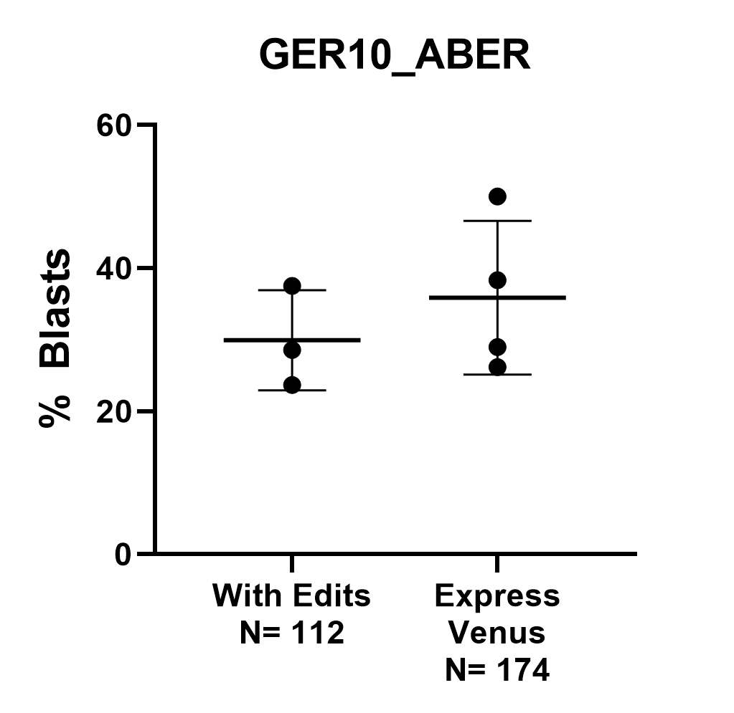
GER10 reporter activity: Blast assay results
Results confirmed with sequencing. No indels detected.
No “leakiness” detected in 2 control experiments (~40 blasts).
4

