Slide 1
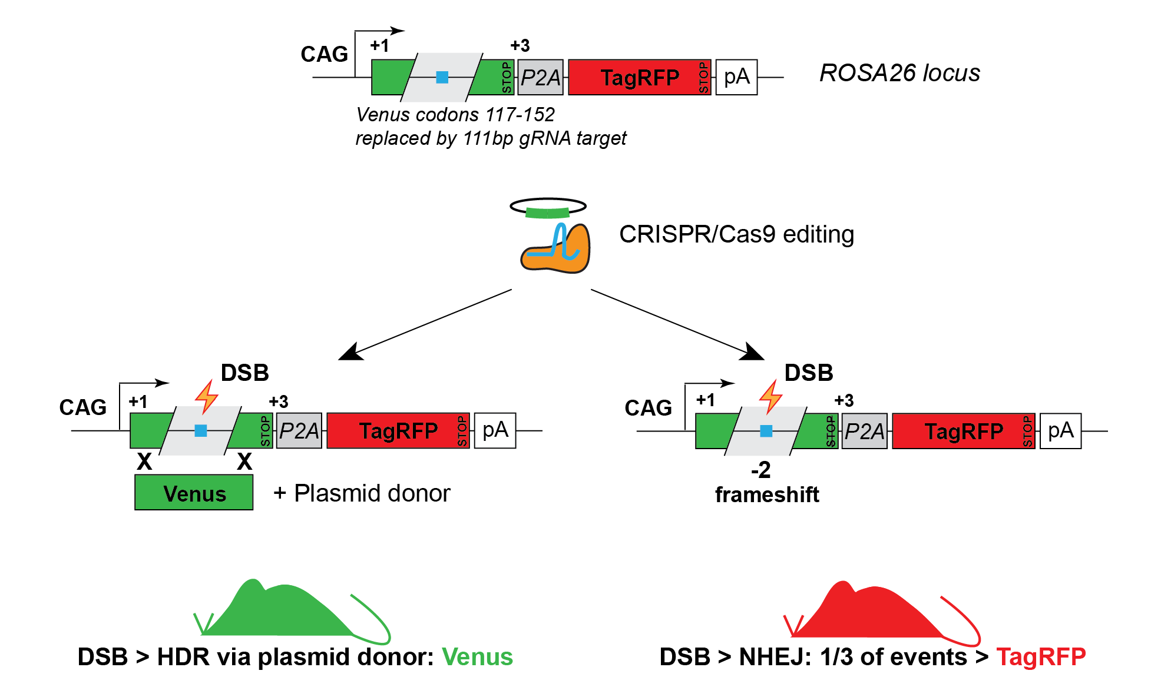
"Traffic light reporter" 2 (TLR-2)
C57BL/6N-Gt(ROSA)26Sor^{tm12(CAG-Venus*,-TagRFP*)Rkuhn}/MurrMmjax
Jax Stock No: 032672
  Simultaneous detection of HR and NHEJ events
  Single guide to edit
  Built on concept from Chu et al. 2015, Nat Biotech
  111 bp interruption of Venus protein; stop codon
  Any guide upstream of STOP can serve as target for NHEJ detection
  Model readily available and validated

Slide 2
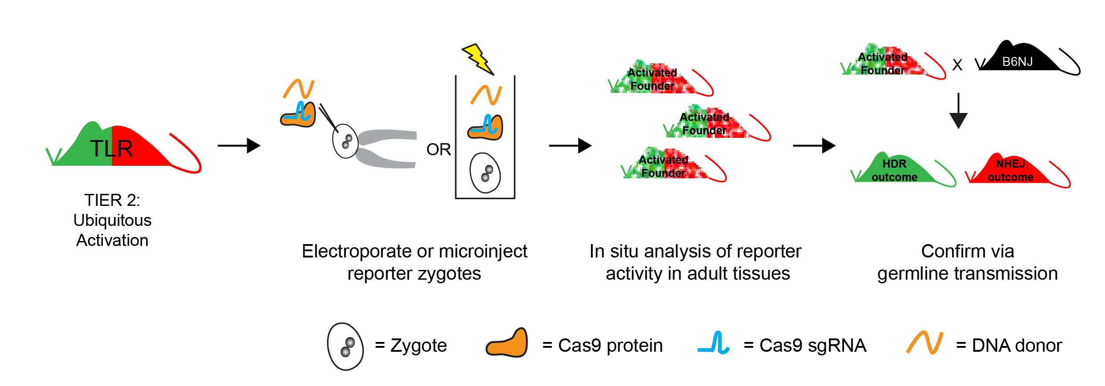
TLR-2 Tier 2 Validation: germline editing & tissue activation potential
Mate HOM reporter males to WT females
Super-ovulate and harvest zygotes
Electroporate zygotes with Cas9 RNP with test guides
Transfer to pseudo-pregnant females and allow dams to deliver to term
Sample offspring, PCR amplify reporter allele, Sanger sequence, use Synthego ICE analysis tool to score edits
Mate activated founders (+1/-2 bp edits) to WT females, assess reporter activity (fluorescence) in adult tissues

Slide 3
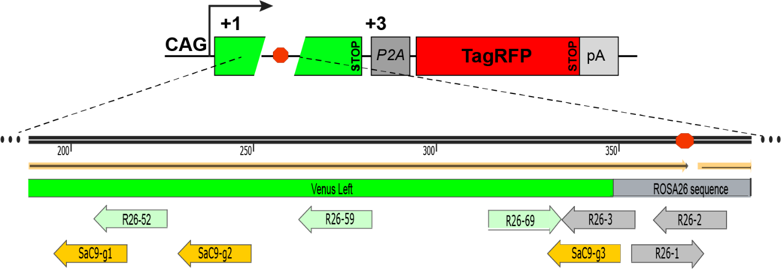
Guides Tested in TLR-2 Tier 2 Validation Assay
Guides used in germline editing experiments
Guide name | Nuclease | DNA strand | Sequence | PAM
26-1* | SpyCas9 | Fwd | ACTCCAGTCTTTCTAGAAGA | TGG
26-2 | SpyCas9 | Rev | CGCCCATCTTCTAGAAAGAC | TGG
26-3 | SpyCas9 | Rev | TTGCAGCTCGAACTTCACCT | CGG
26-52 | SpyCas9 | Rev | GGTAGCGGGCGAAGCACTGC | AGG
26-59 | SpyCas9 | Rev | GACGTAGCCTTCGGGCATGG | CGG
26-69 | SpyCas9 | Fwd | CAACTACAAGACCCGCGCCG | AGG
SaC9-g1 | SauCas9 | Rev | AAGCACTGCAGGCCGTAGCC | CAGGGT
SaC9-g2 | SauCas9 | Rev | GTCGTGCTGCTTCATGTGGT | CGGGGT
SaC9-g3 | SauCas9 | Rev | AGCTCGAACTTCACCTCGGC | GCGGGT
*The 26-1 guide frequently produces a +1 edit downstream of the STOP codon and is thus not recommended for NHEJ/indel detection, however it can be used for HDR applications.

Slide 4
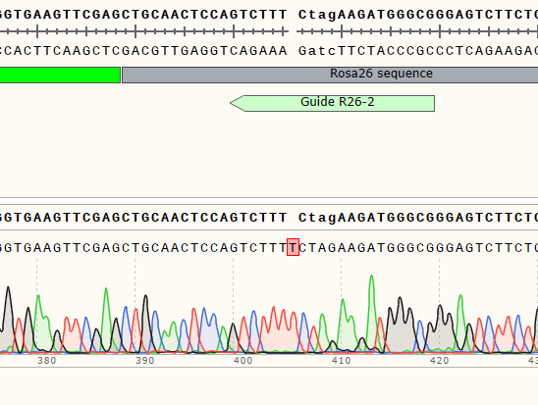
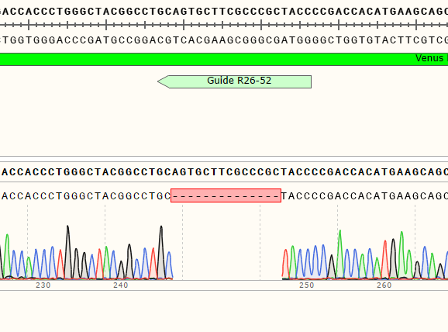
Germline Edited TLR-2 Sublines
TLR2-1829 (+1 ins.)
Edited with Guide R26-2
TLR2-1807 (-14 del.)
Edited with Guide R26-52
Antibody recommended for tagRFP detection in tissue fixed under standard conditions
IHC recommendation:
Primary Ab: RFP Antibody (Invitrogen # R10367), Dilution 1:500
Cy3-Secondary Ab (Jackson ImmunoResearch # 711-165-152), Dilution 1:1000
Stain in parallel: TLR2-1807, TLR2-1829, No Primary Ab Control
Assessed 3 males, 3 females per subline

Slide 5
IHC RFP Detection
Germline Edited -TLR2-1807 (-14) and TLR2-1829 (+1)

Slide 7
Kidney RFP Activation in Germline-Edited Mice
Ureter (arrow L)
Glomeruli (arrow R)

Slide 8
RFP IHC Detection
(Germline Edited TLR2 Mice)

Slide 9
RFP IHC Detection
(Germline Edited TLR2 Mice)

Slide 10
RFP IHC Detection in Ovary
(Germline Edited TLR2 Mice)

Slide 11
RFP IHC Detection in Testis
(Germline Edited TLR2 Mice)

