Slide 1
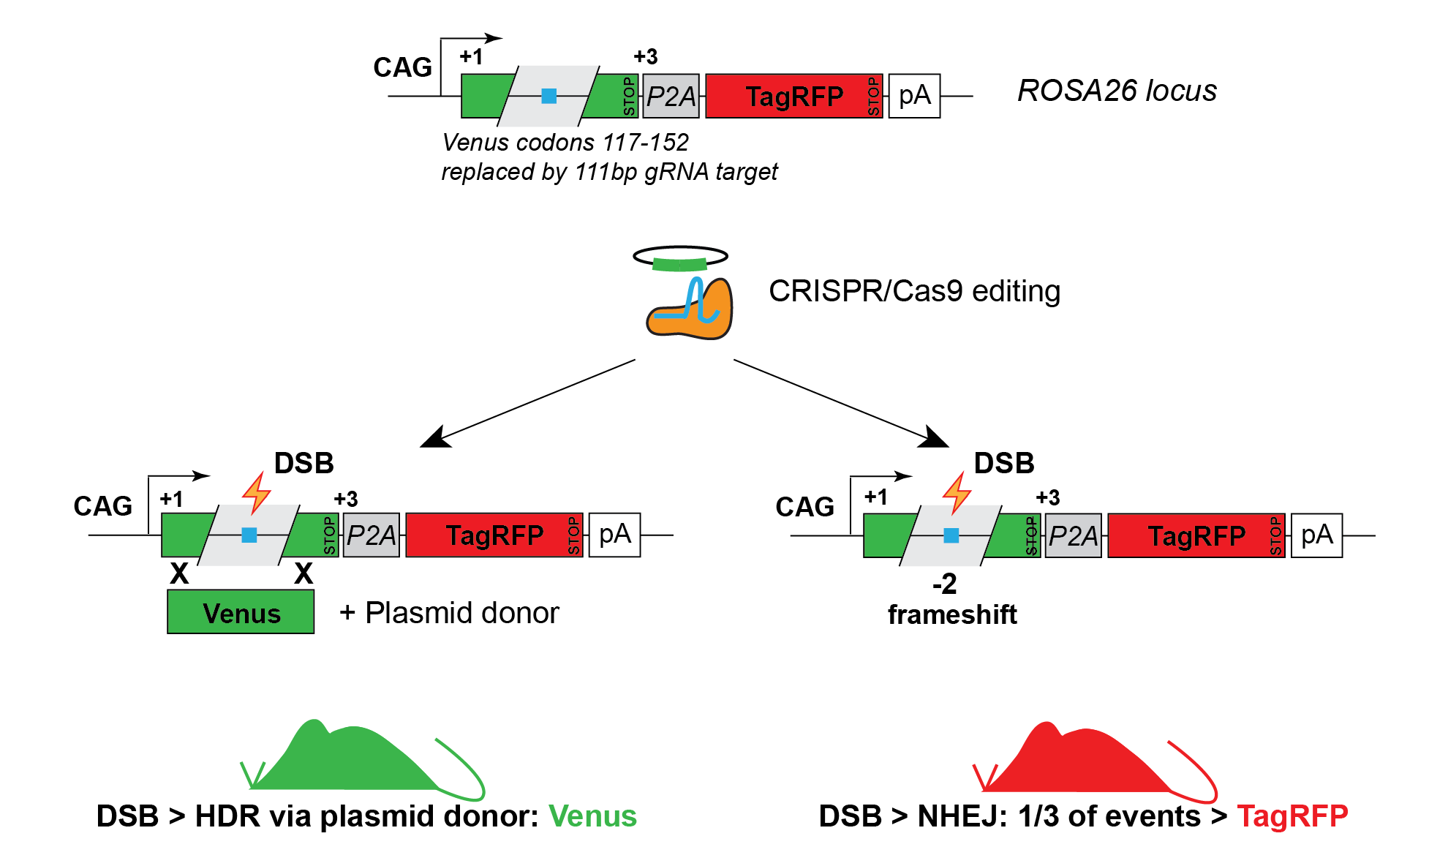
“Traffic light reporter” 2 (TLR-2), JR032672
  Simultaneous detection of HR and NHEJ events
  Single guide to edit
  Built on concept from Chu et al. 2015, Nat Biotech
  111 bp interruption of Venus protein; stop codon
  Any guide upstream of STOP can serve as target for NHEJ detection
  Model readily available and validated

Slide 2
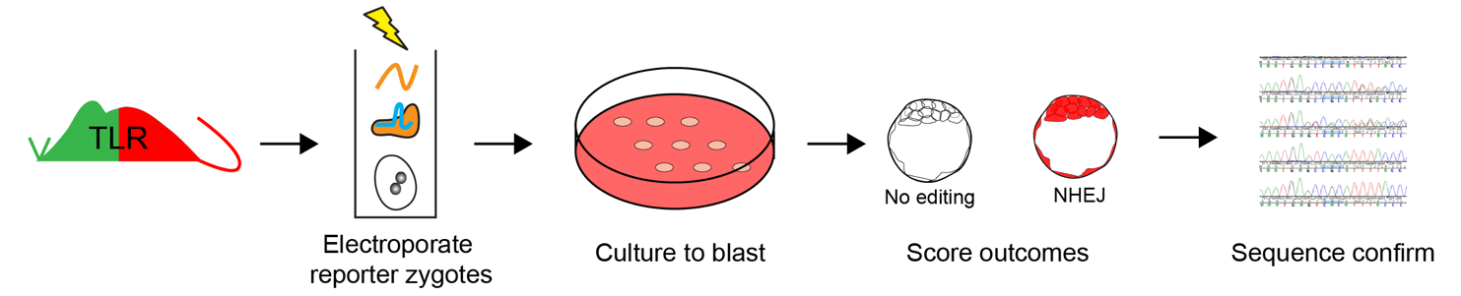
TLR-2 reporter activity: blast assay
Mate HOM reporter males to HOM or WT females
Super-ovulate and harvest zygotes
Electroporate zygotes with Cas9 RNP with test guides
Culture 96 hours to blast stage
Image and score fluorescence signal in each embryo (NHEJ outcomes)
PCR amplify reporter allele in individual blasts, Sanger sequence, use Synthego ICE analysis tool to score edits

Slide 3
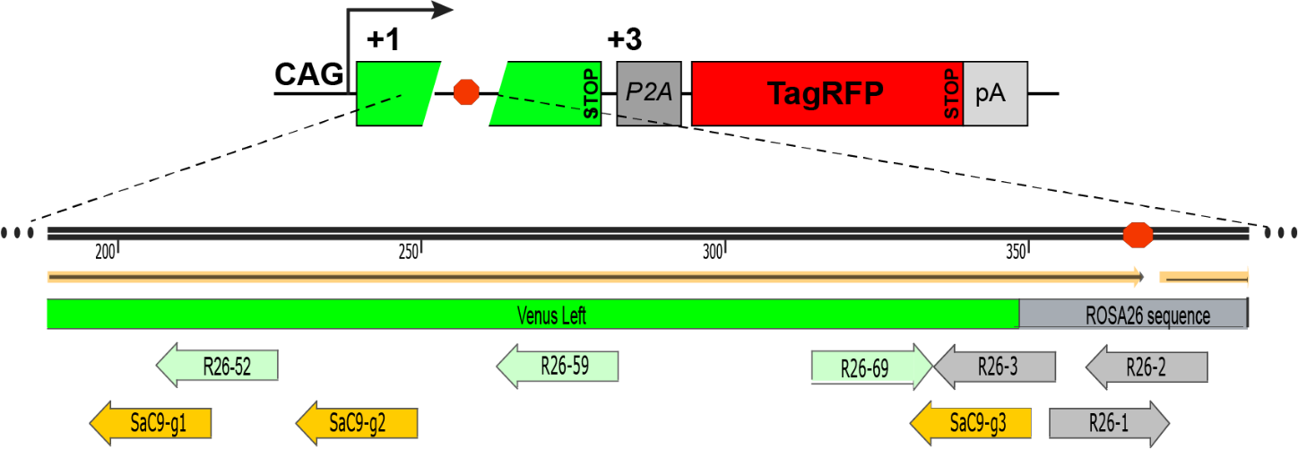
Guides Tested in TLR-2
Guide name | Nuclease | DNA strand | Sequence | PAM
26-1* | SpyCas9 | Fwd | ACTCCAGTCTTTCTAGAAGA | TGG
26-2 | SpyCas9 | Rev | CGCCCATCTTCTAGAAAGAC | TGG
26-3 | SpyCas9 | Rev | TTGCAGCTCGAACTTCACCT | CGG
26-52 | SpyCas9 | Rev | GGTAGCGGGCGAAGCACTGC | AGG
26-59 | SpyCas9 | Rev | GACGTAGCCTTCGGGCATGG | CGG
26-69 | SpyCas9 | Fwd | CAACTACAAGACCCGCGCCG | AGG
SaC9-g1 | SauCas9 | Rev | AAGCACTGCAGGCCGTAGCC | CAGGGT
SaC9-g2 | SauCas9 | Rev | GTCGTGCTGCTTCATGTGGT | CGGGGT
SaC9-g3 | SauCas9 | Rev | AGCTCGAACTTCACCTCGGC | GCGGGT
*The 26-1 guide frequently produces a +1 edit downstream of the STOP codon and is thus not recommended for NHEJ/indel detection, however it can be used for HDR applications.

Slide 4
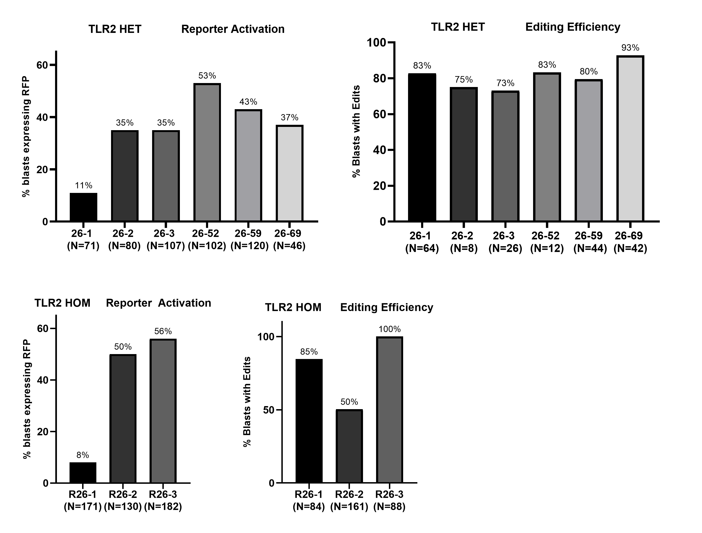
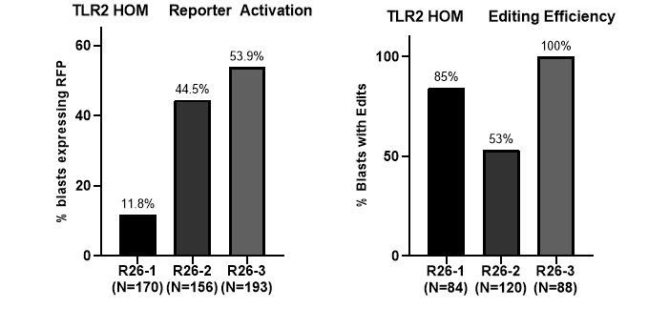
A
B
C
D
E
TLR2 26-2 HOM
Notes:
Overall, five of the SpyCas9 guides showed robust RFP induction, with guide 26-52 displaying the highest efficiency (A. & B.). This is consistent with the inDelphi prediction of a biased resolution of edits to indels with a -2 frameshift. The use of homozygous TLR-2 embryos increased the reporter activation percentages as expected (C. & D.). The R26-1 guide preferentially produces +1 edits which results in the retention of the STOP codon in the 111bp linker sequence, and is thus not recommended for NHEJ detection, despite tis relatively high editing efficiency.

Slide 5
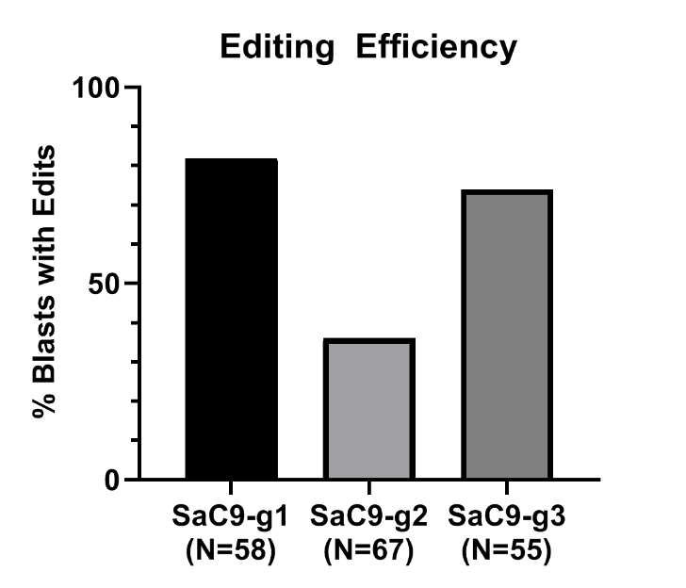
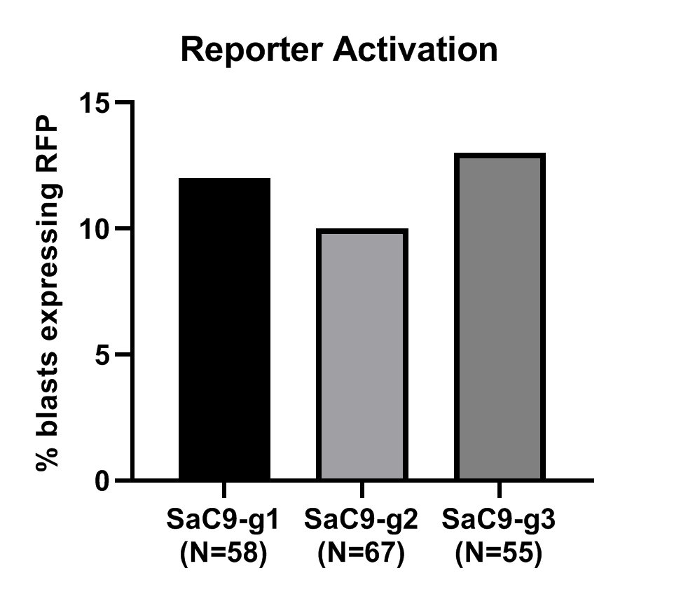
SauCas9 Guides Tested

