Slide 1
Generation of Ai9 reporter plasmid
Plasmid transfected into hiPSCs to generate Ai9 reporter cells (Hockemeyer lab)

Slide 2
Integration of Ai9 reporter in iPS cells
HA-R & HA-L are homologous to AAVS1 locus in PPP1RS12C gene (confirmed by BLAST)
Utilized IGI’s best sgRNA (298) to target Ai9 cassette : AAGTAAAACCTCTACAAATG [TGG]
Based on mouse Ai9 experiments (Staahl BT, et al. Nat Biotechnol. 2017. doi:10.1038/nbt.3806)
  Introduces DSBs/deletions in SV40 late polyA sequences (terminators – in gray)

Slide 3
Sanger sequencing validates Ai9 integration in iPS cells
Unknown nucleotides (n) in the original cassette map around the 3x SV40 PA area have been sequenced and confirmed by Sanger revealing a binding site for sgRNA298 and confirming the new sgRNAs targets.
The tdTomato cassette is intact and fully sequenced
Primers binding either Puromycin cassette or WPRE have failed generating an amplicon by PCR. Sequencing pending.
Integration site in the genome not confirmed yet
Gray rectangles indicate sequenced amplicons

Slide 4

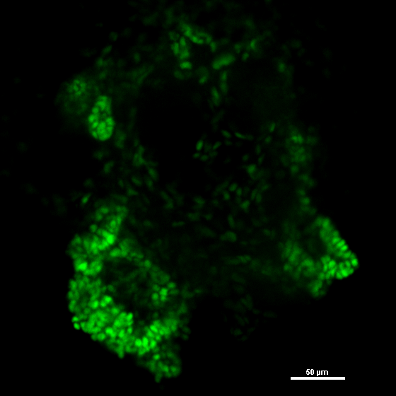
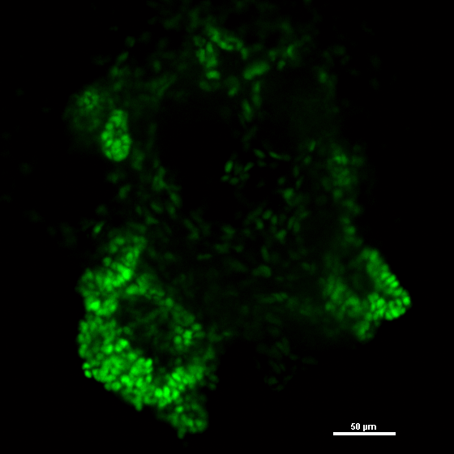
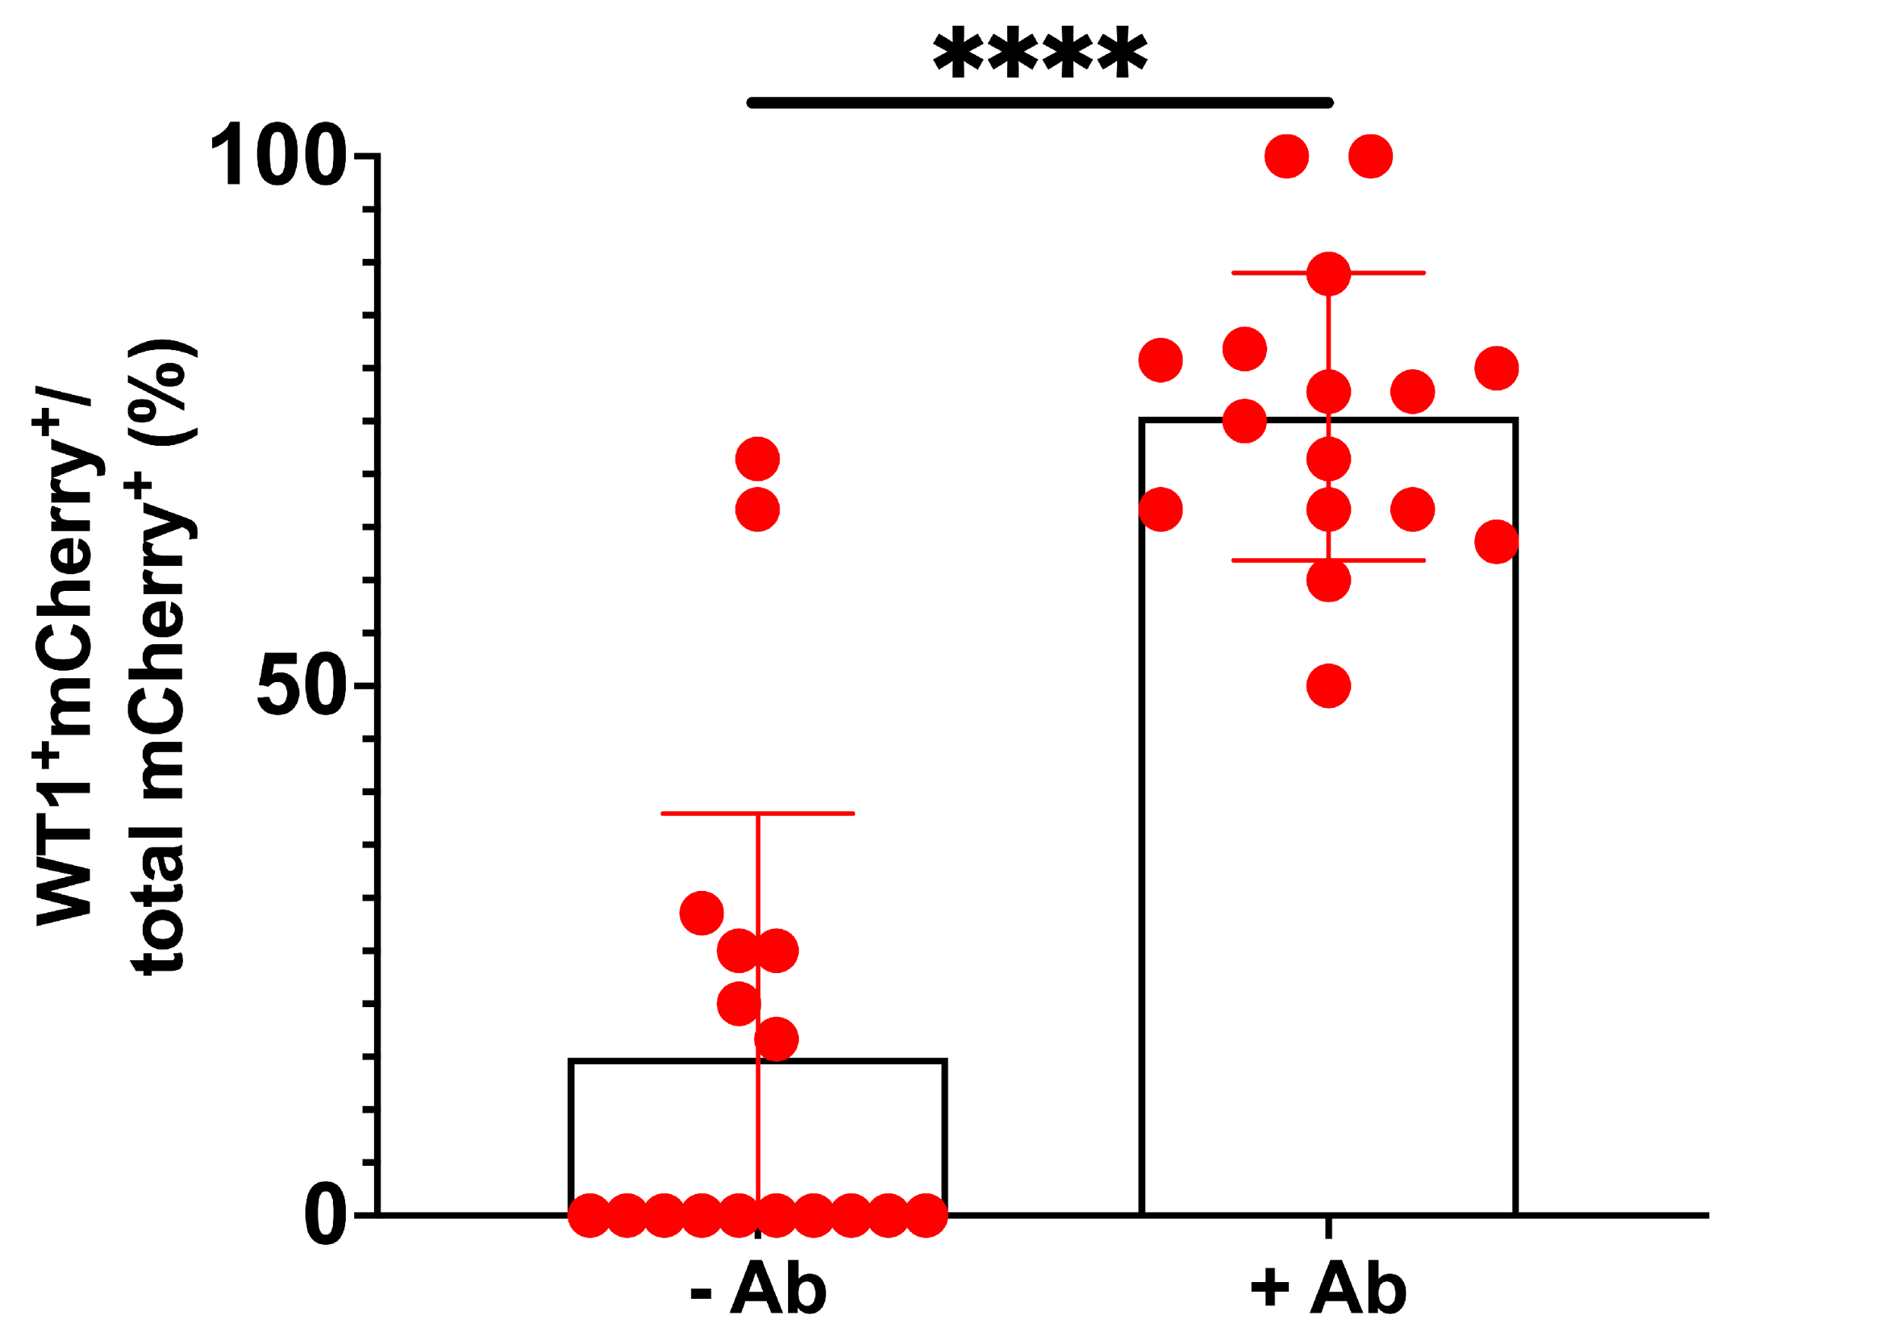

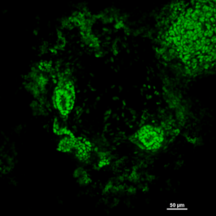
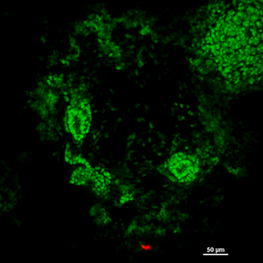
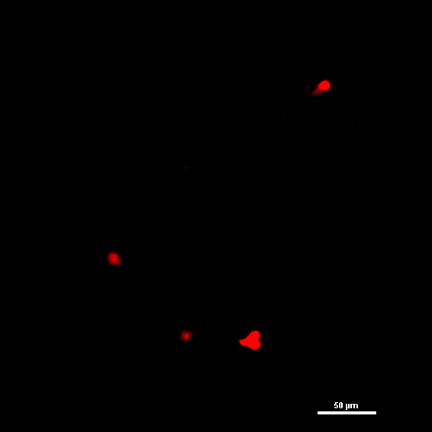
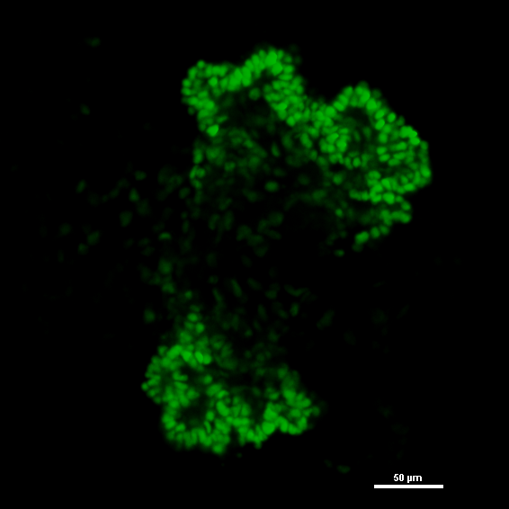
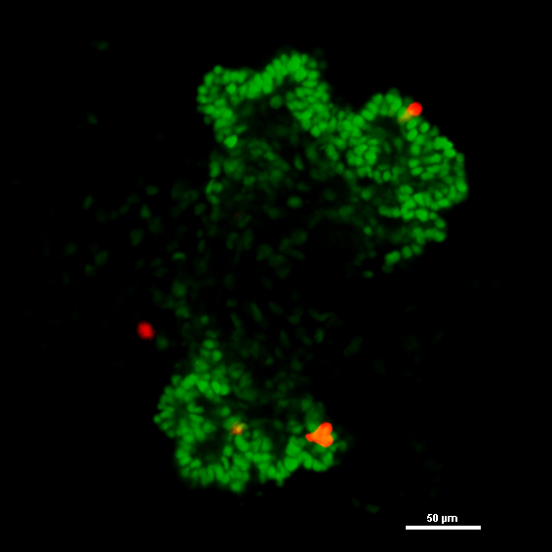
Podocyte-specific targeted gene editing in organoids
TdTomato
podocyte
TdTomato/podocyte
B
A
Organoids were transfected with Cas9 ± molecular targeting agent specific for podocytes
untreated
RNP only
TdTomato+
podocytes (% total)
RNP + MTA
RNP only
RNP + MTA
The proportion of TdTomato⁺ podocytes is significantly increased with MTA

Slide 5
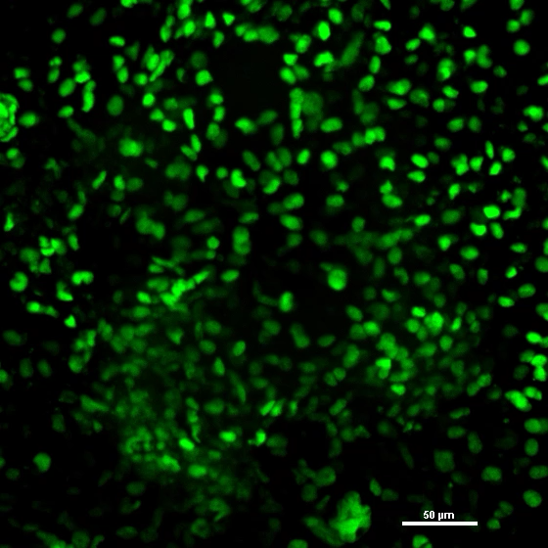
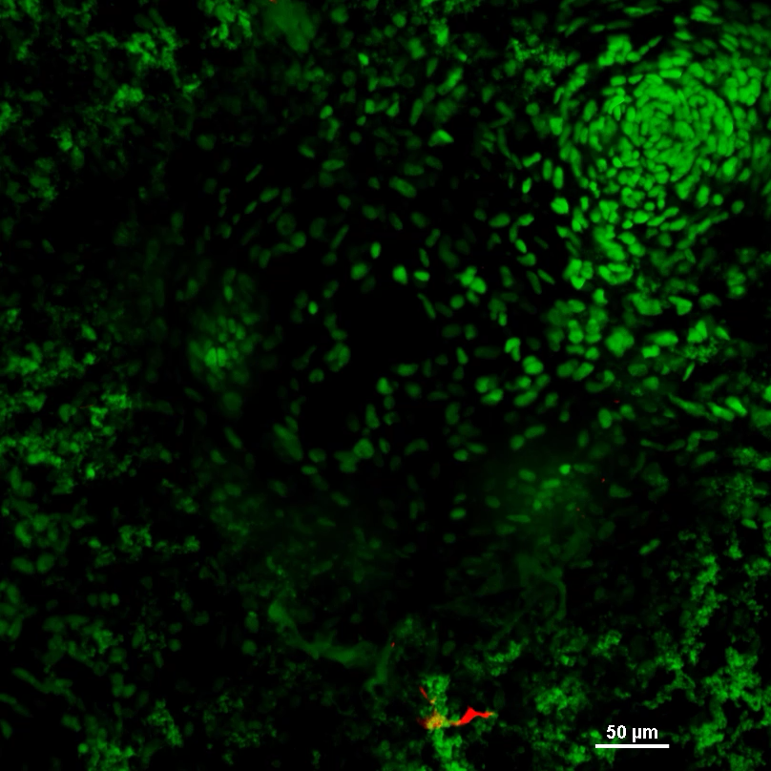
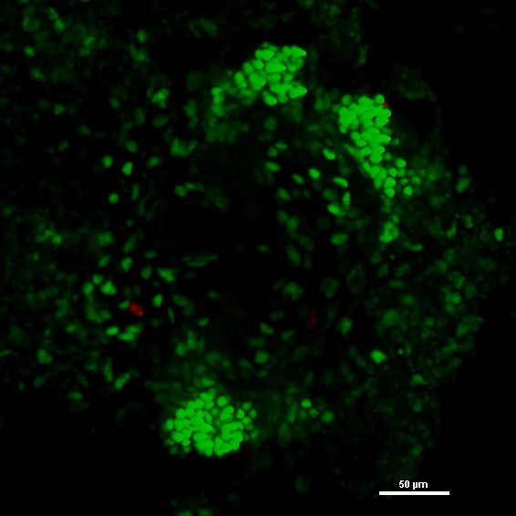
PodoTarget edits podocytes in kidney organoids (z-stack)
podocytes/TdTomato
untreated
RNP only
RNP + MTA

